Slide 1


BIBLICAL THANKSGIVING
Philippians 4/Ephesians 5
Notes:
You can swap out the background picture with whatever you'd like! If you want to make the picture darker, you can adjust the transparency on the top right.

Slide 2

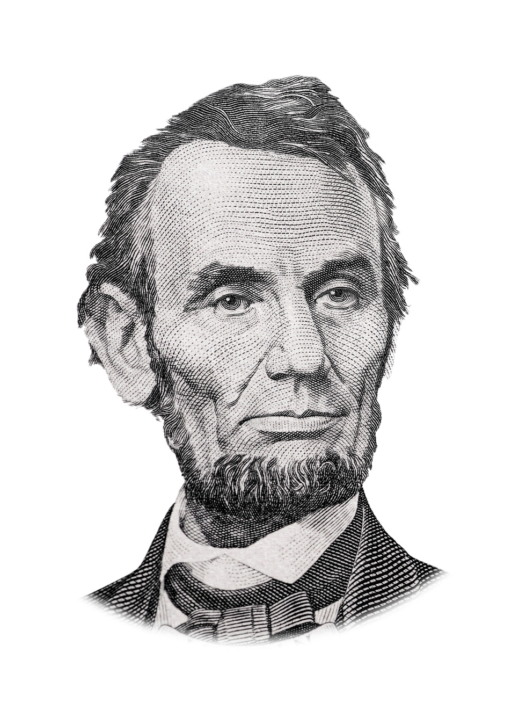
The year that is drawing towards its close, has been filled with the blessings of fruitful fields and healthful skies. To these bounties, which are so constantly enjoyed that we are prone to forget the source from which they come, others have been added, which are of so extraordinary a nature, that they cannot fail to penetrate and soften even the heart which is habitually insensible to the ever watchful providence of Almighty God.
Abraham Lincoln

Slide 3
No human counsel hath devised nor hath any mortal hand worked out these great things. They are the gracious gifts of the Most High God, who, while dealing with us in anger for our sins, hath nevertheless remembered mercy. It has seemed to me fit and proper that they should be solemnly, reverently and gratefully acknowledged as with one heart and one voice by the whole American People.
Abraham Lincoln

Slide 4
I do therefore invite my fellow citizens in every part of the United States, and also those who are at sea and those who are sojourning in foreign lands, to set apart and observe the last Thursday of November next, as a day of Thanksgiving and Praise to our beneficent Father who dwelleth in the Heavens.
Abraham Lincoln

Slide 5
And I recommend to them that while offering up the ascriptions justly due to Him for such singular deliverances and blessings, they do also, with humble penitence for our national perverseness and disobedience, commend to His tender care all those who have become widows, orphans, mourners or sufferers in the lamentable civil strife in which we are unavoidably engaged, and fervently implore the interposition of the Almighty Hand to heal the wounds of the nation and to restore it as soon as may be consistent with the Divine purposes to the full enjoyment of peace, harmony, tranquility and Union.
Abraham Lincoln

Slide 6

Thanksgiving gives us the opportunity to think about gratitude as a mindset and a practice—a form of self-care.

Slide 7
Thanksgiving gives us the opportunity to think about gratitude as a mindset and a practice—a form of self-care.
...gratitude can make us feel better about ourselves.

Slide 8
BIBLICAL THANKSGIVING
Philippians 4/Ephesians 5
Notes:
You can swap out the background picture with whatever you'd like! If you want to make the picture darker, you can adjust the transparency on the top right.

Slide 9

Rejoice in the Lord always; again I will say, rejoice. 5 Let your reasonableness be known to everyone. The Lord is at hand; 6 do not be anxious about anything, but in everything by prayer and supplication with thanksgiving let your requests be made known to God. 7 And the peace of God, which surpasses all understanding, will guard your hearts and your minds in Christ Jesus.
PHILIPPIANS 4:6-7

Slide 10

The Negative Command:
Do not be anxious about anything. Be anxious for nothing.

Slide 11
The Positive Command:
In everything, by prayer, let your requests be made known to God.

Slide 12
The Secret Ingredient:

Slide 13
The Secret Ingredient:
Thanksgiving
In everything by prayer and supplication with thanksgiving let your requests be made known to God.
PHILIPPIANS 4:6

Slide 14
Biblical Thanksgiving
1. Thanksgiving to God

Slide 15
Biblical Thanksgiving
1. Thanksgiving to God
For although they knew God, they did not honor him as God or give thanks to him, but they became futile in their thinking, and their foolish hearts were darkened.
ROMANS 1:21

Slide 16
Biblical Thanksgiving
1. Thanksgiving to God
2. Thanksgiving for God

Slide 17
Biblical Thanksgiving
1. Thanksgiving to God
2. Thanksgiving for God
3. Contentment with God
Not that I am speaking of being in need, for I have learned in whatever situation I am to be content.
PHILIPPIANS 4:11

Slide 18
Therefore be imitators of God, as beloved children. 2 And walk in love, as Christ loved us and gave himself up for us, a fragrant offering and sacrifice to God. 3 But sexual immorality and all impurity or covetousness must not even be named among you, as is proper among saints. 4 Let there be no filthiness nor foolish talk nor crude joking, which are out of place, but instead let there be thanksgiving.
EPHESIANS 5:1-4

Slide 19
True biblical thanksgiving displaces sinful attitudes, sinful attitudes rise from a heart that is not thankful to/for God.

Slide 20
Ephesians 5: Instead of this wickedness, let there be thanksgiving!
Philippians 4: Instead of anxiety, let there be thanksgiving!

Slide 21
Is there Biblical Thanksgiving in your heart?

