Slide 1
No Death Hold
ACTS 2:22-24

Slide 2
Pathways that extend lifespan by 500 percent identified
Scientists have identified synergistic cellular pathways for longevity that amplify lifespan fivefold in C. elegans, a nematode worm used as a model in aging research. The increase in lifespan would be the equivalent of a human living for 400 or 500 years, according to one of the scientists.

Slide 3
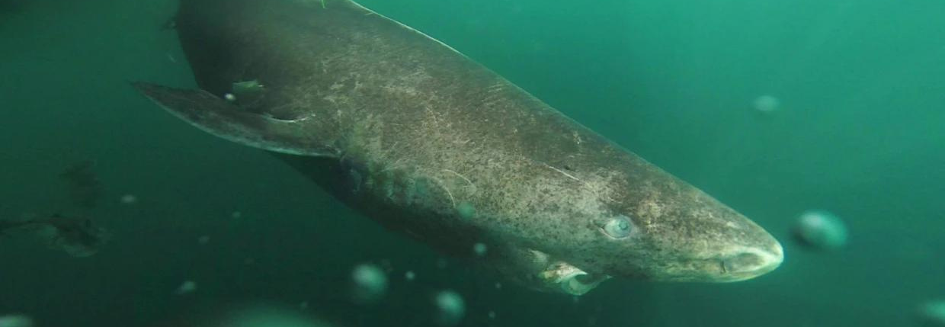
Can This Weird Shark Show Us How to Live for Centuries?
By unlocking the secrets of the Greenland Shark's extreme longevity, scientists hope to be able to extend human life spans.

Slide 4
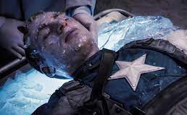
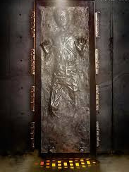
Cryonic Preservation

Slide 5
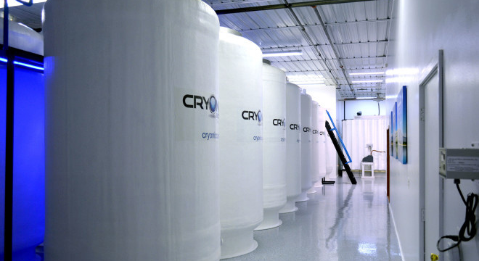
Life After Death? Cryonicists Try To Defy Mortality By Freezing Bodies
Cryonicists hope that modern technology will one day bring frozen bodies back from the dead. But how realistic is a second life after a deep freeze?

Slide 6
“There are genetic changes that occur, that say to the cell, ‘Die.’”
“For those of us who work in the area of freezing biological materials — we’ve tried organs, and so forth — there's just insurmountable problems”
John Baust

Slide 7
No Death Hold
ACTS 2:22-24

Slide 8
Acts of God
1. God sent and attested to this Jesus of Nazareth.
ACTS 2:22
Men of Israel, hear these words: Jesus of Nazareth, a man attested to you by God…

Slide 9
Acts of God
2. God did divine works through this Jesus proving his deity.
ACTS 2:22
Men of Israel, hear these words: Jesus of Nazareth, a man attested to you by God with mighty works and wonders and signs that God did through him in your midst, as you yourselves know…

Slide 10
Acts of God
3. God definitively planned and ordained for this Jesus to be arrested, crucified and killed – yet it was lawless men that killed him.
ACTS 2:23
This Jesus, delivered up according to the definite plan and foreknowledge of God, you crucified and killed by the hands of lawless men.

Slide 11
Acts of God
4. God raised this Jesus from the dead!
ACTS 2:24
God raised him up, loosing the pangs of death, because it was not possible for him to be held by it.

Slide 12
because it was not possible for him [Jesus]
to be held by it [Death].
ACTS 2:24

Slide 13
Notice what Peter is saying here….
It was not possible for death to keep its hold on Jesus.
Death could not hold Jesus.
It was impossible for death to keep its hold on this Jesus.

Slide 14
Why is this so incredible?
Because death holds us every time!!

Slide 15
Reasons Death Could Not Hold Jesus
1. This Jesus of Nazareth was the sinless Son of God.

Slide 16
Reasons Death Could Not Hold Jesus
1. This Jesus of Nazareth was the sinless Son of God.
15 The Lord God took the man and put him in the garden of Eden to work it and keep it. 16 And the Lord God commanded the man, saying, “You may surely eat of every tree of the garden, 17 but of the tree of the knowledge of good and evil you shall not eat, for in the day that you eat of it you shall surely die.”
Genesis 2:15-17

Slide 17
Reasons Death Could Not Hold Jesus
1. This Jesus of Nazareth was the sinless Son of God.
Therefore, just as sin came into the world through one man, and death through sin, and so death spread to all men because all sinned…
Romans 5:12

Slide 18
Reasons Death Could Not Hold Jesus
2. This Jesus, Israel’s promised Messiah, was prophesied to not see the physical corruption of death.

Slide 19
Reasons Death Could Not Hold Jesus
2. This Jesus, Israel’s promised Messiah, was prophesied to not see the physical corruption of death.
For David says concerning him,
“‘I saw the Lord always before me,
for he is at my right hand that I may not be shaken;
26 therefore my heart was glad, and my tongue rejoiced;
my flesh also will dwell in hope.
27 For you will not abandon my soul to Hades,
or let your Holy One see corruption.
ACTS 2:25-27

Slide 20
Reasons Death Could Not Hold Jesus
3. This Jesus was not victimized by death, he submitted himself to death as our willing sacrifice.
For this reason the Father loves me, because I lay down my life that I may take it up again. 18 No one takes it from me, but I lay it down of my own accord. I have authority to lay it down, and I have authority to take it up again. This charge I have received from my Father.”
JOHN 10:17-18

Slide 21
Reasons Death Could Not Hold Jesus
4. This Jesus has authority and power over sin, death, hell and the devil.
9 [Jesus] who saved us and called us to a holy calling, not because of our works but because of his own purpose and grace, which he gave us in Christ Jesus before the ages began, 10 and which now has been manifested through the appearing of our Savior Christ Jesus, who abolished death and brought life and immortality to light through the gospel…
2 TIMOTHY 1:9-10

Slide 22
Reasons Death Could Not Hold Jesus
4. This Jesus has authority and power over sin, death, hell and the devil.
14 Since therefore the children share in flesh and blood, he himself likewise partook of the same things, that through death he might destroy the one who has the power of death, that is, the devil, 15 and deliver all those who through fear of death were subject to lifelong slavery.
HEBREWS 2:14-15

Slide 23
Reasons Death Could Not Hold Jesus
4. This Jesus has authority and power over sin, death, hell and the devil.
17 When I saw him, I fell at his feet as though dead. But he laid his right hand on me, saying, “Fear not, I am the first and the last, 18 and the living one. I died, and behold I am alive forevermore, and I have the keys of Death and Hades.
REVELATION 1:17-18

Slide 24
Reasons Death Could Not Hold Jesus
5. This Jesus is the glorious and exalted one, our risen savior!
33Being therefore exalted at the right hand of God, and having received from the Father the promise of the Holy Spirit, he has poured out this that you yourselves are seeing and hearing.
36Let all the house of Israel therefore know for certain that God has made him both Lord and Christ, this Jesus whom you crucified.
ACTS 2:33, 36

Slide 25
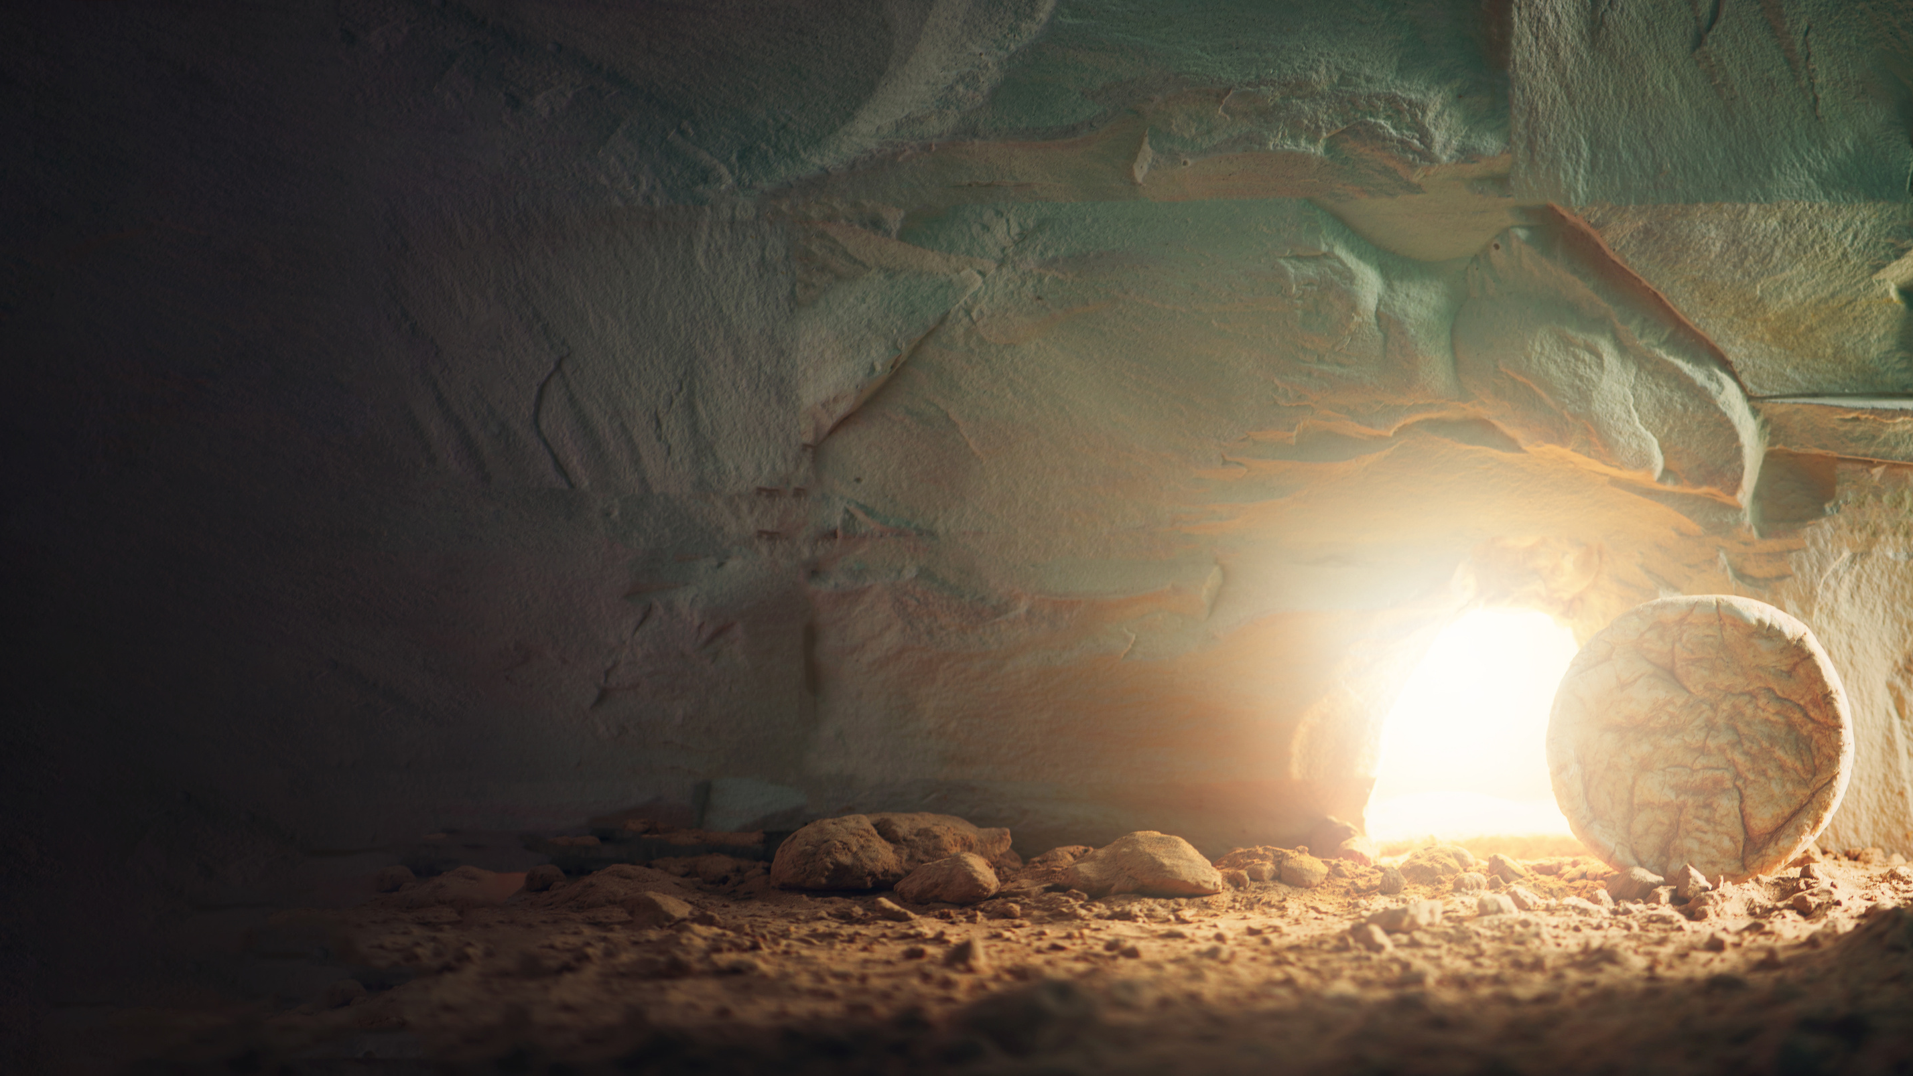
He allowed death to hold him for three days, only for three days...
Death could not hold him!!

Slide 26
What is that promise?
Death and the grave won’t hold believers either!
I am the resurrection and the life. Whoever believes in me, though he die, yet shall he live, 26 and everyone who lives and believes in me shall never die. Do you believe this?
JOHN 11:25-26

Slide 27
Some mocked Peter’s message and did not believe.
Some thought about it, considered it, but they postponed any decision.
Some believed.
What about you?

Slide 28
Where is your hope?

Slide 29
Death awaits us all, may we all trust in the only one...
Death could not hold.

