Slide 1
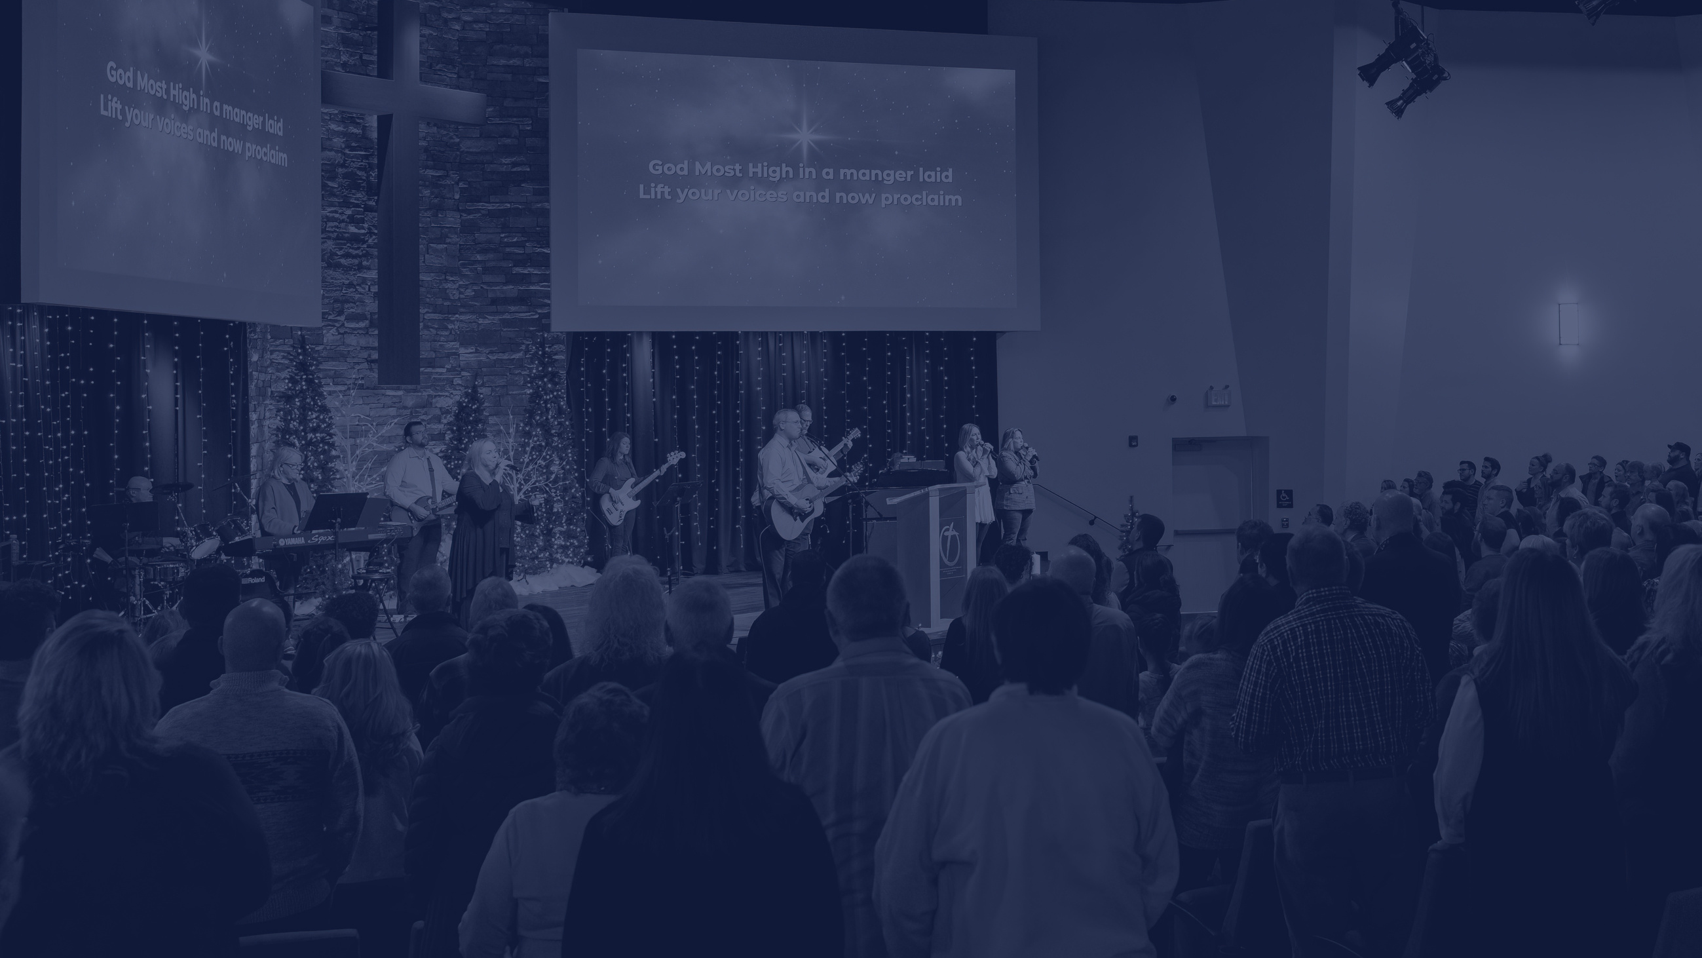

2023
WORSHIPPING. GROWING. SERVING.

Slide 2
2023
SHOW ME YOUR GLORY | EXODUS 33:1-23

Slide 3
A God-Centered Vision for Fellowship
We value God and his glory as our supreme value.

Slide 4


Exodus 33
Israel has been rescued from the bondage of Egypt, they have been promised a new land, they have no home, they are following Moses.

Slide 5
I. The Instruction from God
The Lord said to Moses, “Depart; go up from here, you and the people whom you have brought up out of the land of Egypt, to the land of which I swore to Abraham, Isaac, and Jacob, saying, ‘To your offspring I will give it.’
EXODUS 33:1

Slide 6
I. The Instruction from God
I will send an angel before you, and I will drive out the Canaanites, the Amorites, the Hittites, the Perizzites, the Hivites, and the Jebusites.
EXODUS 33:2

Slide 7
II. The Problem
Go up to a land flowing with milk and honey; but I will not go up among you, lest I consume you on the way, for you are a stiff-necked people.
EXODUS 33:3

Slide 8
III. God Meets and Talks with Moses
7 Now Moses used to take the tent and pitch it outside the camp, far off from the camp, and he called it the tent of meeting. And everyone who sought the Lord would go out to the tent of meeting, which was outside the camp. 8 Whenever Moses went out to the tent, all the people would rise up, and each would stand at his tent door, and watch Moses until he had gone into the tent.
EXODUS 33:7-8

Slide 9
III. God Meets and Talks with Moses
9 When Moses entered the tent, the pillar of cloud would descend and stand at the entrance of the tent, and the Lord would speak with Moses. 10 And when all the people saw the pillar of cloud standing at the entrance of the tent, all the people would rise up and worship, each at his tent door. 11 Thus the Lord used to speak to Moses face to face, as a man speaks to his friend. When Moses turned again into the camp, his assistant Joshua the son of Nun, a young man, would not depart from the tent.
EXODUS 33:9-11

Slide 10
IV. Moses Makes Request to God.
12 Moses said to the Lord, “See, you say to me, ‘Bring up this people,’ but you have not let me know whom you will send with me. Yet you have said, ‘I know you by name, and you have also found favor in my sight.’ 13 Now therefore, if I have found favor in your sight, please show me now your ways, that I may know you in order to find favor in your sight. Consider too that this nation is your people.”
EXODUS 33:12-13

Slide 11
V. God Answers
And he said, “My presence will go with you, and I will give you rest.”
EXODUS 33:14

Slide 12
Do You Want Rest?
Seek the presence of God.

Slide 13
VI. Moses Makes a Conditional Request
And he said to him, “If your presence will not go with me, do not bring us up from here.
EXODUS 33:15

Slide 14
What did Moses want more?
The Promised Land or God himself?

Slide 15
What did Moses want more?
The Promised Land or God himself?
Moses chose the presence of God!

Slide 16

For how shall it be known that I have found favor in your sight, I and your people? Is it not in your going with us, so that we are distinct, I and your people, from every other people on the face of the earth?”
EXODUS 33:16

Slide 17
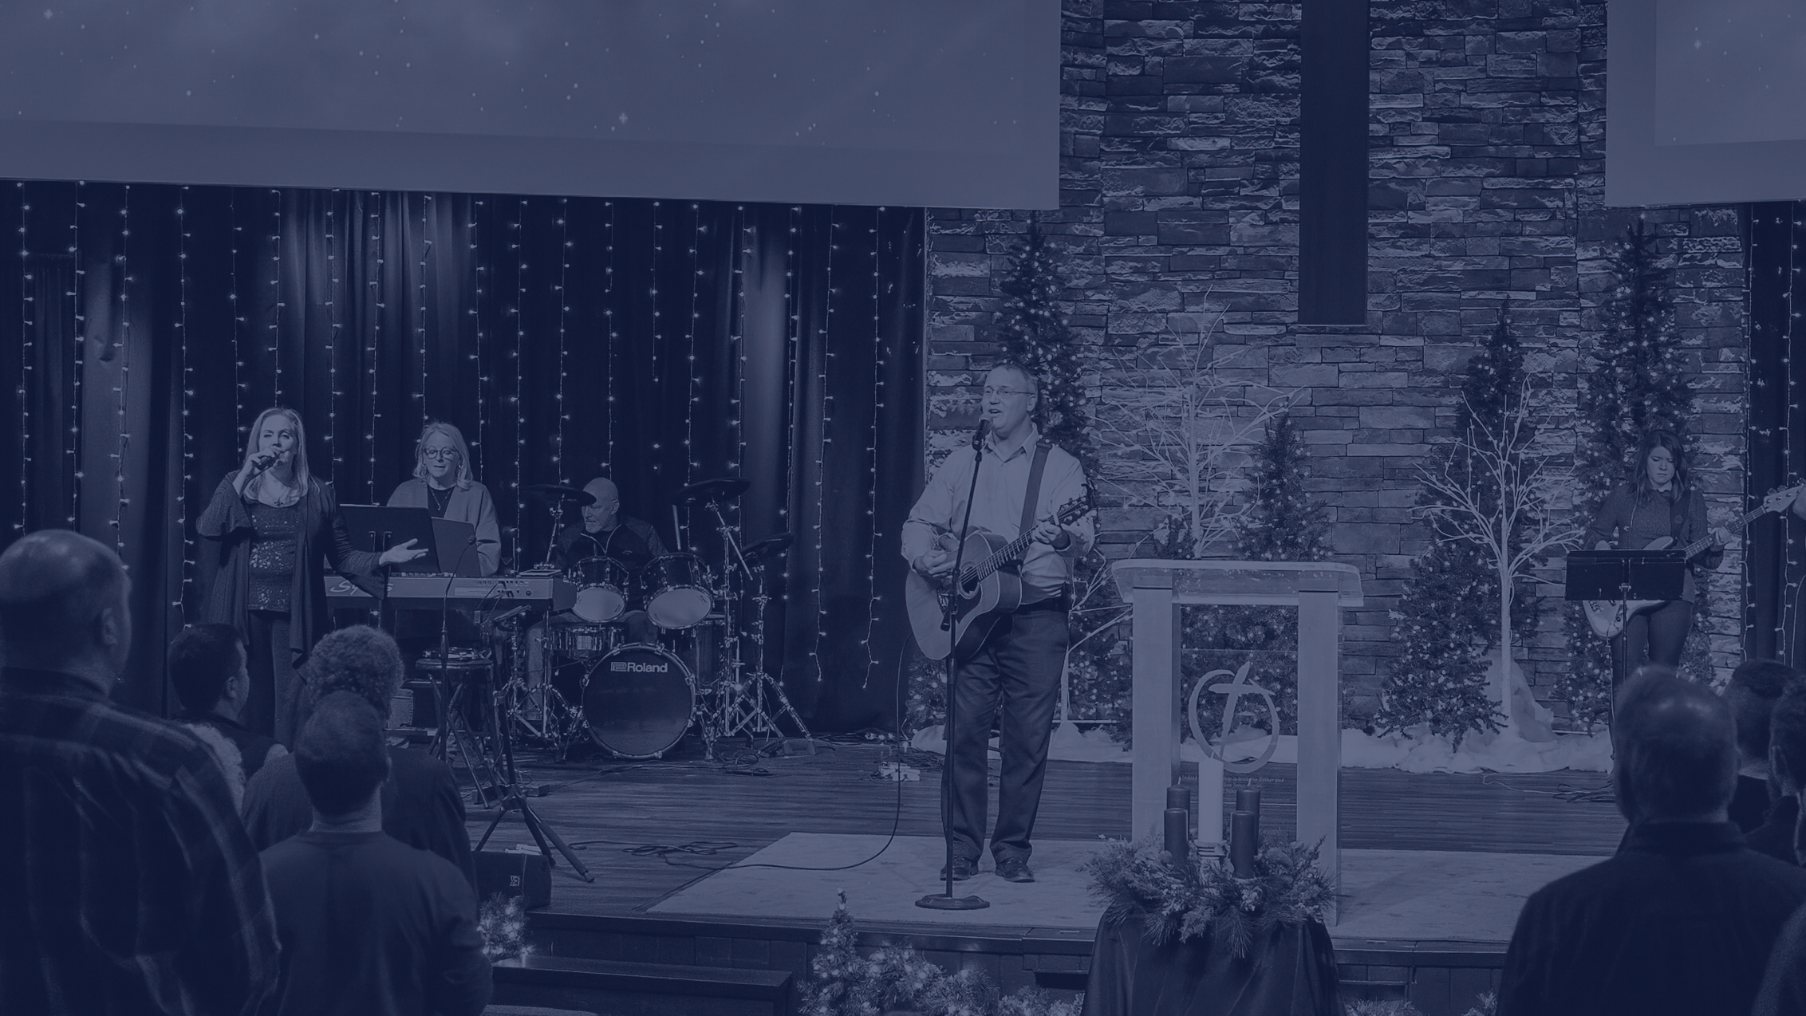
What makes the people of God distinct?
The presence of God with his people

Slide 18
VII. Moses Makes a Unique Request
17 And the Lord said to Moses, “This very thing that you have spoken I will do, for you have found favor in my sight, and I know you by name.” 18 Moses said, “Please show me your glory.”
EXODUS 33:17-18

Slide 19
VII. Moses Makes a Unique Request
And he said, “I will make all my goodness pass before you and will proclaim before you my name ‘The Lord.’ And I will be gracious to whom I will be gracious, and will show mercy on whom I will show mercy. 20 But,” he said, “you cannot see my face, for man shall not see me and live.”
EXODUS 33:19-20

Slide 20
How will God do this so that Moses can live through it?
“Behold, there is a place by me where you shall stand on the rock, 22 and while my glory passes by I will put you in a cleft of the rock, and I will cover you with my hand until I have passed by. 23 Then I will take away my hand, and you shall see my back, but my face shall not be seen.”
EXODUS 33:21-23

Slide 21
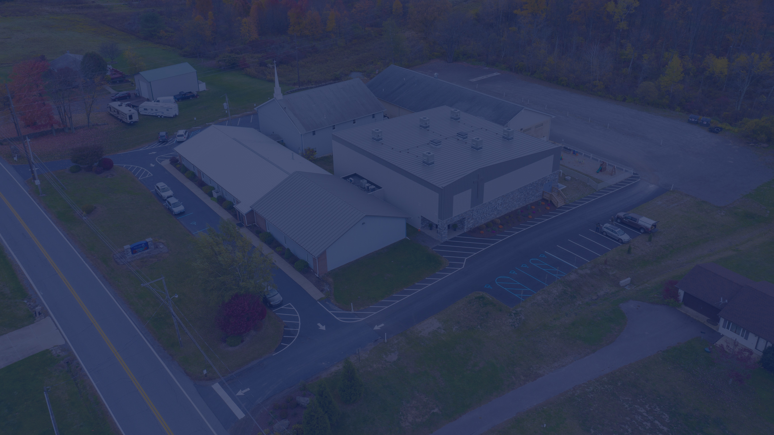
We exist to pervade the Back Mountain, the Wyoming Valley and the world with the gospel by making disciples who make disciples and who display the glory of the Lord Jesus Christ in every phase of their lives.

Slide 22
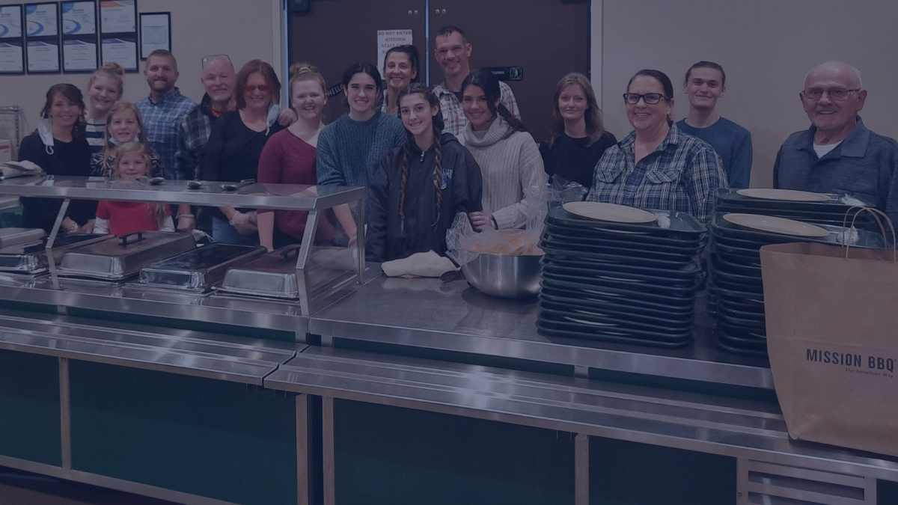
What phase of life are you in?

Slide 23
Will you allow your phase of life to be used for God’s glory?

Slide 24
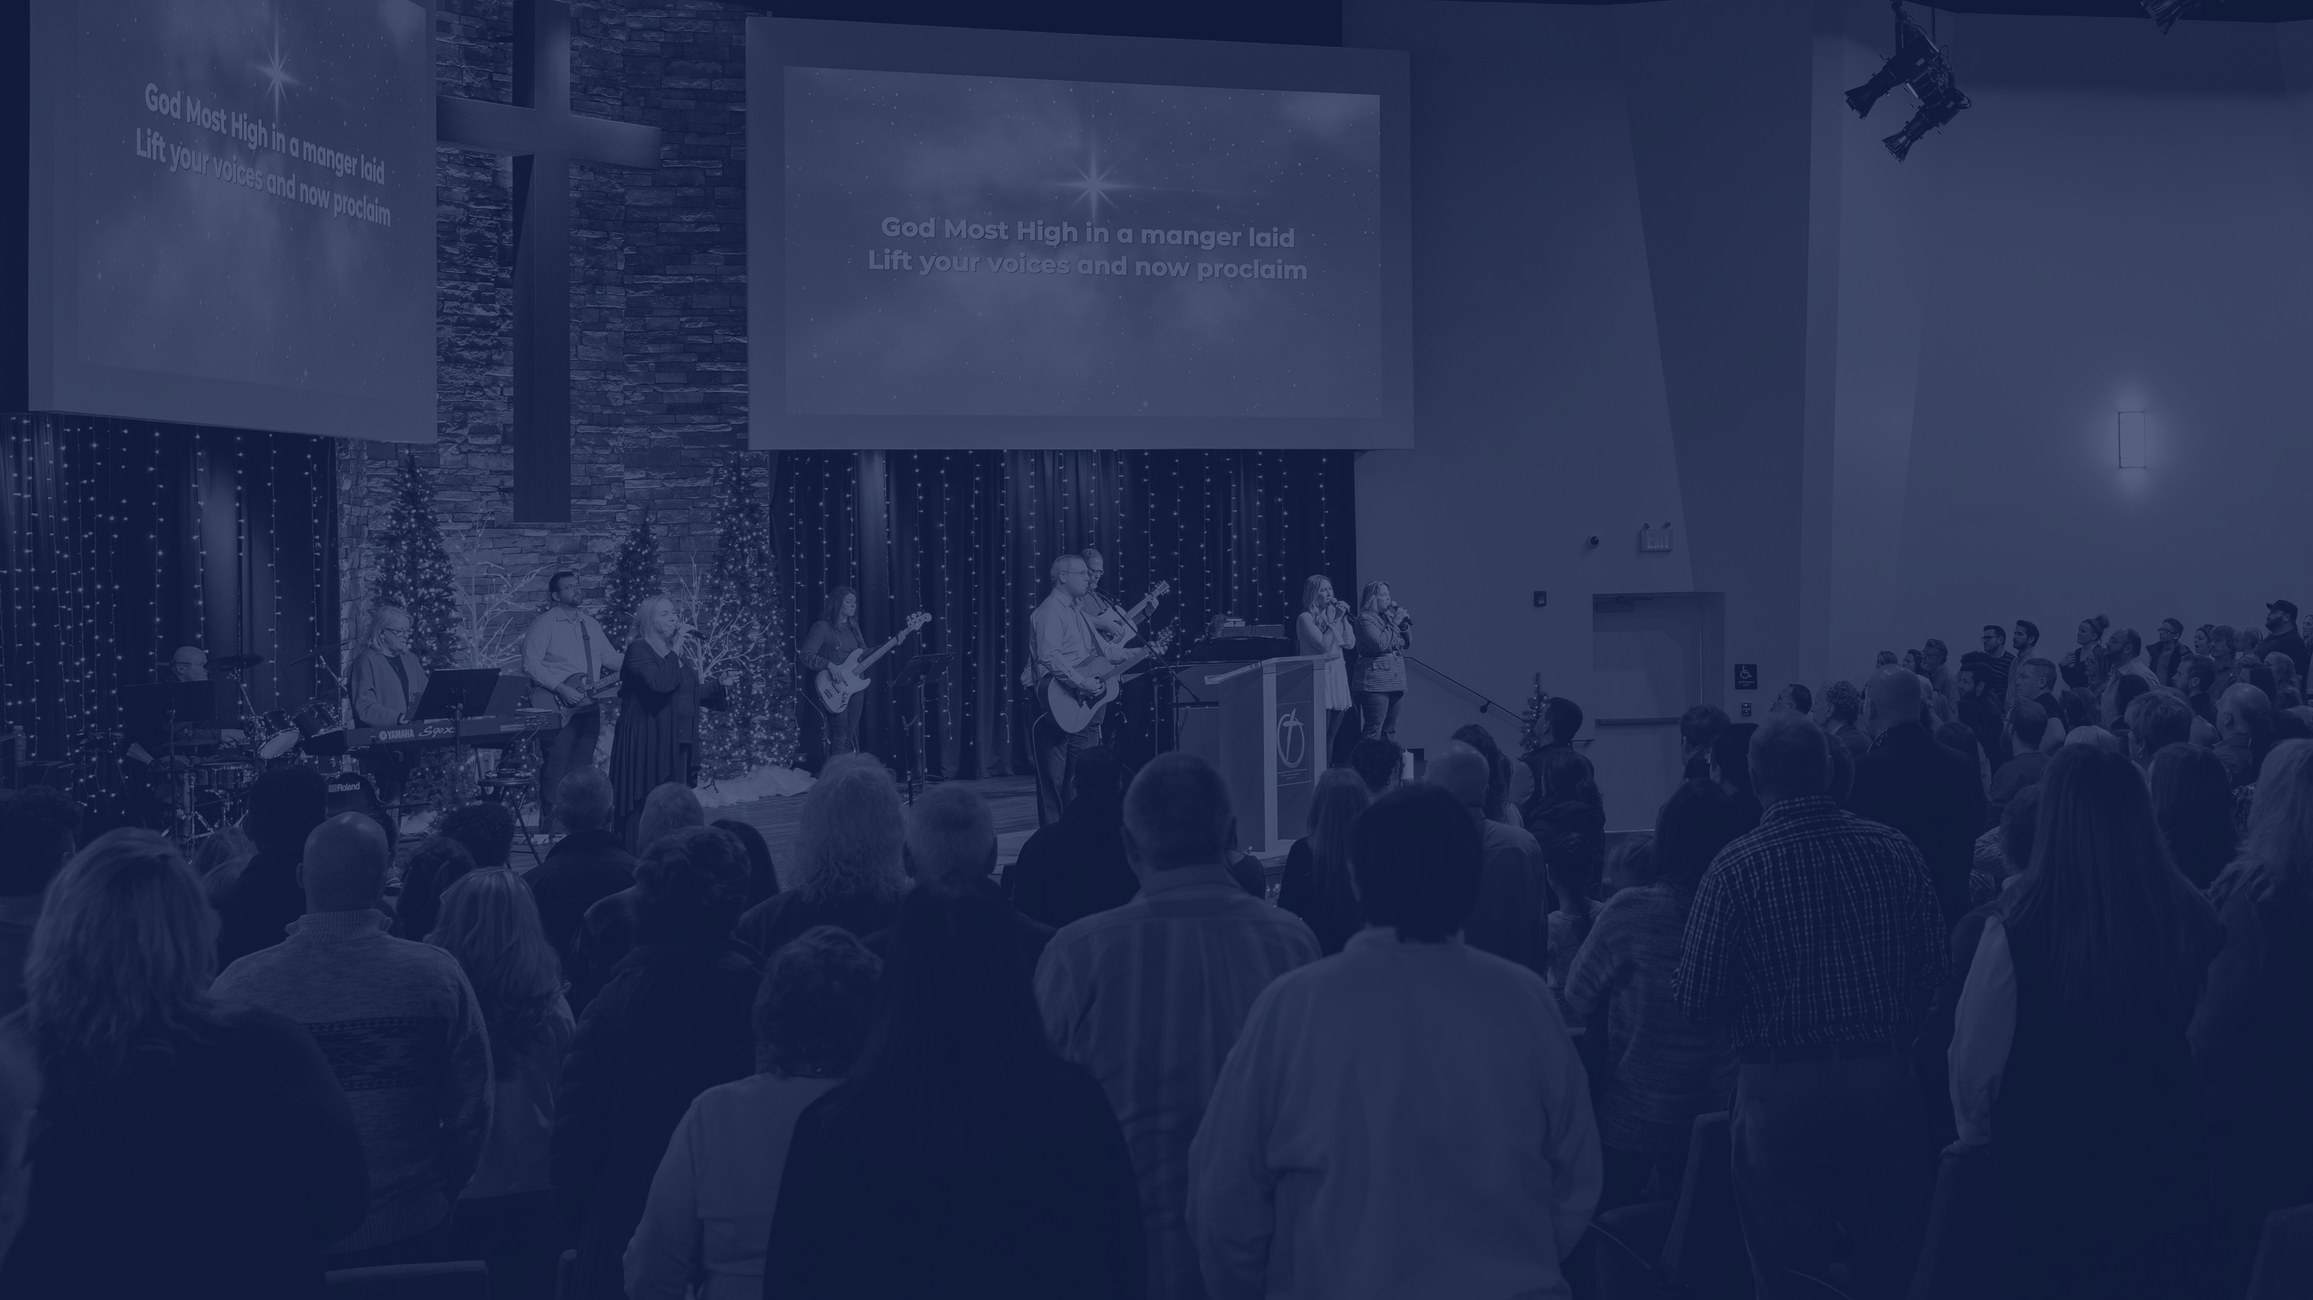
HOW DO YOU BRING GOD GLORY IN EVERY PHASE OF LIFE?
By desiring the presence of God more than you desire the blessing of God.

Slide 25
We desire to display the glory of God to the Back Mountain, Wyoming Valley and the world...
...which means we’re only going where God is leading, but if he’s not going neither are we!

