Slide 1


THE SILENCE OF IDOLATRY
Deuteronomy 4
Notes:
You can swap out the background picture with whatever you'd like! If you want to make the picture darker, you can adjust the transparency on the top right.

Slide 2
Two Questions
First Question: What great nation is there that has a god so near to it as the Lord our God is to us? (v7)
Second Question: What great nation is there that has laws that are as righteous as the laws our God has given to us? (v8)

Slide 3
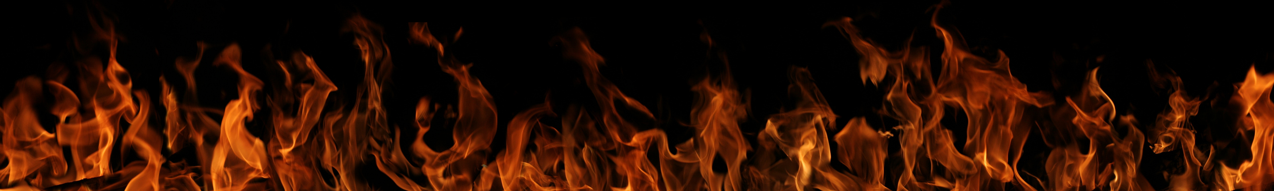
Since you saw no form on the day that the Lord spoke to you at Horeb out of the midst of the fire, 16 beware lest you act corruptly by making a carved image for yourselves, in the form of any figure…
DEUTERONOMY 4:15-16

Slide 4
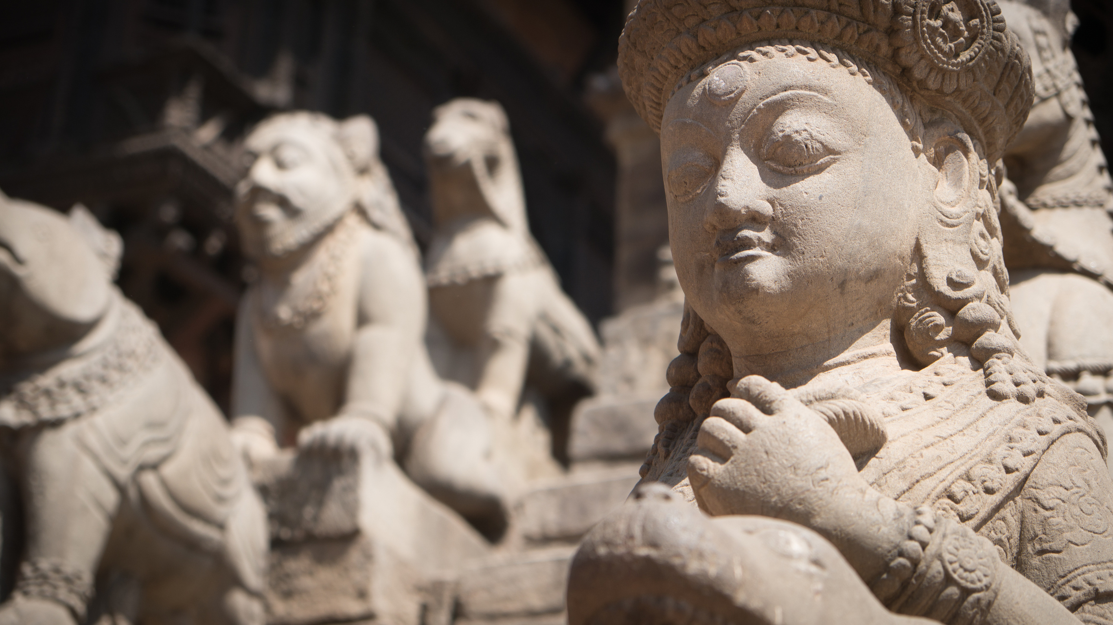
Do Not Replicate My Likeness Through:
> Making a carved image
> The form of any figure
> The likeness of a male or female
> The likeness of any animal on the earth
> The likeness of any winged bird that flies
> The likeness of any creature on the ground
> The likeness of any fish in the water

Slide 5
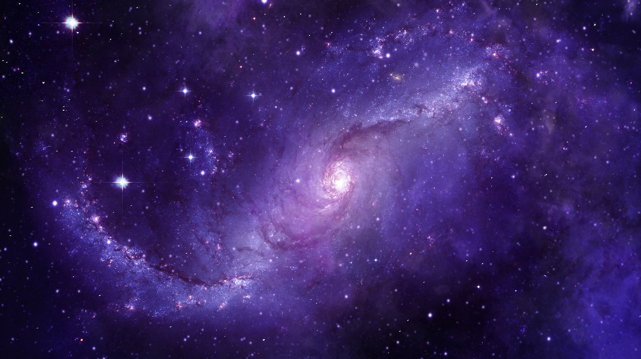
Beware of Worshipping:
> The sun
> The moon
> The stars
> The constellations of the skies
And beware lest you raise your eyes to heaven, and when you see the sun and the moon and the stars, all the host of heaven, you be drawn away and bow down to them and serve them...
Deuteronomy 4:19

Slide 6

What point is being made here, by listing these specific commands against idolatry?
All of these idols have form.

Slide 7
What is the central truth here?

Slide 8

And you came near and stood at the foot of the mountain, while the mountain burned with fire to the heart of heaven, wrapped in darkness, cloud, and gloom. 12 Then the Lord spoke to you out of the midst of the fire. You heard the sound of words, but saw no form; there was only a voice.
DEUTERONOMY 4:11-12

Slide 9

The Central Truth:
God spoke.

Slide 10

What is that Foundation?
Revelation

Slide 11
What is that Commonality?
They do not speak.

Slide 12

What did the voice of God speak?
He spoke a covenant.
And he declared to you his covenant, which he commanded you to perform, that is, the Ten Commandments, and he wrote them on two tablets of stone.
Deuteronomy 4:13

Slide 13
What is Moses reminding Israel about?
1) God spoke.
2) The manner in which God spoke.
And you came near and stood at the foot of the mountain, while the mountain burned with fire to the heart of heaven, wrapped in darkness, cloud, and gloom. 12 Then the Lord spoke to you out of the midst of the fire.
Deuteronomy 4:11-12

Slide 14

What if God had not spoken?

Slide 15
But...God has spoken!!

Slide 16
Has anyone ever heard the God of the universe speak and live to tell about it?

Slide 17
Why did God speak to Israel?
That they might know the Lord is God and there is no other beside him.
To you it was shown, that you might know that the Lord is God; there is no other besides him. 36 Out of heaven he let you hear his voice, that he might discipline you. And on earth he let you see his great fire, and you heard his words out of the midst of the fire.
Deuteronomy 4:35-36

Slide 18

God has spoken so that all of humanity may know that the Lord is God in heaven above and on earth below – and there is no other!

Slide 19

God has spoken so we must obey his Word with unrelenting faithfulness.

Slide 20
Long ago, at many times and in many ways, God spoke to our fathers by the prophets, 2 but in these last days he has spoken to us by his Son, whom he appointed the heir of all things, through whom also he created the world. 3 He is the radiance of the glory of God and the exact imprint of his nature, and he upholds the universe by the word of his power. After making purification for sins, he sat down at the right hand of the Majesty on high…
HEBREWS 1:1-3

Slide 21


Slide 22
He upholds the universe by the word of his power!

Slide 23
God has spoken!
Are you listening?

