Slide 1


REBUKE
FORGIVE
REPEAT

Slide 2

And he said to his disciples,
“Temptations to sin are sure to come, but woe to the one through whom they come!"
LUKE 17:1

Slide 3
TEMPTATION
skan-dal-id'-zo
trap stick, snare, stumbling block

Slide 4
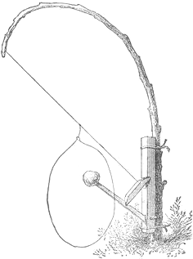


Slide 5
And he said to his disciples,
“Temptations to sin are sure to come, but woe to the one through whom they come!"
LUKE 17:1

Slide 6
“Woe to you, scribes and Pharisees, hypocrites! For you travel across sea and land to make a single proselyte, and when he becomes a proselyte, you make him twice as much a child of hell as yourselves.”
MATTHEW 25:13

Slide 7
"It would be better for him if a millstone were hung around his neck and he were cast into the sea than that he should cause one of these little ones to sin."
LUKE 17:2

Slide 8
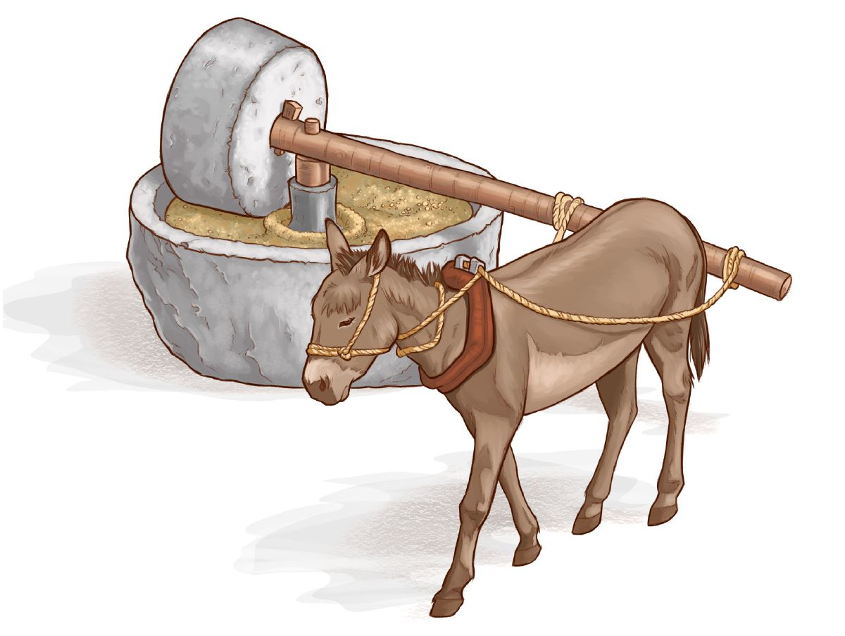

Slide 9
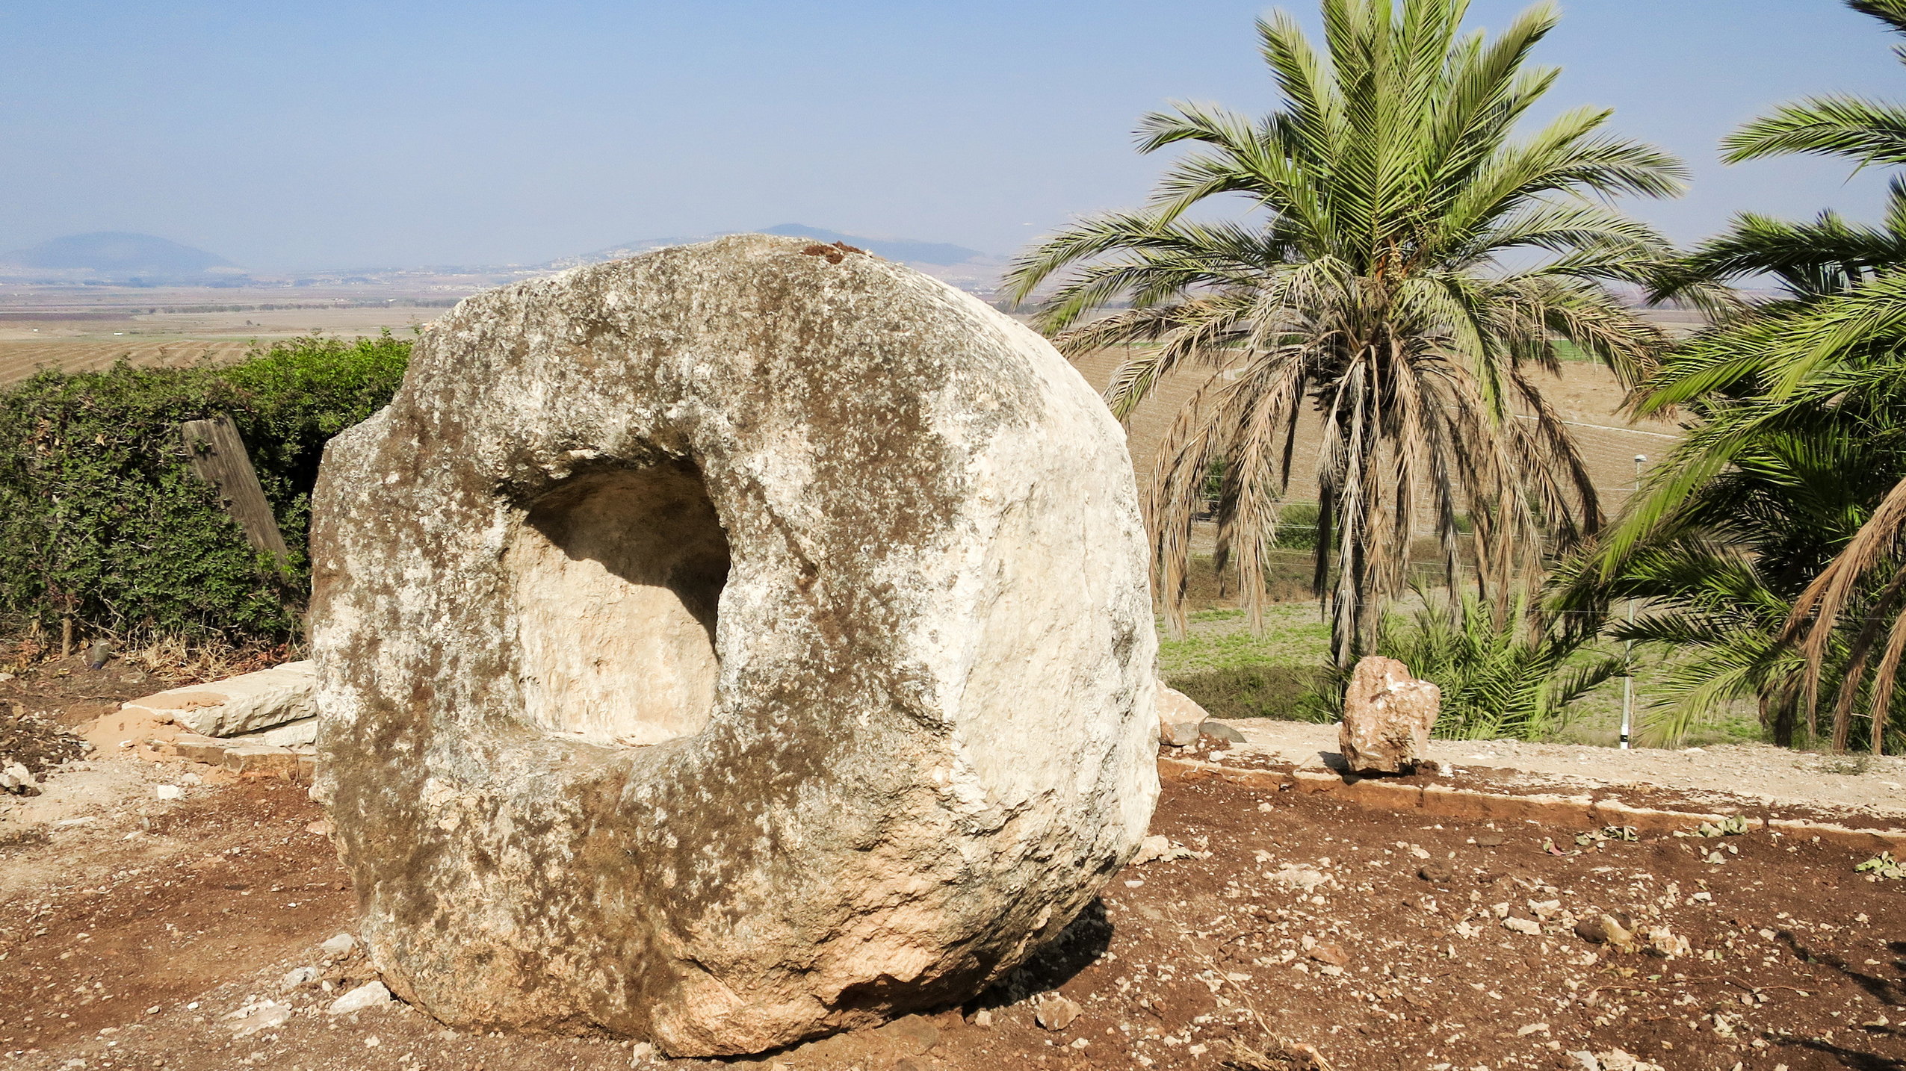

Slide 10
"Pay attention to yourselves!"
LUKE 17:3

Slide 11
"If your brother sins, rebuke him,"
LUKE 17:3

Slide 12
REBUKE
epitimaō
to show honor to; admonish sharply

Slide 13
Rebuking Respectfully
Check yourself before rebuking
Brothers, if anyone is caught in any transgression, you who are spiritual should restore him in a spirit of gentleness. Keep watch on yourself, lest you too be tempted.
GALATIANS 6:1

Slide 14
Rebuking Respectfully
Check yourself before rebuking
Why do you see the speck that is in your brother's eye, but do not notice the log that is in your own eye? How can you say to your brother, ‘Brother, let me take out the speck that is in your eye,’ when you yourself do not see the log that is in your own eye? You hypocrite, first take the log out of your own eye, and then you will see clearly to take out the speck that is in your brother's eye.
LUKE 6:41-42

Slide 15
Rebuking Respectfully
2. Rebuke one-on-one
If your brother sins against you, go and tell him his fault, between you and him alone. If he listens to you, you have gained your brother.
MATTHEW 18:15

Slide 16
Rebuking Respectfully
2. Rebuke one-on-one
If your brother sins against you, go and tell him his fault, between you and him alone. If he listens to you, you have gained your brother. But if he does not listen, take one or two others along with you, that every charge may be established by the evidence of two or three witnesses.
MATTHEW 18:15-16

Slide 17
Rebuking Respectfully
3. Be direct in your rebuke
You shall not hate your brother in your heart, but you shall reason frankly with your neighbor, lest you incur sin because of him.
LEVITICUS 19:17

Slide 18
"If your brother sins, rebuke him, and if he repents, forgive him"
LUKE 17:3

Slide 19
Repent
metanoeō
to change one's mind for the better, heartily to amend with abhorrence to one's past sins

Slide 20

A REBUKE SHOULD ALWAYS BE CONNECTED TO FORGIVENESS

Slide 21
FORGIVE
aphiēmi
sending away, letting go, to omit,
to leave behind

Slide 22
He will again have compassion on us; he will tread our iniquities underfoot. You will cast all our sins into the depths of the sea.
MICAH 7:19

Slide 23
For I will be merciful toward their iniquities, and I will remember their sins no more.
HEBREWS 8:12

Slide 24
Be kind to one another, tenderhearted, forgiving one another, as God in Christ forgave you.
EPHESIANS 4:32

Slide 25

FORGIVENESS IS A PROMISE
FOR THOSE WHO ARE IN CHRIST

Slide 26
"and if he sins against you seven times in the day, and turns to you seven times, saying, ‘I repent,’ you must forgive him."
LUKE 17:4

Slide 27
REPEAT
Matthew 18:21-22
“Lord, how often will my brother sin against me, and I forgive him? As many as seven times?”
Jesus said to him, “I do not say to you seven times,
but seventy-seven times."

Slide 28

FOLLOWERS OF CHRIST SHOULD BE ABLE TO COUNT ON
ONE ANOTHER TO FORGIVE

Slide 29
Do nothing from selfish ambition or conceit, but in humility count others more significant than yourselves. Let each of you look not only to his own interests, but also to the interests of others. Have this mind among yourselves, which is yours in Christ Jesus, who, though he was in the form of God, did not count equality with God a thing to be grasped, but emptied himself, by taking the form of a servant, being born in the likeness of men. And being found in human form, he humbled himself by becoming obedient to the point of death, even death on a cross.
PHILIPPIANS 2:3-8

Slide 30
The apostles said to the Lord, “Increase our faith!” And the Lord said, “If you had faith like a grain of mustard seed, you could say to this mulberry tree, ‘Be uprooted and planted in the sea,’ and it would obey you.
LUKE 17:5-6

Slide 31

Forgiveness Requires Faith
Forgiveness does not require more faith,
it only requires faith that is genuine!

Slide 32
Forgiveness Requires Faith
Total dependence on the God who forgives us will allow us to forgive others immediately and completely.

Slide 33
Forgiveness Requires Faith
Forgiveness is the right and only response
from those who have been forgiven.

Slide 34
REBUKE
FORGIVE
REPEAT

