Slide 1

Easter
AT FELLOWSHIP CHURCH
The Precious Blood of Christ |1 Peter 1:13-21

Slide 2

Are you living in a way that demonstrates Christ’s blood as precious?

Slide 3

Therefore, preparing your minds for action, and being sober-minded, set your hope fully on the grace that will be brought to you at the revelation of Jesus Christ. 14 As obedient children, do not be conformed to the passions of your former ignorance, 15 but as he who called you is holy, you also be holy in all your conduct, 16 since it is written, “You shall be holy, for I am holy.”
1 PETER 1:13-16

Slide 4
17 And if you call on him as Father who judges impartially according to each one's deeds, conduct yourselves with fear throughout the time of your exile, 18 knowing that you were ransomed from the futile ways inherited from your forefathers, not with perishable things such as silver or gold,
1 PETER 1:17-18

Slide 5
19 but with the precious blood of Christ, like that of a lamb without blemish or spot. 20 He was foreknown before the foundation of the world but was made manifest in the last times for the sake of you 21 who through him are believers in God, who raised him from the dead and gave him glory, so that your faith and hope are in God.
1 PETER 1:19-21

Slide 6
Precious
from the Greek word timios
means valuable, costly, honored, esteemed.

Slide 7
Reasons Christ’s Blood is Precious
1) Christ’s blood is precious because it keeps believers living in the fear of God.
And if you call on him as Father who judges impartially according to each one's deeds, conduct yourselves with fear throughout the time of your exile…
1 PETER 1:17

Slide 8
Reasons Christ’s Blood is Precious
2) Christ’s blood is precious because it ransoms us from living futile, wasted lives on earth.
knowing that you were ransomed from the futile ways inherited from your forefathers…
1 PETER 1:18

Slide 9


What were believers ransomed from?
Condemnation for our sin and our rebellion against a holy God.

Slide 10
Who paid the ransom?
Jesus, God himself in the flesh, suffered and sacrificially gave himself as our atoning sacrifice on the cross.

Slide 11
Who was it paid to?
Christ’s atoning sacrifice satisfied the justice that God required for our sin and rebellion against him.

Slide 12
Reasons Christ’s Blood is Precious
3) Christ’s blood is precious because it came from the holy, sinless, perfect, beloved Son of God.
not with perishable things such as silver or gold, 19 but with the precious blood of Christ, like that of a lamb without blemish or spot.
1 PETER 1:18-19

Slide 13
Why does Peter use that analogy to describe the sacrifice of Christ?
like that of a lamb without blemish or spot.
1 Peter 1:19

Slide 14
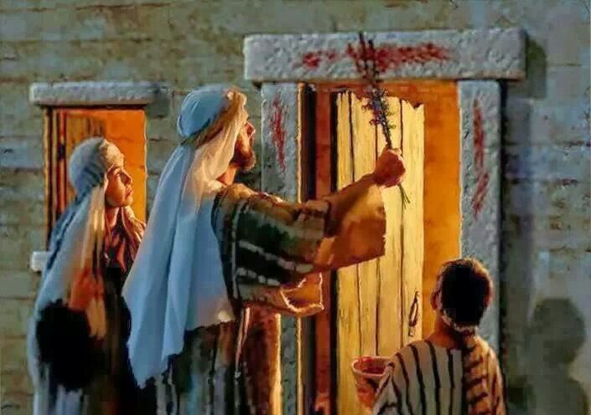
The First Passover

Slide 15
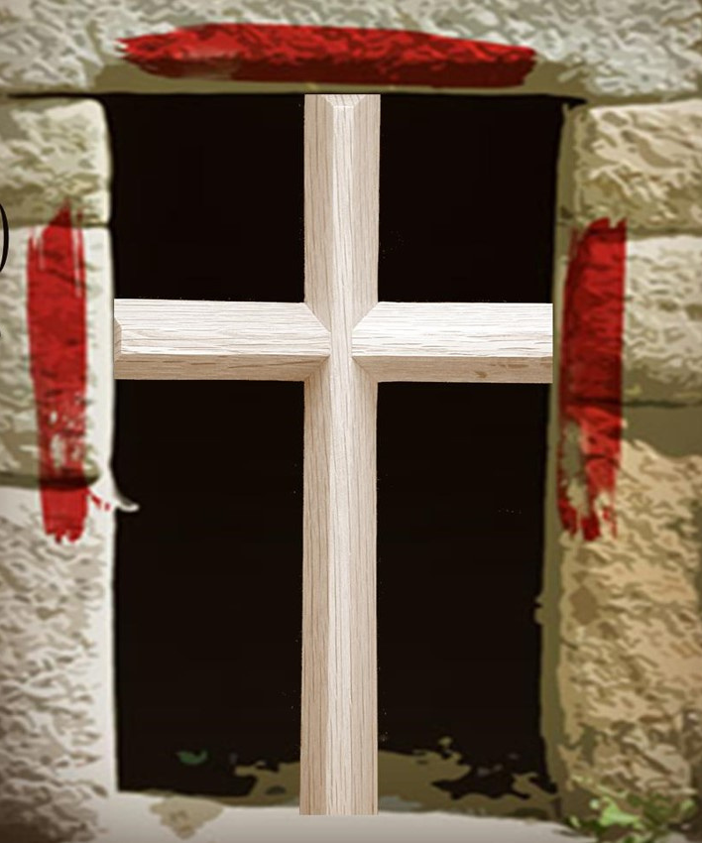
A foreshadowing of Christ's death
‘when I see the blood, I will pass over them’
Exodus 12:13

Slide 16
What was it that saved Israel that night in Egypt?
It was the blood of the lamb applied in faith.

Slide 17
And that is precisely what Peter is saying here....
It’s still the blood of the Lamb that saves!

Slide 18
Reasons Christ’s Blood is Precious
4) Christ’s blood is precious because his redemptive death was planned by God before the foundation of the world.
He was foreknown before the foundation of the world but was made manifest in the last times…
1 PETER 1:20

Slide 19
Reasons Christ’s Blood is Precious
5) Christ’s blood is precious because it was shed for you – those whom Christ will save.
He was foreknown before the foundation of the world but was made manifest in the last times for the sake of you who through him are believers in God.
1 PETER 1:20

Slide 20

How did God unmistakably prove that Christ’s precious blood is the only means for covering the sins of humanity?

Slide 21
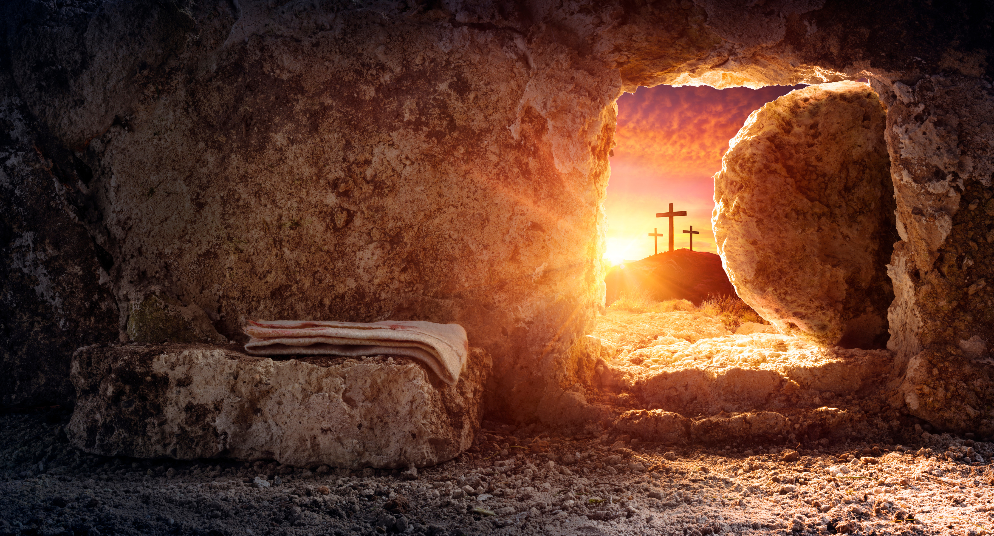
What is that proof?
God raised Christ from the dead and gave him glory!
21who through him are believers in God, who raised him from the dead and gave him glory, so that your faith and hope are in God.

Slide 22
The resurrection was God’s official declaration to the world, that this Jesus is the only one who can save people from their sin and shame!

Slide 23
If not the precious blood of Christ, what are you trusting in to be your salvation?

Slide 24

Are you living in a way that demonstrates Christ’s blood as precious?

