Slide 1
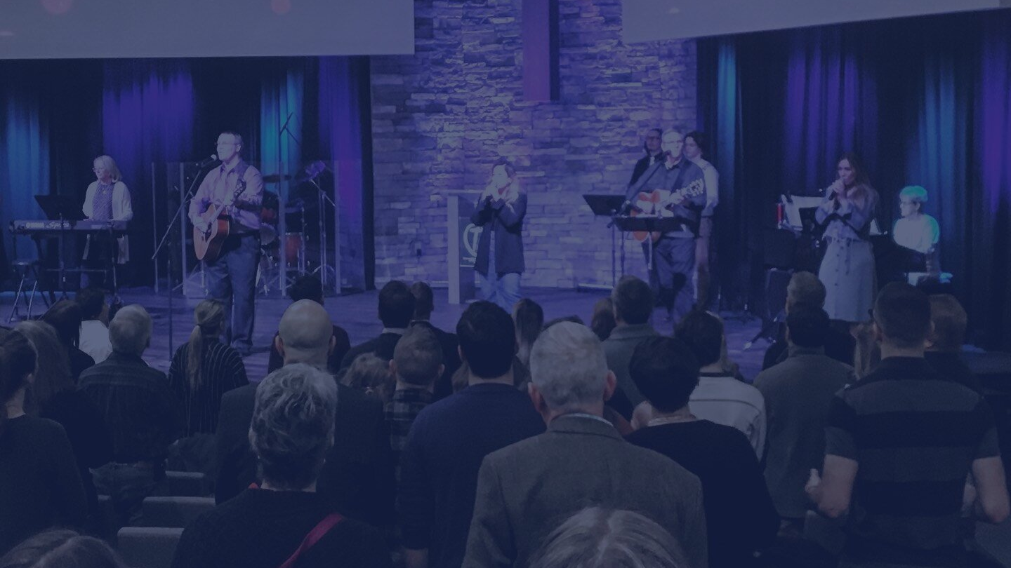

2022
WORSHIPPING. GROWING. SERVING.

Slide 2
2022
WHY COMMUNITY?

Slide 3
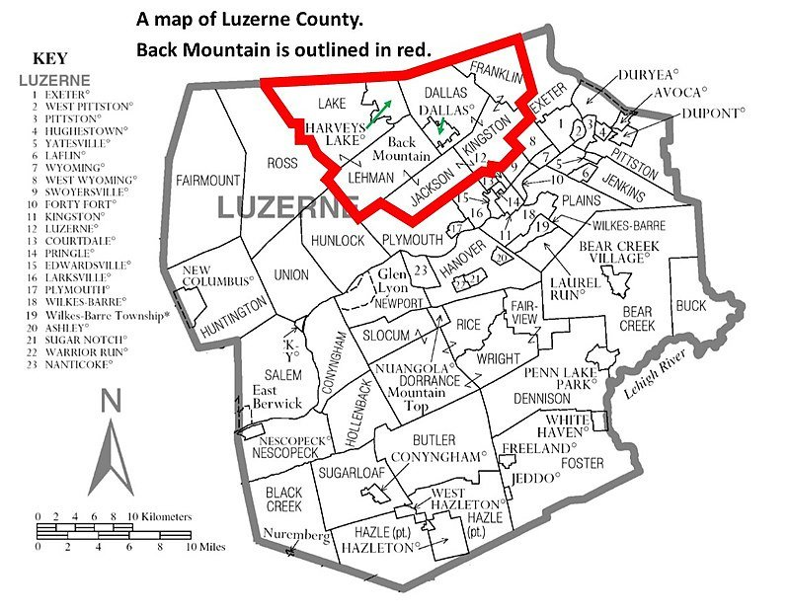

Back Mountain Community

Slide 4
2022
WHY COMMUNITY?

Slide 5
We exist to pervade the Back Mountain, Wyoming Valley and the world with the Gospel by making disciples who make disciples and who display the glory of the Lord Jesus Christ in every phase of their lives.

Slide 6
We will be a Worshipping community:
Declaring the worth of God and his son Jesus Christ.

Slide 7
We will be a Growing community:
Being made into the likeness of Christ.

Slide 8
We will be a Serving community:
Serving in the power and strength of the Holy Spirit.

Slide 9
That which was from the beginning, which we have heard, which we have seen with our eyes, which we looked upon and have touched with our hands, concerning the word of life— 2 the life was made manifest, and we have seen it, and testify to it and proclaim to you the eternal life, which was with the Father and was made manifest to us—
1JOHN 1:1-2

Slide 10
3 that which we have seen and heard we proclaim also to you, so that you too may have fellowship with us; and indeed our fellowship is with the Father and with his Son Jesus Christ. 4 And we are writing these things so that our joy may be complete.
1 JOHN 1:3-4

Slide 11
How does this passage speak into our mission and vision?

Slide 12
Worshipping...
The worshipping community sees God for who he is, as he has been revealed.
That which we have seen...
1 JOHN 1:3

Slide 13
Growing...
2. The growing community hears the truth of God for what it is – truth from God!
That which we have heard...
1 JOHN 1:3

Slide 14
Serving...
3. The serving community proclaims what they saw and heard through selflessly serving their Lord and Savior.
That which we have seen and heard we proclaim also to you.
1 JOHN 1:3

Slide 15
Why do we proclaim this Jesus?
So that others may have true fellowship with us just as we have true fellowship with the Father and the Son.

Slide 16
'koinonia’
1. Fellowship
2. Sharing
3. Participation
4. Common

Slide 17
Fellowship Church exists to help you and to help others worship, grow and serve the Lord in true 'koinonia', in true biblical community.

Slide 18
What does a church like that share in common?

Slide 19
1) Commitment to gospel-centered ministry as a church.

Slide 20
2) Commitment to God-centered worship.

Slide 21
3) Commitment to making disciples in community.

Slide 22
4) Commitment to serving the Lord and his church with our gifts, skills and talents.
Truly, truly, I say to you, a servant is not greater than his master.
John 13:16

Slide 23
5) Commitment to God’s truth and to cultural engagement with that truth.

Slide 24
5) Commitment to God’s truth and to cultural engagement with that truth.
When the Spirit of truth comes, he will guide you into all the truth.
John 16:13

Slide 25
6) Commitment to being a gospel witness to our community and to the world.

Slide 26
7) Commitment to godly living in this present age.

Slide 27
7) Commitment to godly living in this present age.
For the grace of God has appeared, bringing salvation for all people, 12 training us to renounce ungodliness and worldly passions, and to live self-controlled, upright, and godly lives in the present age.
Titus 2:11-12

Slide 28

Why Community?
Because we have seen, we have heard...and what we have seen, what we have heard…that we proclaim!

Slide 29
Why Do We Proclaim?
So that you may have 'koinonia' with us, so that you too may have fellowship with us, and our fellowship is with the Father and with his son Jesus Christ.

Slide 30
Why Community?
Because Jesus has called us into fellowship together, into koinonia together!

Slide 31
3 that which we have seen and heard we proclaim also to you, so that you too may have fellowship with us; and indeed our fellowship is with the Father and with his Son Jesus Christ.
1 JOHN 1:3

