Slide 1


Slide 2

Peace Forevermore| Isaiah 9:6-7

Slide 3






Slide 4
Peace Forevermore| Isaiah 9:6-7

Slide 5


The people who walked in darkness
have seen a great light;
those who dwelt in a land of deep darkness, on them has light shone.
Isaiah 9:2

Slide 6
For to us a child is born, to us a son is given.
Isaiah 9:6

Slide 7
She will bear a son, and you shall call his name Jesus, for he will save his people from their sins.” 22 All this took place to fulfill what the Lord had spoken by the prophet: 23 “Behold, the virgin shall conceive and bear a son, and they shall call his name Immanuel” (which means, God with us).
Matthew 1:21-23

Slide 8
What was the promise and the sign?
Therefore the Lord himself will give you a sign. Behold, the virgin shall conceive and bear a son, and shall call his name Immanuel.
Isaiah 7:14

Slide 9
For to us a child is born, to us a son is given.
Isaiah 9:6

Slide 10
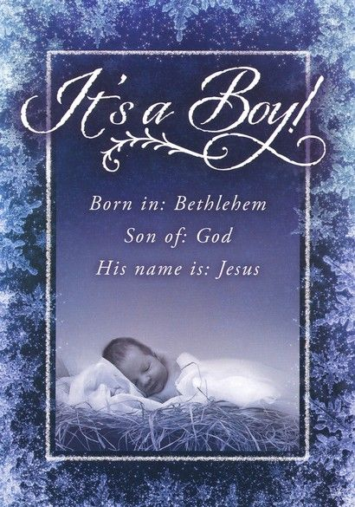
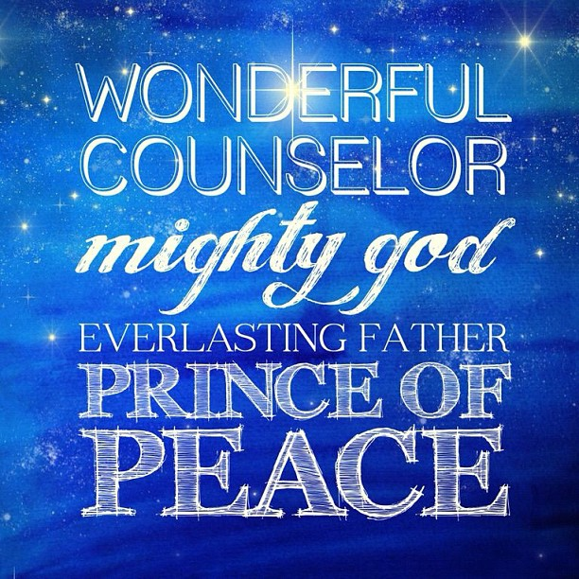

Slide 11

Christ’s Birth Announcement
This Christ child is a gift to the world, to humanity.
For to us a child is born, to us a son is given…
Isaiah 9:6

Slide 12
Christ’s Birth Announcement
This Christ child was born to us as a baby.
For to us a child is born, to us a son is given…
Isaiah 9:6

Slide 13
Christ’s Birth Announcement
This Christ child is ‘given’ as a Son.
For to us a child is born, to us a son is given…
Isaiah 9:6

Slide 14
Christ’s Birth Announcement
This Christ child will rule the world.
and the government shall be on his shoulder…
Isaiah 9:6

Slide 15
…and his name shall be called Wonderful Counselor, Mighty God, Everlasting Father, Prince of Peace.
Isaiah 9:6

Slide 16

His Name Foretold
His name shall be called Wonderful Counselor.
and his name shall be called Wonderful Counselor…
Isaiah 9:6

Slide 17
His Name Foretold
His name shall be called Mighty God.
and his name shall be called Wonderful Counselor, Mighty God…
Isaiah 9:6

Slide 18
His Name Foretold
His name shall be called Everlasting Father.
and his name shall be called Wonderful Counselor, Mighty God, Everlasting Father…
Isaiah 9:6

Slide 19
His Name Foretold
His name shall be called Prince of Peace.
and his name shall be called Wonderful Counselor, Mighty God, Everlasting Father, Prince of Peace.
Isaiah 9:6

Slide 20
Prince of Peace
Peace with God
Peace with one another
Peace of mind and heart
Peace forevermore
Of the increase of his government and of peace there will be no end…
Isaiah 9:7

Slide 21
Of the increase of his government and of peace there will be no end, on the throne of David and over his kingdom, to establish it and to uphold it with justice and with righteousness from this time forth and forevermore. The zeal of the Lord of hosts will do this.
Isaiah 9:7

Slide 22

How does this forever peace compare to the temporary peace that the world offers?

Slide 23
Temporary Peace
The Key to Lasting Peace: Freeing the Mind
Master breather, certified breath facilitator, trained in many energy-based healing modalities.
‘Enhance the awareness of the human potential and to empower individuals’.

Slide 24
Temporary Peace
The Key to Lasting Peace: Freeing the Mind
Restore well being and connect to oneness through transformational breathing.
‘The mind is powerful beyond belief, it creates everything in our life, however it creates unconsciously’.
Goal is to help us ‘regain our consciousness’.

Slide 25
You don’t find lasting peace from within yourself, the forever peace that comes from Jesus lasts forever, because it is from him and not you.

Slide 26
Christ’s birth is proof that his promise of peace forevermore can be trusted.

Slide 27
Christmas reminds us that when God promises something, he delivers!

