Slide 1


Slide 2

Irony
the strange disparity between what is expected to happen from what actually happens

Slide 3

The Irony of the Christmas Story
Heaven has to come to earth in order for those on earth to go to heaven.

Slide 4

For I have come down from heaven, not to do my own will but the will of him who sent me. 39 And this is the will of him who sent me, that I should lose nothing of all that he has given me, but raise it up on the last day.
John 6:38-39

Slide 5
40 For this is the will of my Father, that everyone who looks on the Son and believes in him should have eternal life, and I will raise him up on the last day.
John 6:40

Slide 6
And the Word became flesh and dwelt among us, and we have seen his glory, glory as of the only Son from the Father, full of grace and truth.
John 1:14

Slide 7
The Irony of the Christmas Story
Humanity is born to live and then die but the Christ child was born to die and then live.

Slide 8
Now is my soul troubled. And what shall I say? ‘Father, save me from this hour’? But for this purpose I have come to this hour. 28 Father, glorify your name.” Then a voice came from heaven: “I have glorified it, and I will glorify it again.”
John 12:27-28

Slide 9
And I, when I am lifted up from the earth, will draw all people to myself.” 33 He said this to show by what kind of death he was going to die.
John 12:32-33

Slide 10
The Irony of the Christmas Story
Humanity is born to live and then die but the Christ child was born to die and then live.

Slide 11
The Irony of the Christmas Story
Christ’s death may seem like a tragic end to the Christmas story but it is in fact the glorious culmination of this divine story.

Slide 12
For this reason the Father loves me, because I lay down my life that I may take it up again. 18 No one takes it from me, but I lay it down of my own accord. I have authority to lay it down, and I have authority to take it up again. This charge I have received from my Father.
John 10:17-18

Slide 13

The baby born in Bethlehem is the same Jesus crucified on Good Friday and is the same Jesus risen from the dead on Easter Sunday!

Slide 14
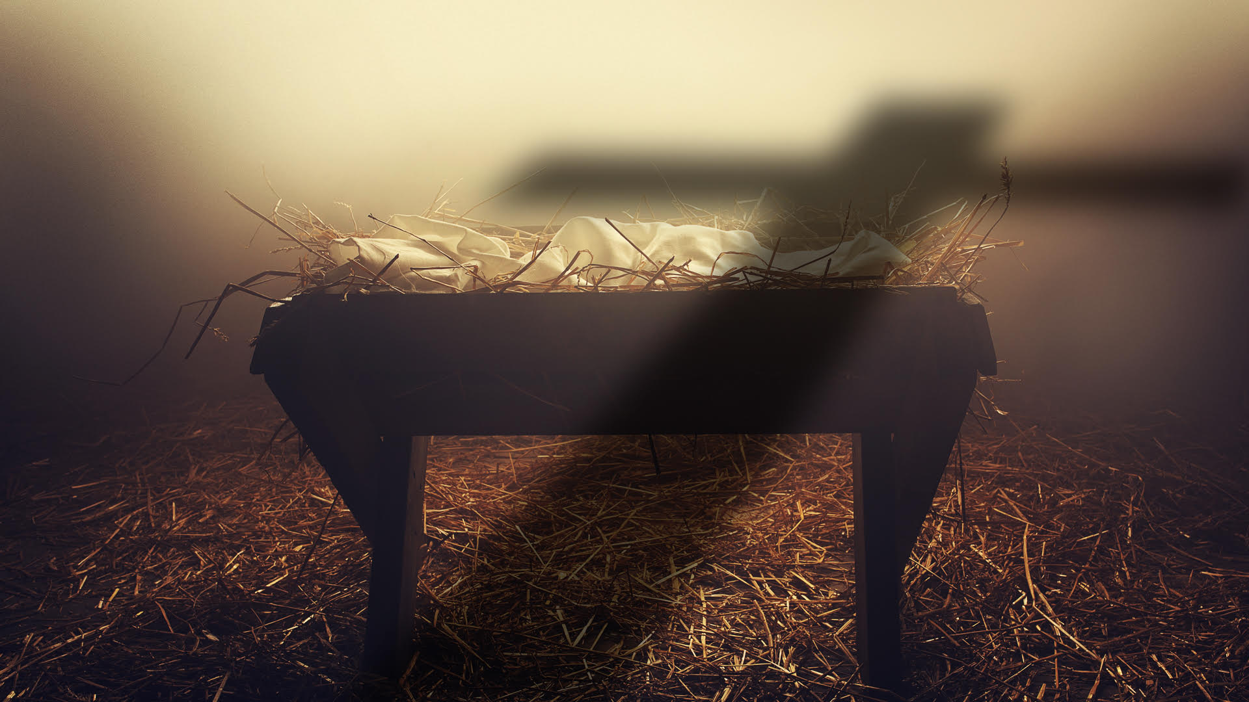

The manger scene should always be viewed under the shadow of the cross

Slide 15
The Irony of the Christmas Story
The King of kings had come to make room for the world yet the world had no room for the king.

Slide 16
And she gave birth to her firstborn son and wrapped him in swaddling cloths and laid him in a manger, because there was no place for them in the inn.
Luke 2:7

Slide 17
Where is he who has been born king of the Jews?
Matthew 2:2

Slide 18
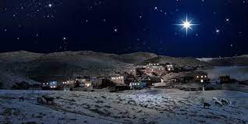
Bethlehem had no room at Christmas, in the same way Jerusalem had no room on Good Friday, in the same way many today still have no room.

Slide 19

Have you made room for Jesus in your life?

Slide 20

