Slide 1
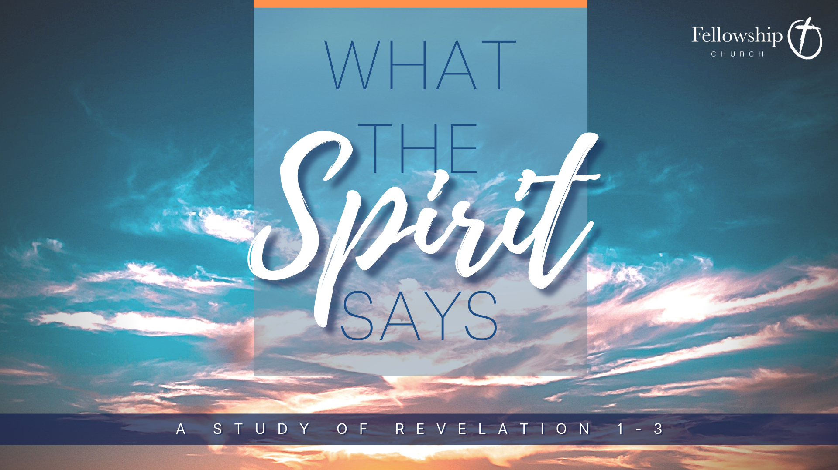

Slide 2

The Lukewarm Church | Revelation 3:14-22

Slide 3


I. A Glimpse of the Risen Christ
And to the angel of the church in Laodicea write: ‘The words of the Amen, the faithful and true witness, the beginning of God's creation.
Revelation 3:14

Slide 4
I. A Glimpse of the Risen Christ
The Amen.
Isaiah 65:16, “The God of the Amen”
Used to affirm the preceding statement
Revelation 3:14

Slide 5
I. A Glimpse of the Risen Christ
The Amen.
The faithful and true witness.
Reference to 1:5, 19:11
“Then I saw heaven opened, and behold, a white horse! The one sitting on it is called Faithful and True, and in righteousness he judges and makes war.”
Revelation 3:14

Slide 6
I. A Glimpse of the Risen Christ
The Amen.
The faithful and true witness.
The beginning of God’s creation.
Revelation 3:14

Slide 7
I. A Glimpse of the Risen Christ
Christ is not the “beginning of God’s creation” in the sense that He is the “first created thing”…
Christ is the “beginning of God’s creation” in the sense that He is the SOURCE of all of God’s creation!
Revelation 3:14

Slide 8

He is the image of the invisible God, the firstborn of all creation. For by him all things were created, in heaven and on earth, visible and invisible, whether thrones or dominions or rulers or authorities—all things were created through him and for him.
Colossians 1:15-16

Slide 9

II. Encouragement
None!

Slide 10
Laodicea
Founded in the late 3rd century and rests within the Lycus River Valley with its two sister cities, Colossae and Hierapolis.
Positioned at an intersection of three imperial trade routes.
In AD 60 an earthquake destroyed the region, but Laodicea refused imperial aid.

Slide 11
Laodicea
Prominent banking center due to being a trade center.
Sheep with glossy black wool used for fine clothing and carpets.
Advanced medical school, famous for ophthalmic therapy.

Slide 12

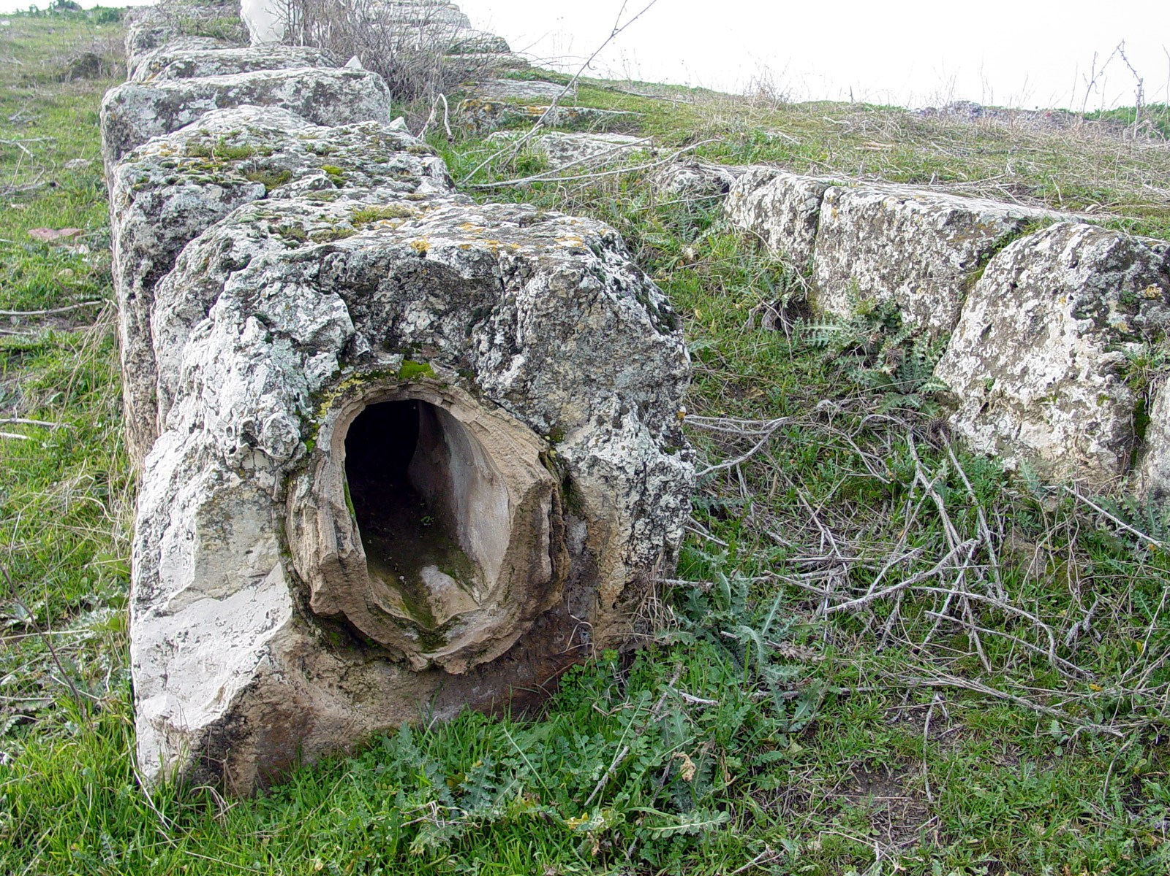
“The water supply of Laodicea was derived from an artificial pipeline, bringing water which was literally lukewarm, and so impure so as to have an emetic effect”

Slide 13
Laodicea
1. A prominent banking center
2. Fine black clothing
3. Advanced medical practices
4. Revolting water

Slide 14

¹⁵ ‘I know your works: you are neither cold nor hot. Would that you were either cold or hot! ¹⁶ So, because you are lukewarm, and neither hot nor cold, I will spit you out of my mouth. ¹⁷ For you say, I am rich, I have prospered, and I need nothing, not realizing that you are wretched, pitiable, poor, blind, and naked.
Revelation 3:15-17

Slide 15
III. Critique
Jesus knows this church
Neither cold nor hot
‘I know your works: you are neither cold nor hot. Would that you were either cold or hot!
Revelation 3:15

Slide 16
III. Critique
They are Lukewarm
So, because you are lukewarm, and neither hot nor cold, I will spit you out of my mouth.
Revelation 3:16

Slide 17

Lukewarm
For you say… | But you are…
Beautiful | Wretched
Envied | Pitied
Abounding in wealth | Poorest of all people
See enlightened truth | Blind as a rock
Clothed in fine clothing | Naked, deserving of the highest shame
Revelation 3:17

Slide 18

“You are not hot water that is useful for remedy, and you are not cold water that is useful for refreshment. You are lukewarm water, and you are revolting to me”

Slide 19
The description of the Laodiceans implies that they did not have genuine faith in Christ

Slide 20

You cannot claim Jesus as LORD, and live your life undistinguishable from the world…

Slide 21


You must no longer walk as the Gentiles do, in the futility of their minds. They are darkened in their understanding, alienated from the life of God because of the ignorance that is in them, due to their hardness of heart. They have become callous and have given themselves up to sensuality, greedy to practice every kind of impurity. But that is not the way you learned Christ!
Ephesians 4:17-20
Source

Slide 22
¹⁸ I counsel you to buy from me gold refined by fire, so that you may be rich, and white garments so that you may clothe yourself and the shame of your nakedness may not be seen, and salve to anoint your eyes, so that you may see. ¹⁹ Those whom I love, I reprove and discipline, so be zealous and repent.
Revelation 3:18-19

Slide 23
1. Gold refined by fire
Contrasts their sense of wealth from their banking
Symbolizes all the spiritual blessings that come from Christ!
“I counsel you to buy from me gold refined by fire, so that you may be rich”
Revelation 3:18

Slide 24
2. White garments
Contrasts their clothing business
Symbolizes the righteousness of the saints!
“I counsel you to buy from me… white garments so that you may clothe yourself and the shame of your nakedness may not be seen”
Revelation 3:18

Slide 25

λευκὰ (leuka)
Λευκός:
Dazzling, Bright white

Slide 26
3. Eye salve
Contrasts their medical practices
Symbolizes the understanding of the truth of God that comes from the Spirit through faith!
“I counsel you to buy from me… salve to anoint your eyes, so that you may see.
Revelation 3:18

Slide 27
IV. Correction
Christ LOVES these people!
Be zealous and repent!
Those whom I love, I reprove and discipline, so be zealous and repent.
Revelation 3:19

Slide 28
IV. Correction
The cure for lukewarmness is genuine faith and repentance that results in an intimate relationship with God!
Revelation 3:18-19

Slide 29
V. Promise
²⁰ Behold, I stand at the door and knock. If anyone hears my voice and opens the door, I will come in to him and eat with him, and he with me.
Revelation 3:20

Slide 30
God not only desires for intimacy with His people…
He also desires that we would experience a willful choice of that intimacy!

Slide 31
V. Promise
²¹ The one who conquers, I will grant him to sit with me on my throne, as I also conquered and sat down with my Father on his throne. ²² He who has an ear, let him hear what the Spirit says to the churches.’
Revelation 3:21-22

Slide 32
V. Promise
If we take the offer for intimacy with Christ here on earth, we will have a deeper intimacy with Him in heaven.
Revelation 3:21

Slide 33
“He who has an ear, let him hear what the Spirit says to the churches”
Revelation 3:22

Slide 34
Application
Self-sufficiency has become one of our “acceptable sins”, and is a breeding ground for a lack of dependency on God.

Slide 35
Application
Self-sufficiency has become one of our “acceptable sins”, and is a breeding ground for a lack of dependency on God.
God desires to have an intimate relationship with His people

