Slide 1

What God Has Done
Celebration Service & Open House
October 3, 2021

Slide 2
Thank You!

Slide 3
Now therefore in the sight of all Israel, the assembly of the Lord, and in the hearing of our God, observe and seek out all the commandments of the Lord your God, that you may possess this good land and leave it for an inheritance to your children after you forever.
1 Chronicles 28:8

Slide 4
What God Has Done
God changed the heart of our church in regard to money, stewardship, generosity and sacrificial giving.
The earth is the Lord’s, and everything in it, the world, and all who live in it…
Psalm 24:1

Slide 5
Do not lay up for yourselves treasures on earth, where moth and rust destroy and where thieves break in and steal, 20 but lay up for yourselves treasures in heaven, where neither moth nor rust destroys and where thieves do not break in and steal. 21 For where your treasure is, there your heart will be also.
Matthew 6:19-21

Slide 6
What God Has Done
God increased our faith and dependence on himself.
for we walk by faith, not by sight…
2 Corinthians 5:7

Slide 7
What God Has Done
God increased our faith and dependence on himself.
the life I now live in the flesh I live by faith in the Son of God, who loved me and gave himself for me.
Galatians 2:20

Slide 8
What God Has Done
God unified our church.
eager to maintain the unity of Spirit in the bond of peace.
Ephesians 4:3

Slide 9
What God Has Done
God invited new people into the church to join us on this exciting ministry journey.

Slide 10
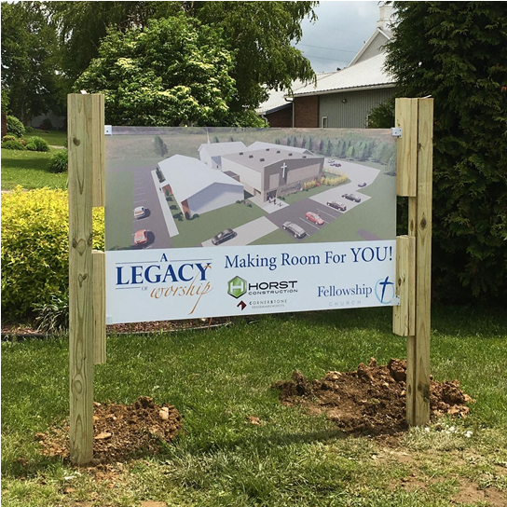
Making Room For You!

Slide 11
What God Has Done
God invited new people into the church to join us on this exciting ministry journey.

Slide 12
What God Has Done
God has once again proven himself to be faithful to us – as he always does!
God is faithful, by whom you were called into the fellowship of his Son, Jesus Christ our Lord.
1 Corinthians 1:9

Slide 13
What God Has Done
God has once again proven himself to be faithful to us – as he always does!
if we are faithless, he remains faithful
2 Timothy 2:13

Slide 14
Lord, you are my God; I will exalt you and praise your name, for in perfect faithfulness you have done wonderful things, things planned long ago.
Isaiah 25:1

Slide 15


