Slide 1
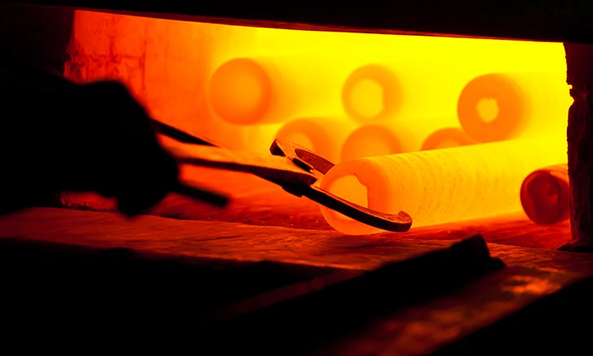

HOPE & SUFFERING
Romans 5:1-5

Slide 2
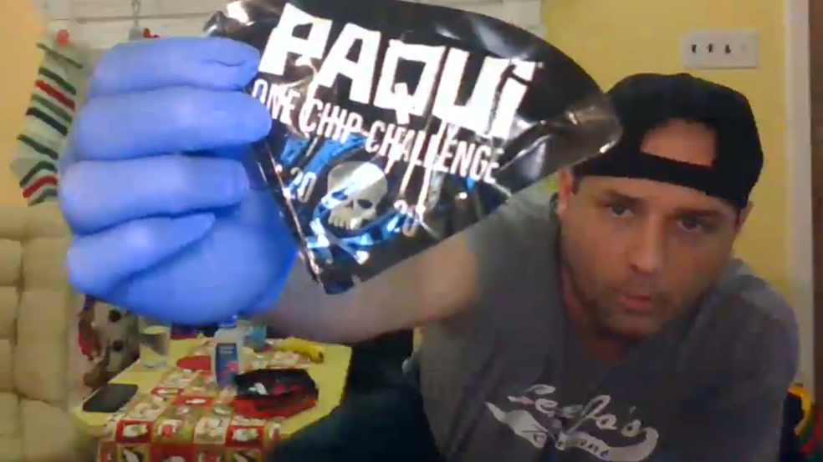
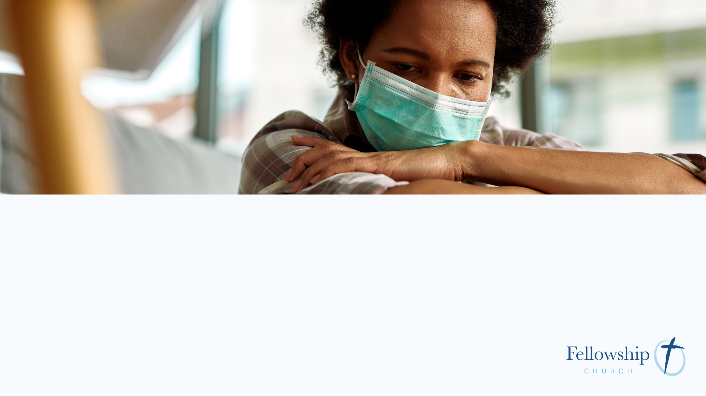
62%
Statistic information
Reference

Slide 3
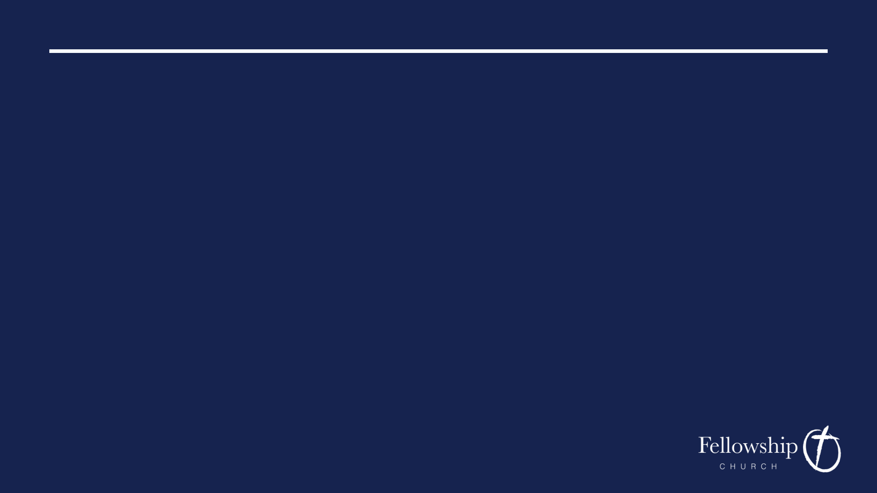
Therefore, since we have been justified by faith, we have peace with God through our Lord Jesus Christ.
ROMANS 5:1

Slide 4
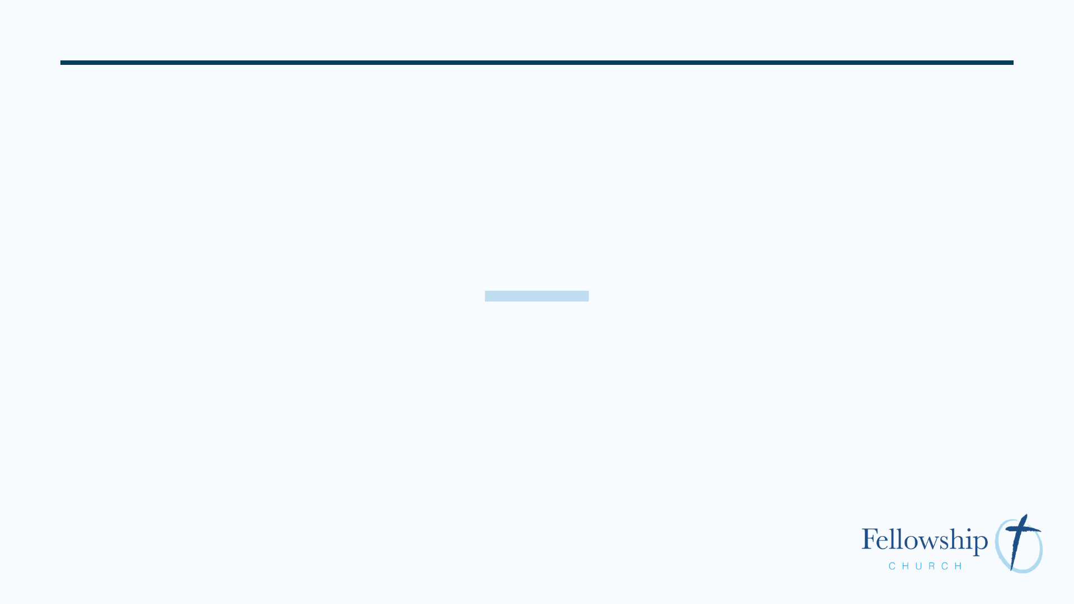
Justification
because of Christ, we stand before God forgiven for all our sins; declared righteous

Slide 5
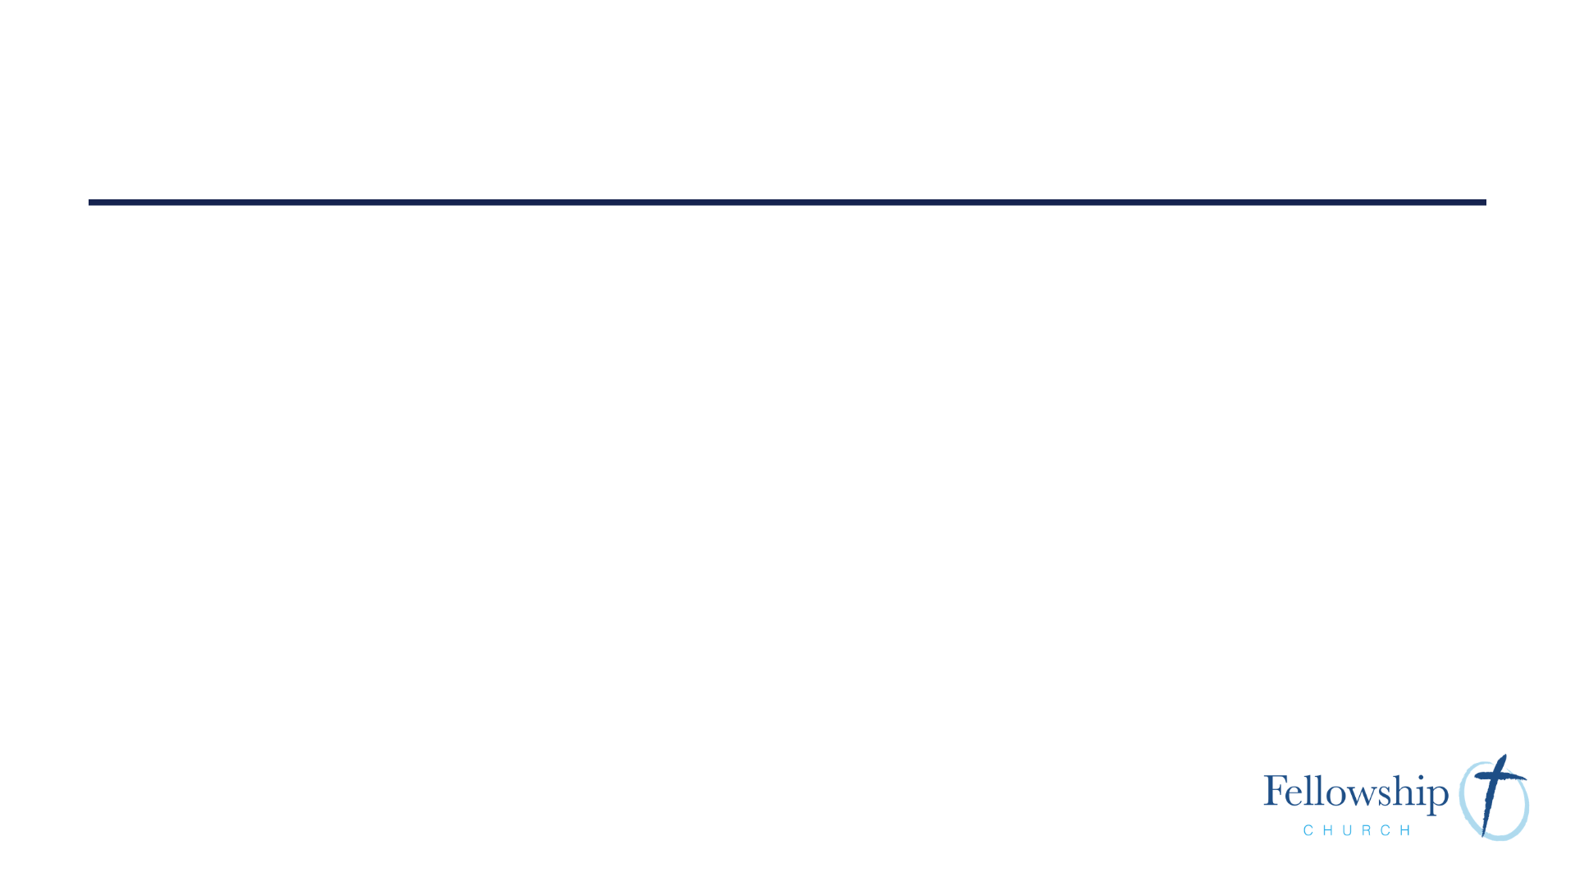
3 blessings for believers
peace with God
access to grace
hope of glory

Slide 6

Peace with God
does not mean
we won’t have
difficulty in this life

Slide 7
Through him we have also obtained access by faith into this grace in which we stand
ROMANS 5:2

Slide 8
Grace
God’s unmerited favor

Slide 9
kau-cha-o-mai
to boast
a triumphant, rejoicing, confidence

Slide 10
Hope
confident expectancy

Slide 11
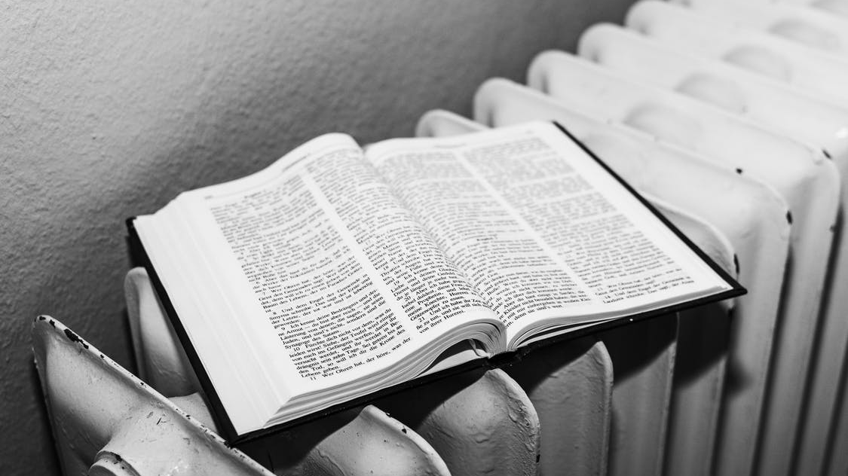
Real hope is a firm assurance in what God has promised

Slide 12
Not only that, but we rejoice in our sufferings, knowing that suffering produces endurance, and endurance produces character, and character produces hope
ROMANS 5:3-4

Slide 13

We look beyond the suffering to the victory that is ours

Slide 14
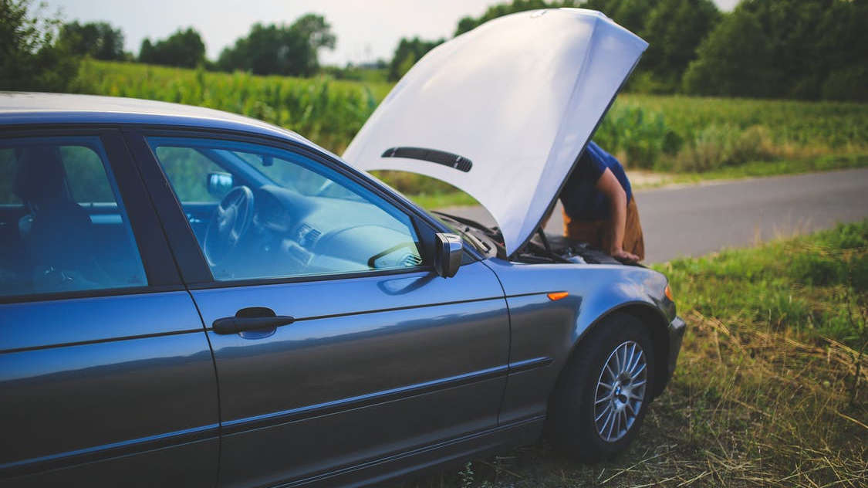
Sufferings are defined not by what they are but how they test your faith

Slide 15
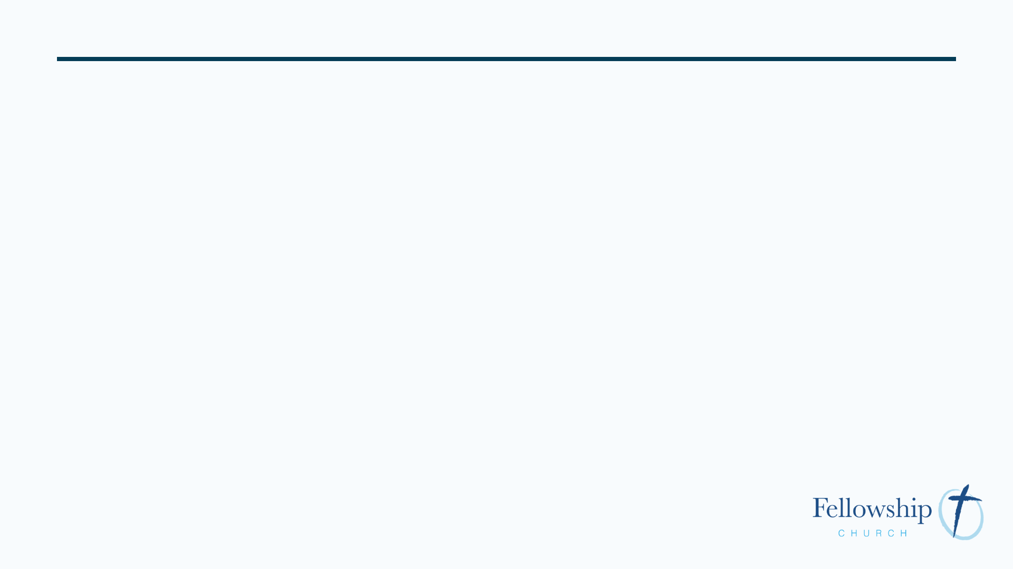
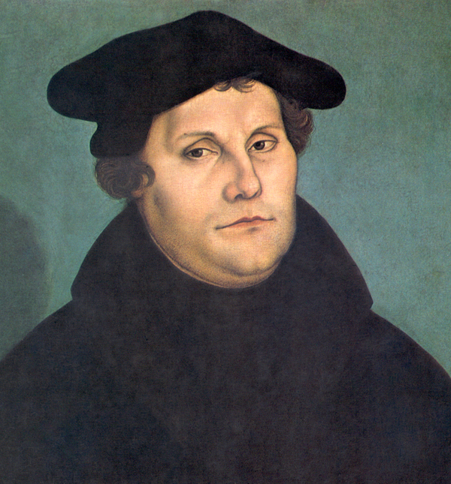
Whatever virtues tribulation finds us in, it develops more fully. If anyone is carnal, weak, blind, wicked, irascible, haughty, and so forth, tribulation will make him more carnal, weak, blind, wicked and irritable. On the other hand, if one is spiritual, strong, wise, pious, gentle and humble, he will become more spiritual, powerful, wise, pious, gentle and humble.
Martin Luther

Slide 16
Perseverance
steadfast effort to follow God’s commands

Slide 17
Character
approved, tried, genuine

Slide 18
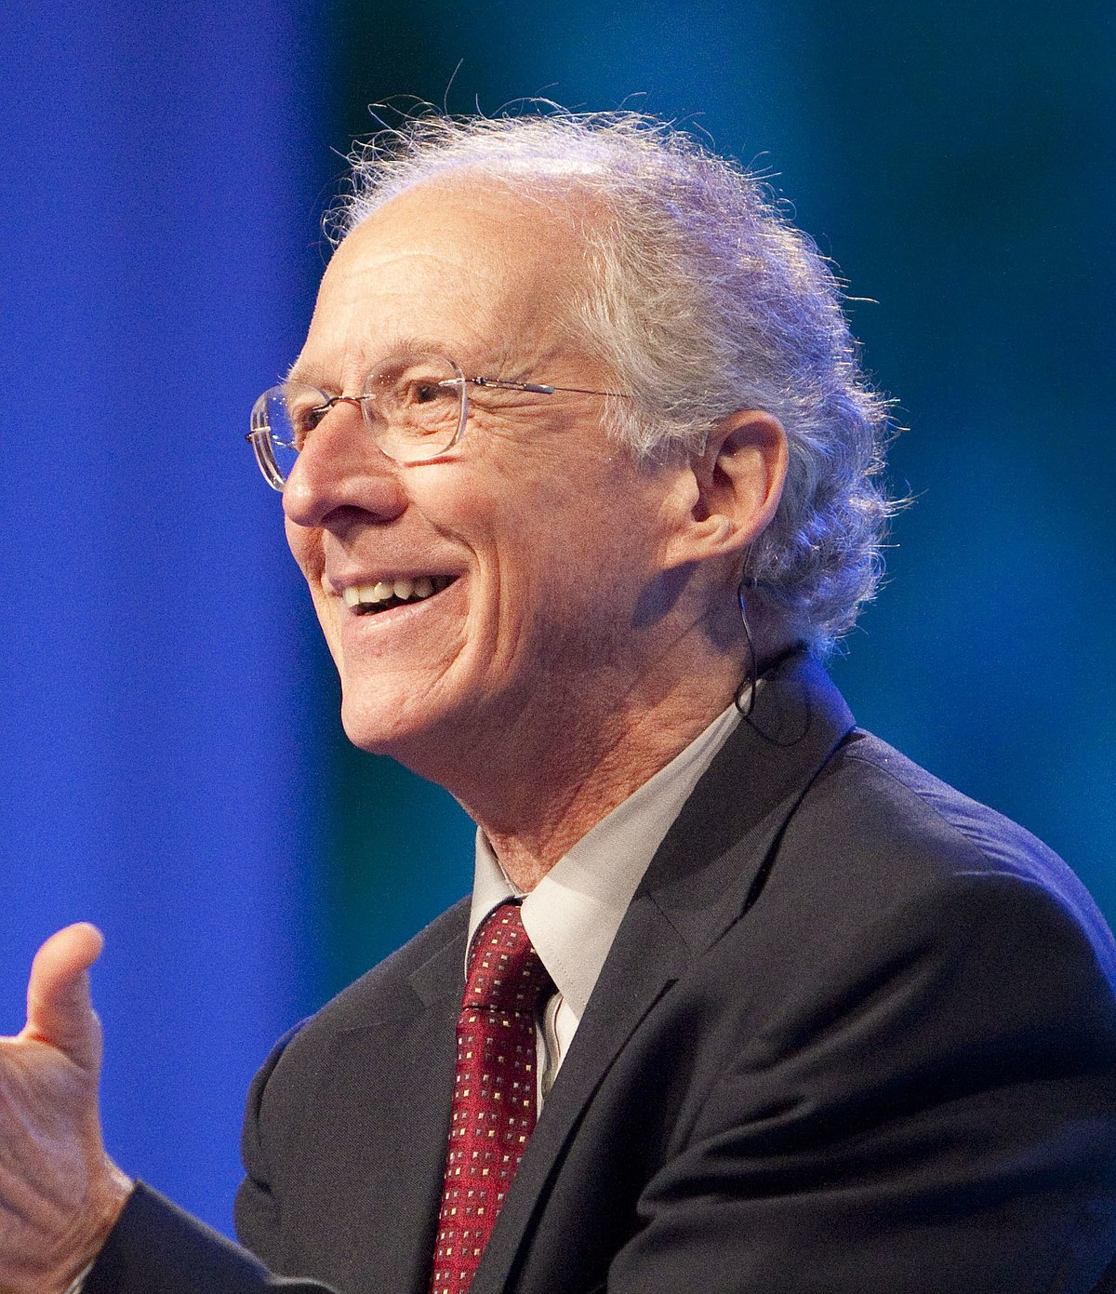
What gets us through tribulation is hope. We don’t first get hope by producing perseverance and proven character. We have hope first, and only then can we endure trials to the glory of God.
John Piper

Slide 19
hope does not put to shame because God’s love has been poured into out hearts through the Holy Spirit who has been given to us.
ROMANS 5:5

Slide 20
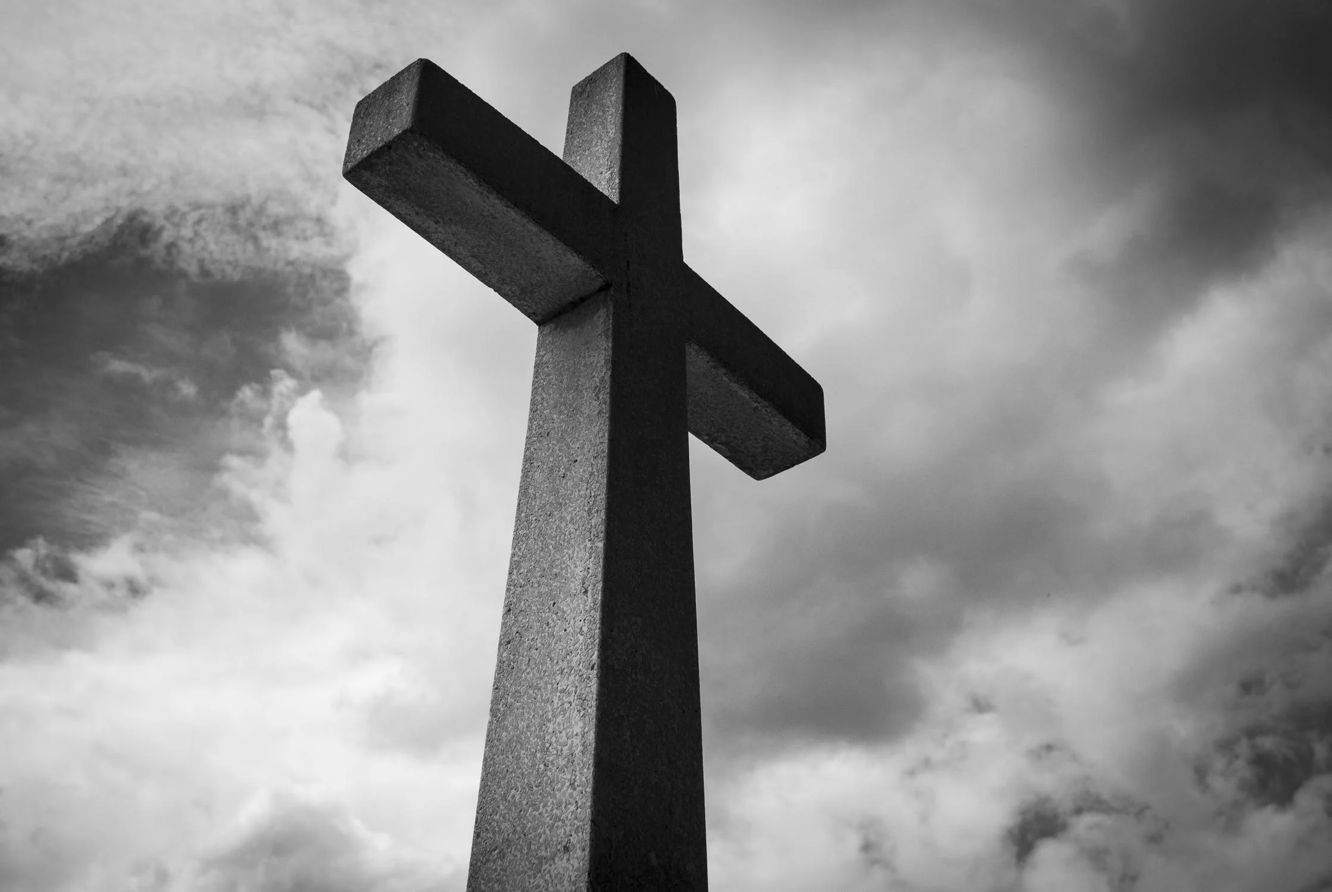
Jesus is the only hope that does not disappoint

Slide 21
God’s love in our hearts is evidence for the hope that we have

Slide 22
1. Rejoice in Suffering
“So we do not lose heart. Though our outer self is wasting away, our inner self is being renewed day by day. For this light momentary affliction is preparing for us an eternal weight of glory beyond all comparison, as we look not to the things that are seen but to the things that are unseen. For the things that are seen are transient, but the things that are unseen are eternal.”
2 Corinthians 4:16-18

Slide 23
1. Rejoice in Suffering
“I consider that our present sufferings are not worth comparing with the glory that will be revealed in us.”
Romans 8:18

Slide 24
2. Remember God’s Love
“For while we were still weak, at the right time Christ died for the ungodly. For one will scarcely die for a righteous person—though perhaps for a good person one would dare even to die—but God shows his love for us in that while we were still sinners, Christ died for us. Since, therefore, we have now been justified by his blood, much more shall we be saved by him from the ^{wrath of God.”}
Romans 5:6-9

Slide 25
3. Replicate the Savior
“If they persecuted me they will persecute you.”
John 15:20

Slide 26
3. Replicate the Savior
“But whatever gain I had, I counted as loss for the sake of Christ. Indeed, I count everything as loss because of the surpassing worth of knowing Christ Jesus my Lord. For his sake I have suffered the loss of all things and count them as rubbish, in order that I may gain Christ and be found in him, not having a righteousness of my own that comes from the law, but that which comes through faith in Christ, the righteousness from God that depends on faith—that I may know him and the power of his resurrection, and may share his sufferings, becoming like him in his death.”
Philippians 3:7-10

Slide 27
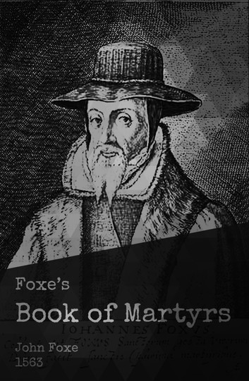
Suffer my child! anon thou shalt pass to him that will adorn thy naked head with a crown of eternal glory.

