Slide 1


Slide 2


Slide 3
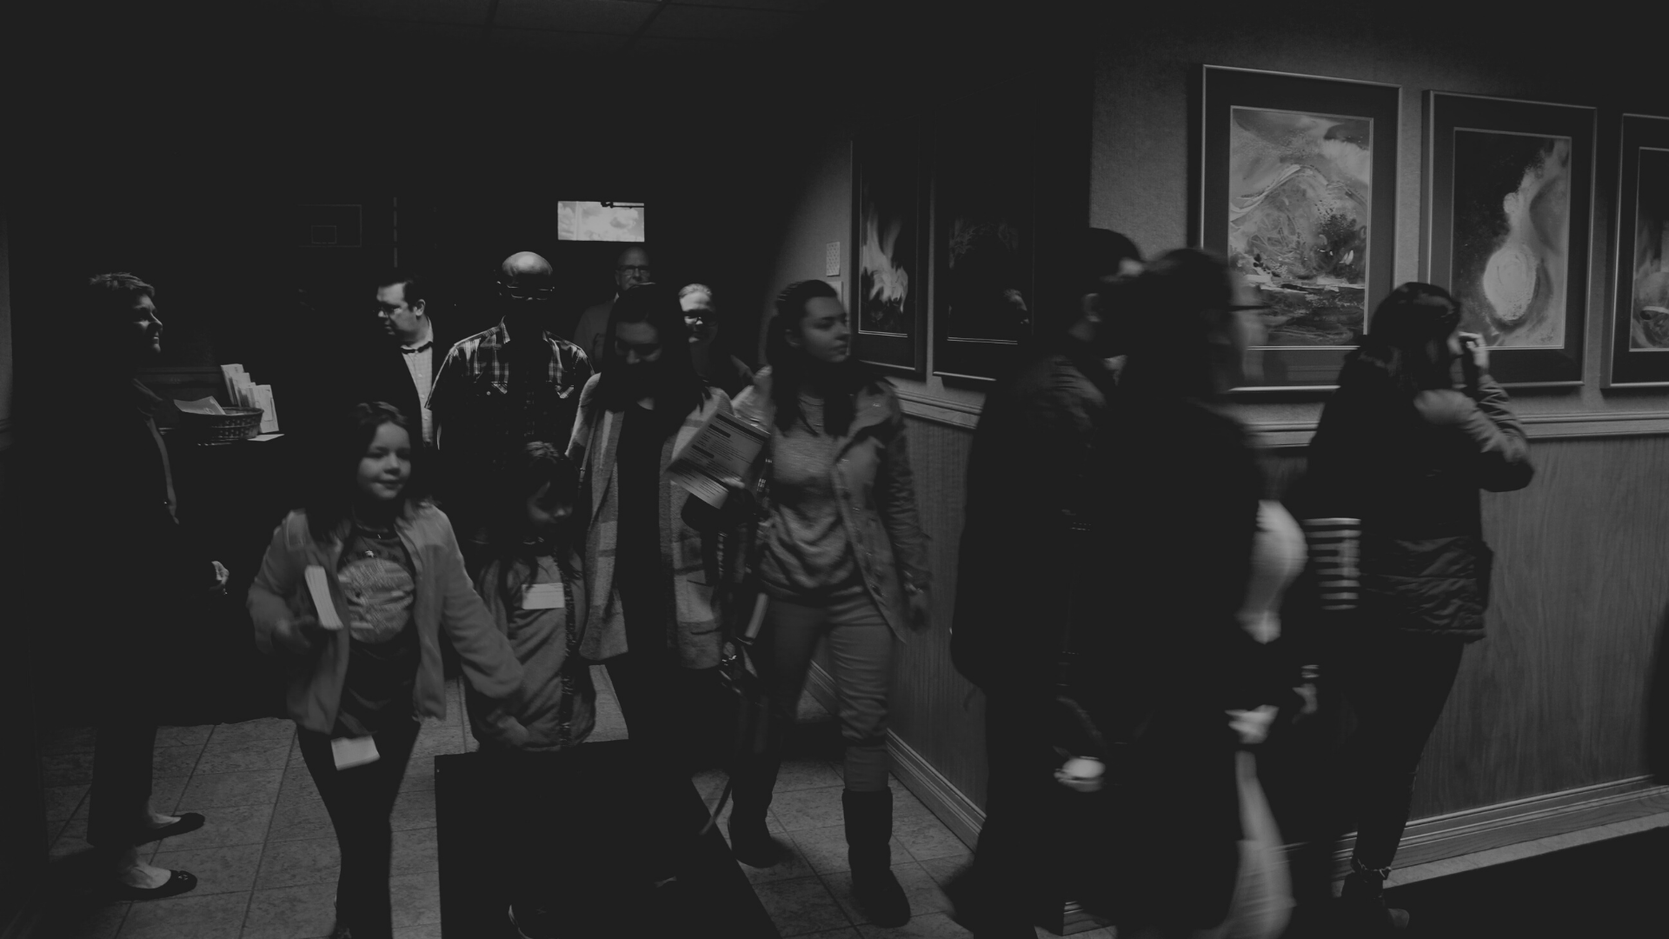

What is Ministry Mobilization?
Key point of emphasis

Slide 4
Mobilization is our intentional emphasis on identifying the skills, talents, abilities and gifts of our people, then mobilizing those people for ministry service according to their respective talents, abilities and gifts.
Key point of emphasis

Slide 5


Slide 6

As each has received a gift, use it to serve one another, as good stewards of God's varied grace: 11 whoever speaks, as one who speaks oracles of God; whoever serves, as one who serves by the strength that God supplies—in order that in everything God may be glorified through Jesus Christ. To him belong glory and dominion forever and ever. Amen.
1 Peter 4:10-11

Slide 7
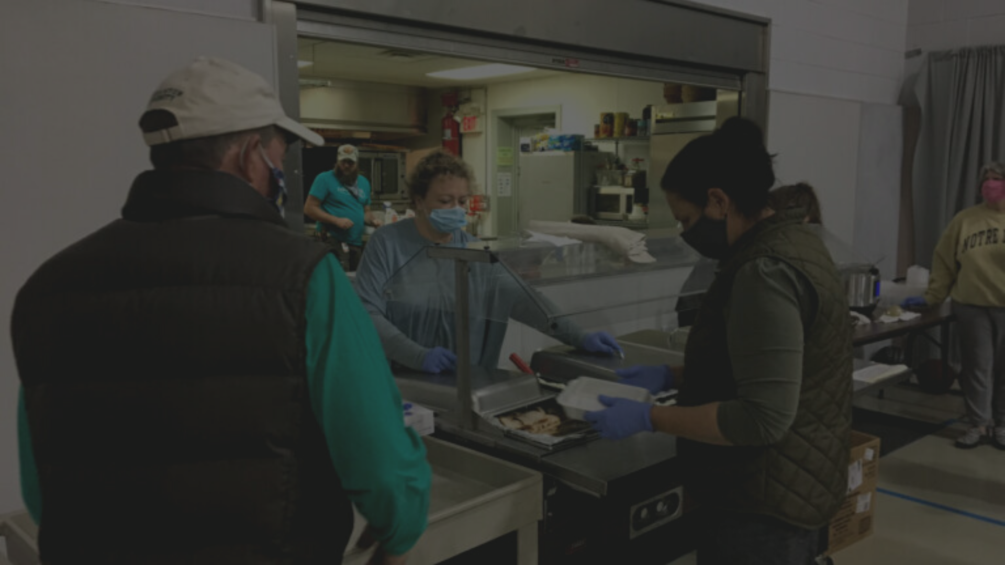
Do you want to be a good steward of the grace that God has given to you?
Key point of emphasis

Slide 8
Then use the gifts he has given you to serve…
serve one another,
serve the Lord,
serve the Lord’s church.
Key point of emphasis

Slide 9

Qualifications to Serve
Faithful
~ Loyal, steadfast in allegiance, reliable.
One who is faithful in a very little is also faithful in much, and one who is dishonest in a very little is also dishonest in much.
Luke 16:10

Slide 10

Faithful
We love when people are faithful! Like our tech team every Sunday morning.

Slide 11
Qualifications to Serve
Available
~ ready for use, accessible, at someone’s disposal.
And I heard the voice of the Lord saying, “Whom shall I send, and who will go for us?” Then I said, “Here I am! Send me.”
Isaiah 6:8

Slide 12
Make availability a priority in your life!
Key point of emphasis

Slide 13
Your stage of life should not determine if you serve, it should only clarify where and how you serve.
Key point of emphasis

Slide 14

Available
We love when people are available, just like our parking team!

Slide 15
Qualifications to Serve
Teachable
~ willing to learn, receive instruction and correction.
All Scripture is breathed out by God and profitable for teaching, for reproof, for correction, and for training in righteousness, 17 that the man of God may be complete, equipped for every good work.
2 Timothy 3:16-17

Slide 16

Teachable
We love when people are teachable, just like our TLC students!

Slide 17
Faithful
Available
Teachable
Key point of emphasis

Slide 18
Faithful
Being faithful makes it possible for others to trust you.

Slide 19
Available
Being available makes it possible for people to depend on you.

Slide 20
Teachable
Being teachable makes it possible for people to serve joyfully with you.

Slide 21

Which of these is problematic for you?
Faithful Available Teachable

Slide 22
Will you commit to finding a place to serve the Lord and his church in 2021?

Slide 23
As each has received a gift, use it to serve one another, as good stewards of God's varied grace: 11 whoever speaks, as one who speaks oracles of God; whoever serves, as one who serves by the strength that God supplies—in order that in everything God may be glorified through Jesus Christ. To him belong glory and dominion forever and ever. Amen.
1 Peter 4:10-11

