Slide 1
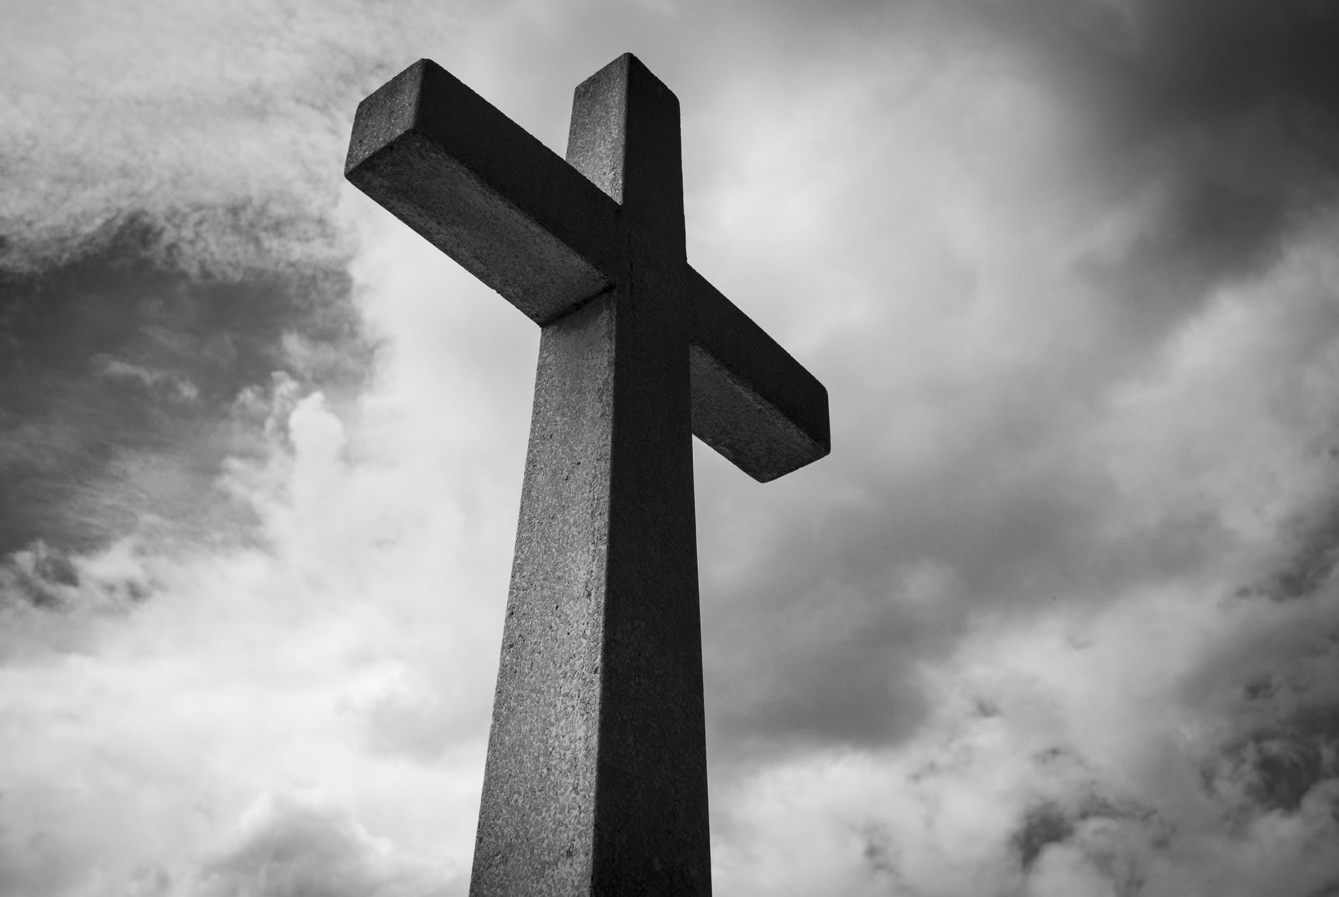

Grateful
Hebrews 12:25-29

Slide 2
What are you thankful for?

Slide 3
Hebrews 12:28
Therefore let us be grateful for receiving a kingdom that cannot be shaken…

Slide 4
Hebrews 12:18-21
For you have not come to what may be touched, a blazing fire and darkness and gloom and a tempest and the sound of a trumpet and a voice whose words made the hearers beg that no further messages be spoken to them. For they could not endure the order that was given, “If even a beast touches the mountain, it shall be stoned.” Indeed, so terrifying was the sight that Moses said, “I tremble with fear.”

Slide 5
Exodus 19:16-19
On the morning of the third day there were thunders and lightnings and a thick cloud on the mountain and a very loud trumpet blast, so that all the people in the camp trembled. Then Moses brought the people out of the camp to meet God, and they took their stand at the foot of the mountain. Now Mount Sinai was wrapped in smoke because the Lord had descended on it in fire. The smoke of it went up like the smoke of a kiln, and the whole mountain trembled greatly. And as the sound of the trumpet grew louder and louder, Moses spoke, and God answered him in thunder.

Slide 6
Exodus 20:1-3
And God spoke all these words, saying,
I am the Lord your God, who brought you out of the land of Egypt, out of the house of slavery.
You shall have no other gods before me…

Slide 7
Hebrews 12:22-24
But you have come to Mount Zion and to the city of the living God, the heavenly Jerusalem, and to innumerable angels in festal gathering, and to the assembly of the firstborn who are enrolled in heaven, and to God, the judge of all, and to the spirits of the righteous made perfect, and to Jesus, the mediator of a new covenant, and to the sprinkled blood that speaks a better word than the blood of Abel.

Slide 8
Hebrews 12:25-27
See that you do not refuse him who is speaking...

Slide 9
Hebrews 12:25-27
See that you do not refuse him who is speaking. For if they did not escape when they refused him who warned them on earth, much less will we escape if we reject him who warns from heaven…

Slide 10
Hebrews 12:25-27
At that time his voice shook the earth, but now he has promised, “Yet once more I will shake not only the earth but also the heavens.” This phrase, “Yet once more,” indicates the removal of things that are shaken—that is, things that have been made—in order that the things that cannot be shaken may remain.

Slide 11
Hebrews 12:28
Therefore let us be grateful for receiving a kingdom that cannot be shaken…

Slide 12
Hebrews 12:28,29
Therefore let us be grateful for receiving a kingdom that cannot be shaken, and thus let us offer to God acceptable worship, with reverence and awe, for our God is a consuming fire.

Slide 13
Hebrews 12:24
…Jesus, the mediator of a new covenant, and to the sprinkled blood that speaks a better word than the blood of Abel.

Slide 14
Hebrews 12:28,29
Therefore let us be grateful for receiving a kingdom that cannot be shaken, and thus let us offer to God acceptable worship, with reverence and awe, for our God is a consuming fire.

Slide 15
Hebrews 12:28,29
Therefore let us be grateful for receiving a kingdom that cannot be shaken, and thus let us offer to God acceptable worship, with reverence and awe, for our God is a consuming fire.

Slide 17
Habakkuk 3:17,18
Though the fig tree should not blossom,
nor fruit be on the vines,
the produce of the olive fail
and the fields yield no food,
the flock be cut off from the fold
and there be no herd in the stalls,
yet I will rejoice in the Lord;
I will take joy in the God of my salvation.

