Slide 1
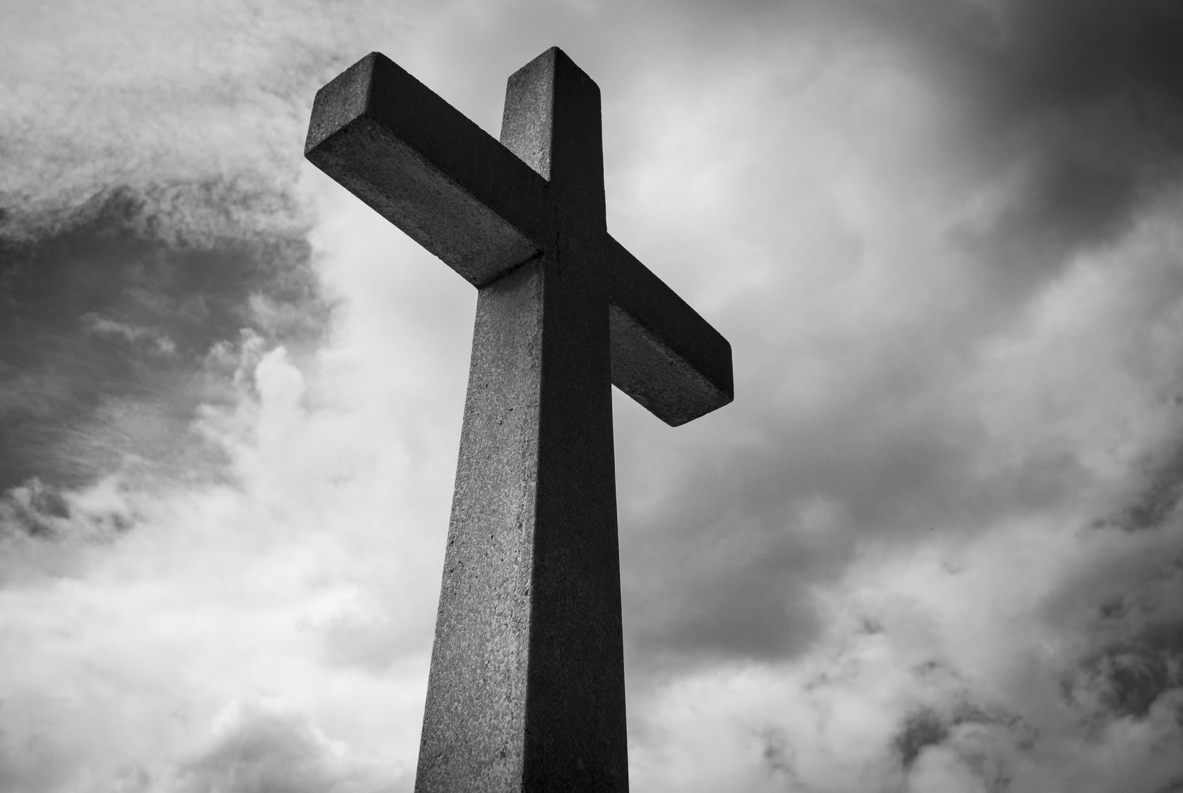

Gospel Unity Ephesians 4:11-16

Slide 2
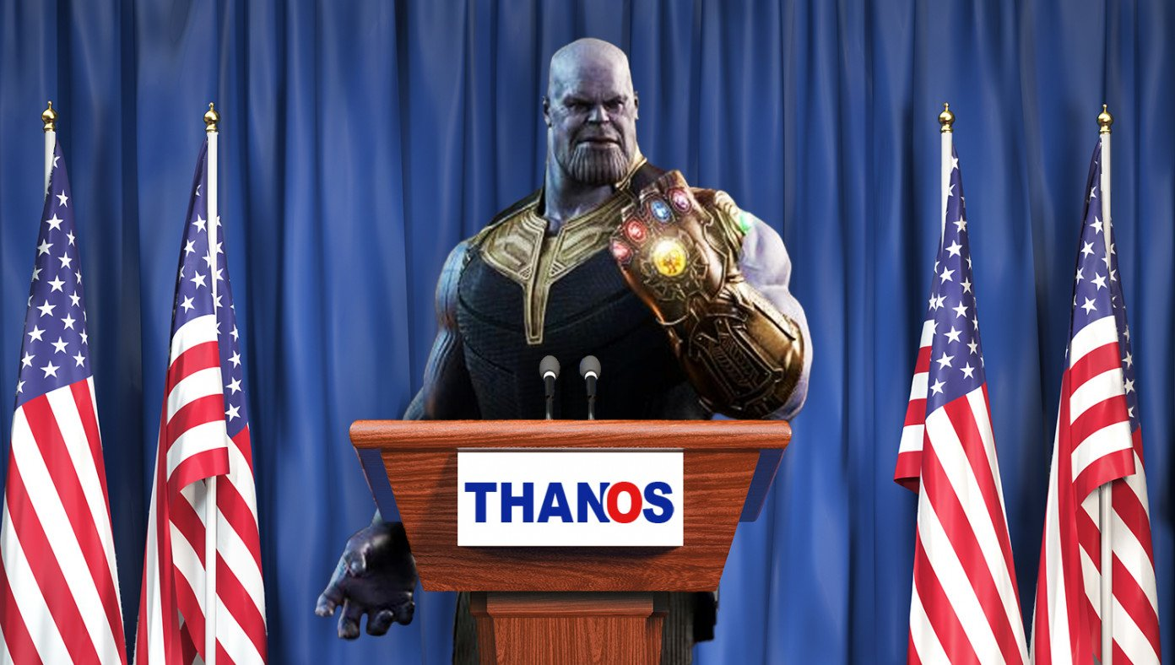
After Wiping Out Half The Universe, Thanos Calls For Unity

Slide 3
Gospel Unity Ephesians 4:11-16

Slide 4
And he gave the apostles, the prophets, the evangelists, the shepherds and teachers, 12 to equip the saints for the work of ministry, for building up the body of Christ, 13 until we all attain to the unity of the faith and of the knowledge of the Son of God, to mature manhood, to the measure of the stature of the fullness of Christ…
Ephesians 4:11-13

Slide 5
Two Pillars of Biblical Unity
Unity in the true gospel.
Unity in the person and work of Jesus Christ.
until we all attain to the unity of the faith and of the knowledge of the Son of God…
Ephesians 4:13

Slide 6
Unity At All Costs?
If one or both of these two pillars is missing, should we expect unity to remain?
No!

Slide 7
What about agreeing to disagree?

Slide 8
What about agreeing to disagree?
We cannot agree to disagree when it comes to gospel matters, or matters that impact the person and work of Christ, and then somehow call that unity.

Slide 9
Who creates the unity among believers?
The Spirit of God.
I therefore, a prisoner for the Lord, urge you to walk in a manner worthy of the calling to which you have been called, 2 with all humility and gentleness, with patience, bearing with one another in love, 3 eager to maintain the unity of the Spirit in the bond of peace.
Ephesians 4:1-3

Slide 10
Gospel Unity
The church never becomes more unified by becoming less faithful to the biblical gospel.
We don’t achieve more gospel unity with less gospel fidelity.
It is our compromise in gospel matters that is creating the division and disunity we want so much to avoid.

Slide 11
The Result of this Kind of Faithful Unity
Christ-like maturity
until we all attain to the unity of the faith and of the knowledge of the Son of God, to mature manhood, to the measure of the stature of the fullness of Christ…
Ephesians 4:13

Slide 12
What Does True Biblical Unity Protect us From?
It protects us from threats to gospel unity.

Slide 13
Threats to Gospel Unity
This gospel unity protects us from remaining as spiritually immature infants.
so that we may no longer be children… (NIV-infants)
Ephesians 4:14

Slide 14
Threats to Gospel Unity
This gospel unity protects us from being easily swayed and moved by every new wind of doctrine.
so that we may no longer be children, tossed to and fro by the waves and carried about by every wind of doctrine…
Ephesians 4:14

Slide 15
Threats to Gospel Unity
This gospel unity protects us from being easily deceived by the cunning and craftiness of others.
so that we may no longer be children, tossed to and fro by the waves and carried about by every wind of doctrine, by human cunning, by craftiness in deceitful schemes.
Ephesians 4:14

Slide 16
Instead of ….
Compromising on the gospel or Christ and sacrificing our unity.
Being tossed around by every new wind of teaching you hear.
Being easily deceived by human craftiness and cunning.
Instead of all that, do this…

Slide 17
Instead of all that….Do This!
Speak the Truth in Love!
Rather, speaking the truth in love, we are to grow up in every way into him who is the head, into Christ…
Ephesians 4:15

Slide 18
A Call to Gospel Unity
So yes, let us unite, but let us unite around the true gospel, let us unite around the person and work of Christ as revealed in the scripture, not as revealed in the culture!
The church will never become more unified by becoming less faithful to the biblical gospel and we will never achieve more gospel unity with less gospel fidelity.

