Slide 1


Slide 2
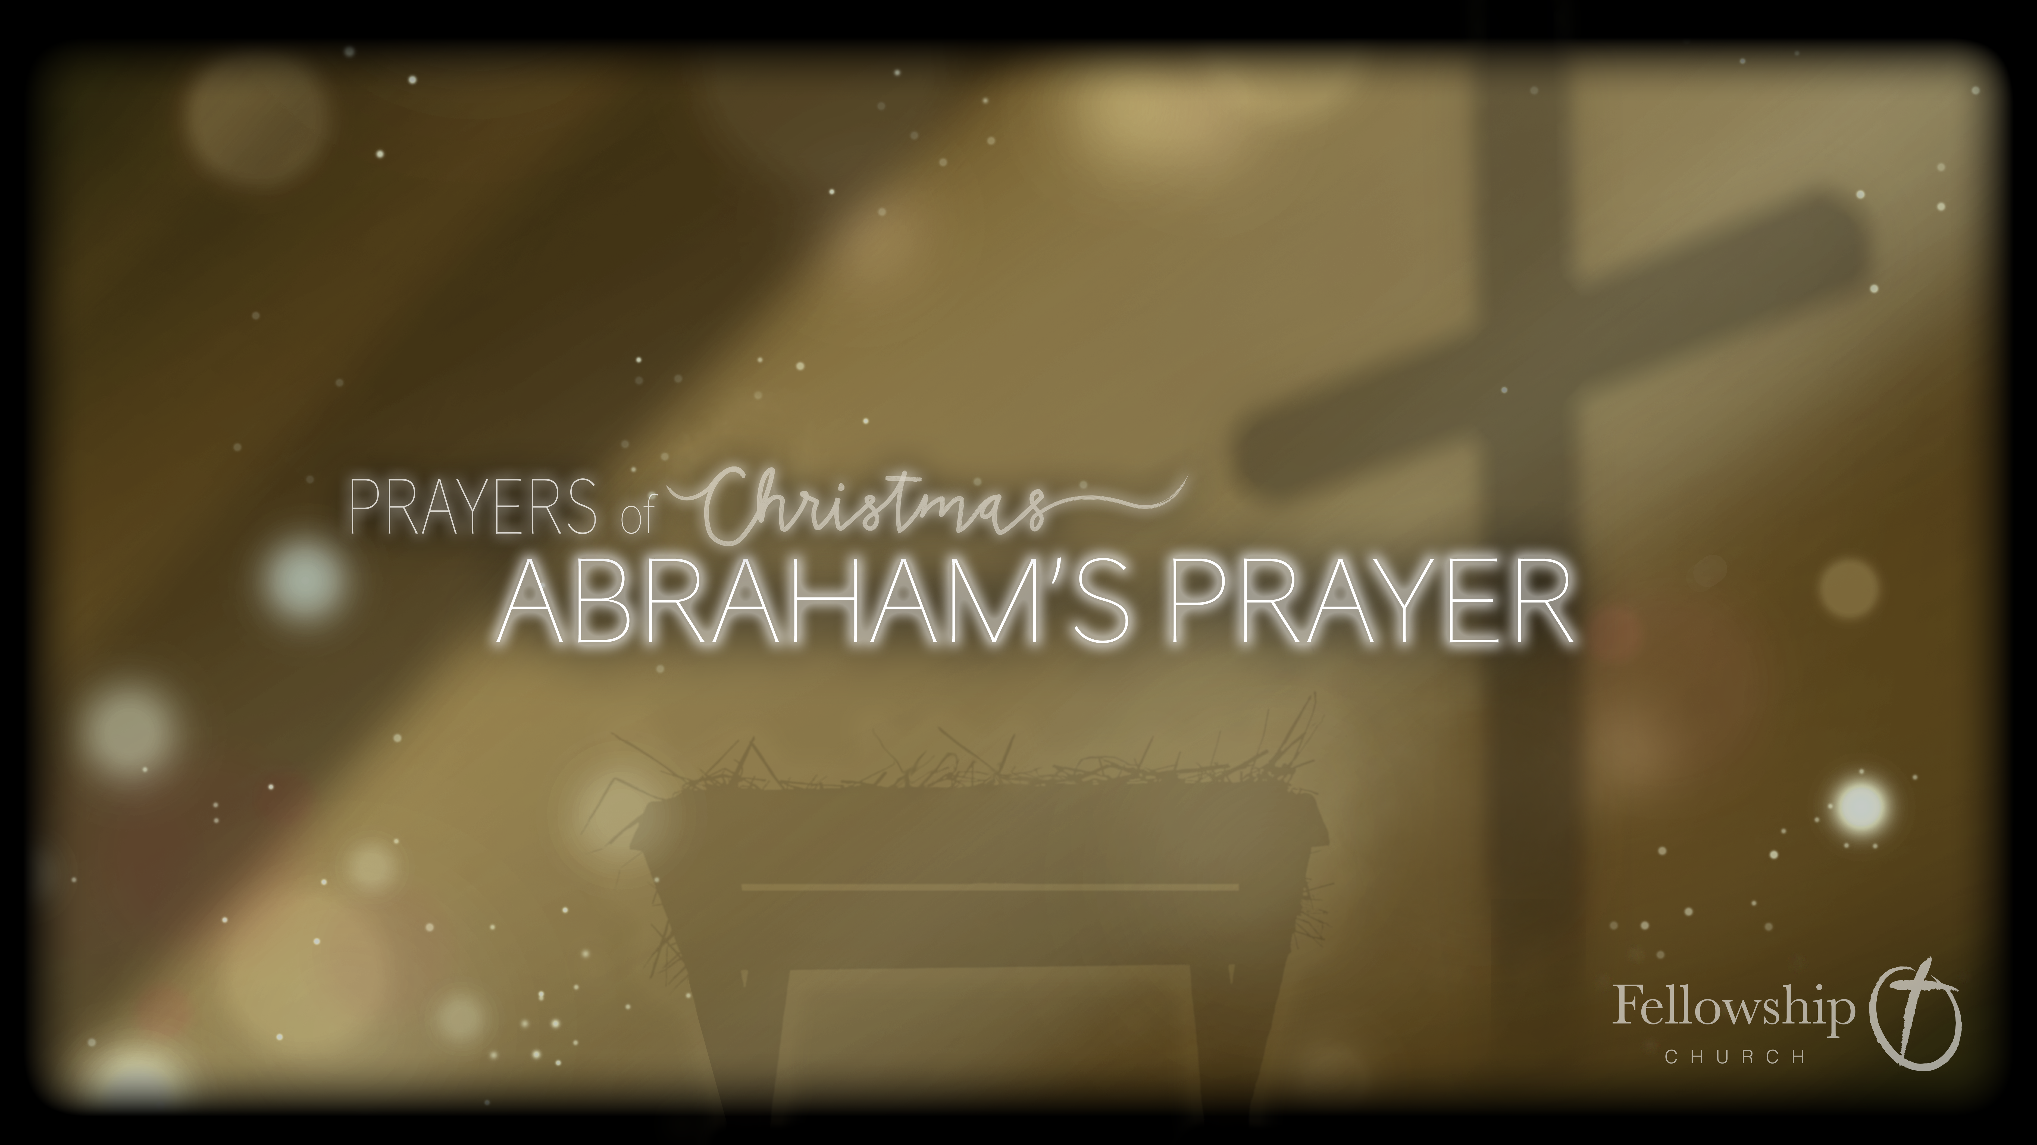

Slide 3
Genesis
Genesis 1-11 covers numerous generations.
By chapter 7 the great flood has occurred.
Chapter 11 ends with the descendants of Noah being listed.

Slide 4
Abram
Shem, Noah’s son, had a future descendant named Terah.
Terah had three sons, one of those sons was a man named Abram.
Abram was born in Ur of the Chaldeans, Ur was an ancient city in modern day Iraq.
Abram’s family left Ur to go to Canaan, they stopped in Haran and settled there.
Abram was married to Sarai.
Terah, Abram’s father, died in Haran

Slide 5
God’s Call on Abram
Leave everything you have ever known and go where I tell you to go.
Now the Lord said to Abram, “Go from your country and your kindred and your father's house to the land that I will show you.”
Genesis 12:1

Slide 6
God’s Promise
And I will make of you a great nation, and I will bless you and make your name great, so that you will be a blessing. 3 I will bless those who bless you, and him who dishonors you I will curse, and in you all the families of the earth shall be blessed.
Genesis 12:2-3

Slide 7
What Does God Promise to Abram?
1) A promise of land
2) A promise of a new and great nation
And I will make of you a great nation, and I will bless you and make your name great…
Genesis 12:2

Slide 8
What Does God Promise to Abram?
1) A promise of land
2) A promise of a new and great nation
3) A promise of blessing
I will bless those who bless you, and him who dishonors you I will curse, and in you all the families of the earth shall be blessed.
Genesis 12:3

Slide 9
What Did Abram Do?
Abram left his family
So Abram went, as the Lord had told him...
Genesis 12:4

Slide 10
Genesis 15

Slide 11
Genesis 15
After these things the word of the Lord came to Abram in a vision: “Fear not, Abram, I am your shield; your reward shall be very great.”
Genesis 15:1

Slide 12
Abram’s Prayer
1) Your promise of an heir remains unfulfilled
But Abram said, “O Lord God, what will you give me, for I continue childless, and the heir of my house is Eliezer of Damascus?”
Genesis 15:2

Slide 13
Abram’s Prayer
Your promise of an heir remains unfulfilled
Do I need to fulfill the promise myself?
And Abram said, “Behold, you have given me no offspring, and a member of my household will be my heir.”
Genesis 15:3

Slide 14
God Answers Abram’s Prayer
Your servant is not the promised one.
Your very own son will be your heir.
And behold, the word of the Lord came to him: “This man shall not be your heir; your very own son shall be your heir.”
Genesis 15:4

Slide 15
God Answers Abram’s Prayer
Your servant is not the promised one.
Your very own son will be your heir.
Look toward heaven and number the stars – if you can – so shall your descendants be.
And he brought him outside and said, “Look toward heaven, and number the stars, if you are able to number them.” Then he said to him, “So shall your offspring be.”
Genesis 15:5

Slide 16
Genesis 21
The Lord visited Sarah as he had said, and the Lord did to Sarah as he had promised. 2 And Sarah conceived and bore Abraham a son in his old age at the time of which God had spoken to him. 3 Abraham called the name of his son who was born to him, whom Sarah bore him, Isaac.
Genesis 21:1-3

Slide 17
God’s Promise Fulfilled
God miraculously allowed Sarah to conceive.
Sarah gave birth to Isaac.
The Lord visited Sarah as he had said, and the Lord did to Sarah as he had promised. 2 And Sarah conceived and bore Abraham a son in his old age at the time of which God had spoken to him. 3 Abraham called the name of his son who was born to him, whom Sarah bore him, Isaac.
Genesis 21:1-3

Slide 18
Abraham and Christmas
How is Abraham’s prayer and his story connected to Christmas?
…in you all the families of the earth shall be blessed.
Genesis 12:3

Slide 19
And in the same region there were shepherds out in the field, keeping watch over their flock by night. 9 And an angel of the Lord appeared to them, and the glory of the Lord shone around them, and they were filled with great fear. 10 And the angel said to them, “Fear not, for behold, I bring you good news of great joy that will be for all the people. 11 For unto you is born this day in the city of David a Savior, who is Christ the Lord.
Luke 2:8-11

Slide 20
What is the Good News of Great Joy that will be for all the People?
Jesus is born!!

Slide 21
How is Christ’s Birth Connected to Abraham?
Jesus is a descendant of Abraham

Slide 22
Jesus is the Bright Morning Star
I, Jesus, have sent my angel to testify to you about these things for the churches. I am the root and the descendant of David, the bright morning star.”
Revelation 22:16

Slide 23
How Did God Bless all the Families of the Earth?
For unto you is born this day in the city of David a Savior, who is Christ the Lord.
Luke 2:11

Slide 24
How Did God Bless all the Families of the Earth?
A Savior has been born
The Christ has been born
The promised Messiah has been born
Christ the Lord has been born
For unto you is born this day in the city of David a Savior, who is Christ the Lord.
Luke 2:11

Slide 25
A Miracle:
God fulfilled his promise to Abraham and Sarah through a miraculous conception (Isaac);
In the same way God fulfilled his promise to humanity through another miraculous conception (Jesus).

Slide 26
New Life:
God fulfilled his promise to Abraham and Sarah through the birth of a baby boy;
In the same way God fulfilled his promise to humanity through the birth of a baby boy.

Slide 27
A Son:
Isaac was the son of promise, the one through whom the nation of Israel would come;
Jesus was the son of promise, the one through whom all believers would come to God for salvation.

Slide 28
The prayer of Abraham was answered through the birth of Isaac, but it was answered more fully through the birth of Christ.

