Slide 1
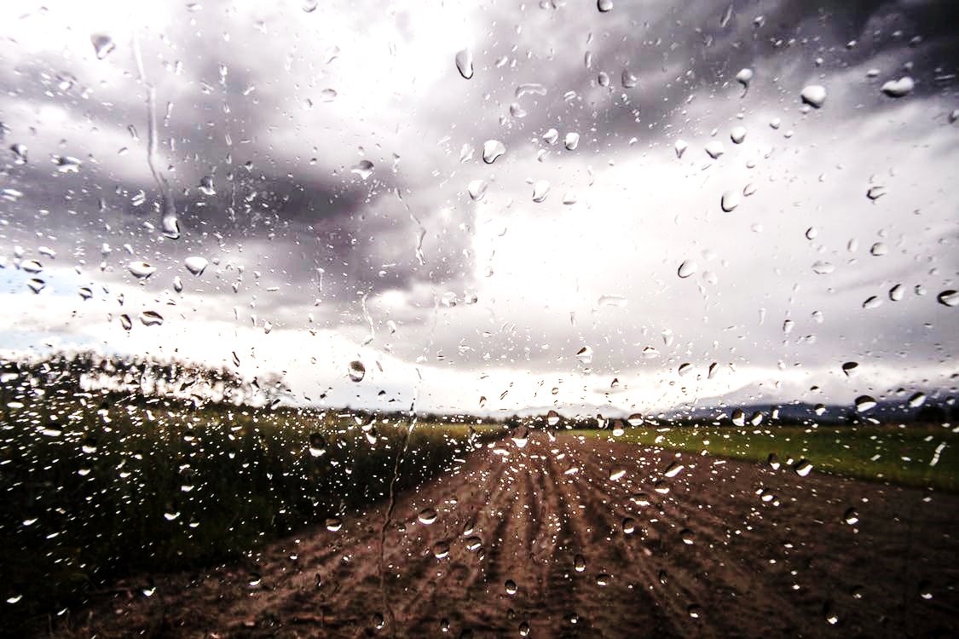

It Pours, He Reigns Psalm 29

Slide 2
THE GLORY OF THE LORD
Ascribe to the LORD, O heavenly beings, ascribe to the LORD glory and strength.
Ascribe to the LORD the glory due his name; worship the LORD in the splendor of holiness.
Psalm 29:1-2

Slide 3
REVELATION 4:6-11
And around the throne, on each side of the throne, are four living creatures…And the four living creatures, each of them with six wings, are full of eyes all around and within, and day and night they never cease to say, “Holy, holy, holy, is the Lord God Almighty, who was and is and is to come…”
And whenever the living creatures give glory and honor and thanks to him who is seated on the throne, who lives forever and ever, the twenty-four elders fall down before him…saying, “Worthy are you, our Lord and God, to receive glory and honor and power, for you created all things, and by your will they existed and were created.”

Slide 4
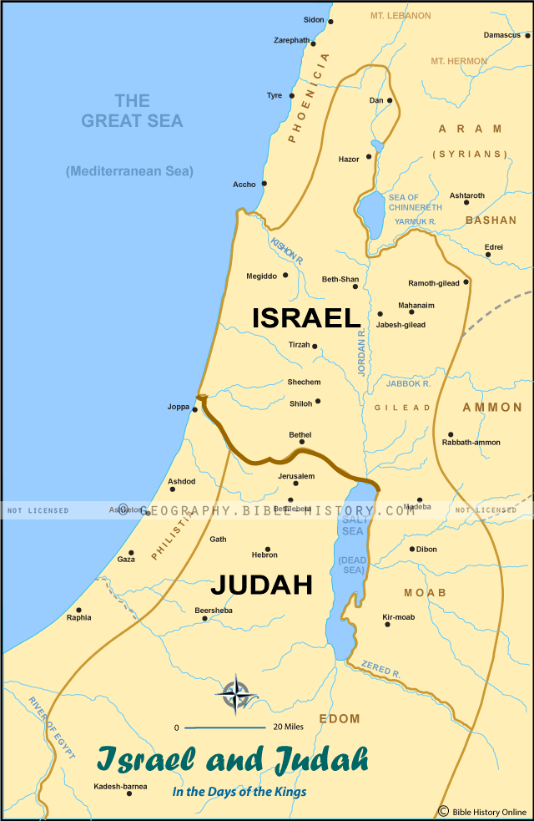
MT LEBANON
The voice of the LORD breaks the cedars; the LORD breaks the cedars of Lebanon.
Psalm 29:5
MT SIRION
He makes Lebanon to skip like a calf, and Sirion like a young wild ox.
Psalm 29:6
aka Mt Hermon
KADESH
The LORD shakes the wilderness of Kadesh.
Psalm 29:8

Slide 5
THE VOICE OF THE LORD
The voice of the LORD is over many waters;
The God of glory thunders, the LORD, over many waters.
Psalm 29:3

Slide 6
THE VOICE OF THE LORD
The voice of the LORD is powerful;
The voice of the LORD is full of majesty.
Psalm 29:4

Slide 7
THE VOICE OF THE LORD
The voice of the LORD breaks the cedars;
The LORD breaks the cedars of Lebanon.
He makes Lebanon to skip like a calf,
and Sirion like a young wild ox.
Psalm 29:5-6

Slide 8
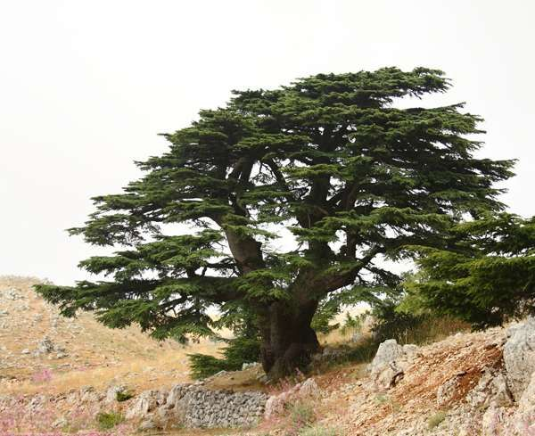
LEBANON
CEDAR

Slide 9
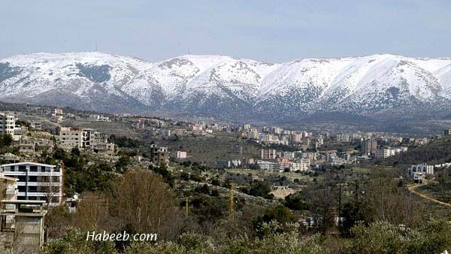
MT. LEBANON

Slide 10
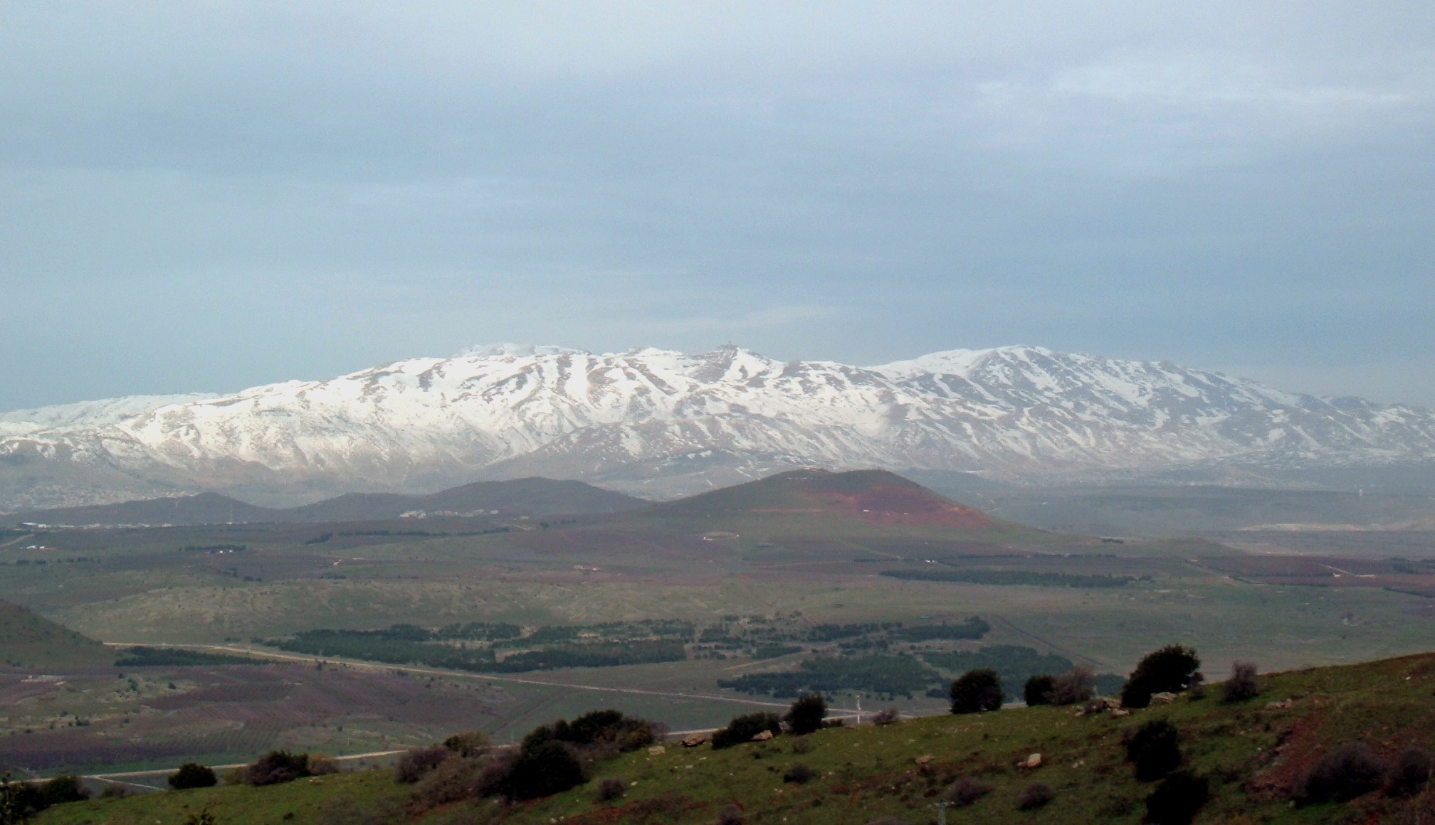
SIRION
MT. SIRION

Slide 11
THE VOICE OF THE LORD
The voice of the LORD flashes forth flames of fire.
Psalm 29:7

Slide 12
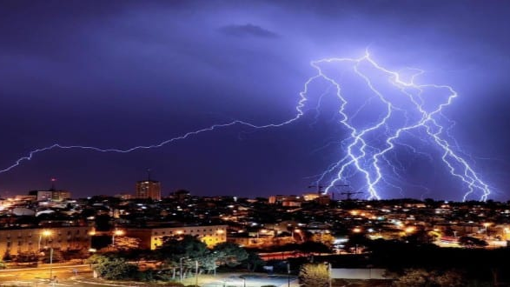
ISRAEL

Slide 13
THE VOICE OF THE LORD
The voice of the LORD shakes the wilderness;
the LORD shakes the wilderness of Kadesh.
Psalm 29:8

Slide 14
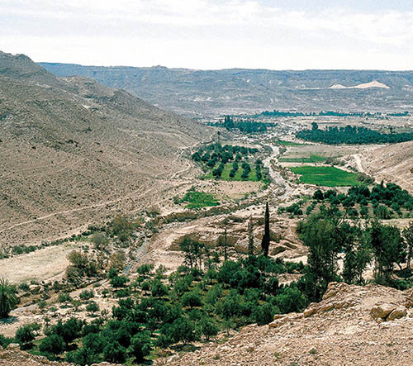
KADESH

Slide 15
THE VOICE OF THE LORD
And Jesus cried out again with a loud voice and yielded up his spirit. And behold, the curtain of the temple was torn in two, from top to bottom. And the earth shook, and the rocks were split. The tombs also were opened. And many bodies of the saints who had fallen asleep were raised, and coming out of the tombs after his resurrection they went into the holy city and appeared to many. When the centurion and those who were with him, keeping watch over Jesus, saw the earthquake and what took place, they were filled with awe and said, “Truly this was the Son of God!”
Matthew 27:50-54

Slide 17
THE VOICE OF THE LORD
And he said, “Go out and stand on the mount before the LORD.” And behold, the LORD passed by, and a great and strong wind tore the mountains and broke in pieces the rocks before the LORD, but the LORD was not in the wind. And after the wind an earthquake, but the LORD was not in the earthquake. And after the earthquake a fire, but the LORD was not in the fire.
And after the fire the sound of a low whisper.
1Kings 19:11-12

Slide 18
THE POSITION OF THE LORD
The LORD sits enthroned above the flood;
The LORD sits enthroned as King forever.
Psalm 29:10

Slide 19
THE STRENGTH OF THE LORD
May the LORD give strength to his people!
May the LORD bless his people with peace!
Psalm 29:11

Slide 20
THE GLORY OF THE LORD
The voice of the LORD makes the deer give birth and strips the forests bare, and in his temple all cry, “Glory!”
Psalm 29:9

Slide 21
GOD IS SPEAKING
LISTEN FOR HIS VOICE!

Slide 22
GOD IS SPEAKING
So faith comes from hearing, and hearing through the word of Christ. Romans 10:17
My sheep hear my voice, and I know them, and they follow me. John 10:27
Give ear, and hear my voice; give attention, and hear my speech.
Isaiah 28:23

Slide 23
GOD IS STRONGER
FIND YOUR STRENGTH IN HIM!

Slide 24
GOD IS STRONGER
From the throne came flashes of lightning, and rumblings and peals of thunder…
and day and night they never cease to say, “Holy, holy, holy, is the Lord God Almighty, who was and is and is to come…
They cast their crowns before the throne, saying,
“Worthy are you, our Lord and God, to receive glory and honor and power…”
Revelation 4:5-11

Slide 25
GOD IS SEATED ON THE THRONE
WORSHIP HIM!

Slide 26
GOD IS SEATED ON THE THRONE
A great multitude that no one could number…standing before the throne and before the Lamb, clothed in white robes, with palm branches in their hands, and crying out with a loud voice, “Salvation belongs to our God who sits on the throne, and to the Lamb… They have washed their robes and made them white in the blood of the Lamb.
Therefore they are before the throne of God, and serve him day and night in his temple; and he who sits on the throne will shelter them with his presence. They shall hunger no more, neither thirst anymore; the sun shall not strike them, nor any scorching heat. For the Lamb in the midst of the throne will be their shepherd, and he will guide them to springs of living water, and God will wipe away every tear from their eyes.”
Revelation 7:9-17

Slide 27
It Pours, He Reigns Psalm 29

