Slide 1
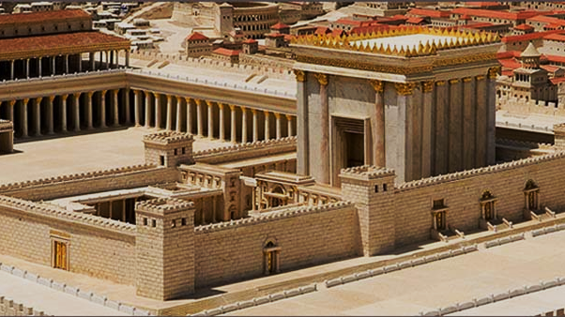

Cleansed for God’s Purpose
Mark 11:15-19; Isaiah 56:1-8; Jeremiah 7:1-11

Slide 2
Mark 11:15-19

Slide 3
Mark 11:15-19
And they came to Jerusalem. And he entered the temple and began to drive out those who sold and those who bought in the temple, and he overturned the tables of the money-changers and the seats of those who sold pigeons. And he would not allow anyone to carry anything through the temple.

Slide 4
Mark 11:15-19
And he was teaching them and saying to them, “Is it not written, ‘My house shall be called a house of prayer for all the nations’? But you have made it a den of robbers.” And the chief priests and the scribes heard it and were seeking a way to destroy him, for they feared him, because all the crowd was astonished at his teaching. And when evening came they went out of the city.

Slide 5
Jesus Cleanses the Temple

Slide 6
Jesus Cleanses the Temple
“Cleansing” refers to Malachi 3 prophesy of the LORD refining and cleansing.

Slide 7
Jesus Cleanses the Temple
“Cleansing” refers to Malachi 3 prophesy of the LORD refining and cleansing.
Jesus cleansing the temple is recorded in Matthew 21, Mark 11, Luke 19, and John 2.

Slide 8
Jesus Cleanses the Temple
“Cleansing” refers to Malachi 3 prophesy of the LORD refining and cleansing.
Jesus cleansing the temple is recorded in Matthew 21, Mark 11, Luke 19, and John 2.
Matthew, Mark, Luke the same event, John 2 is likely a separate event earlier in Jesus’ ministry.

Slide 9
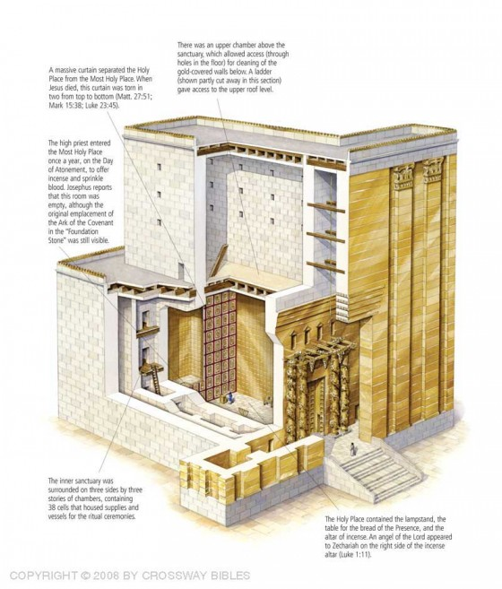
The First Century Temple

Slide 10
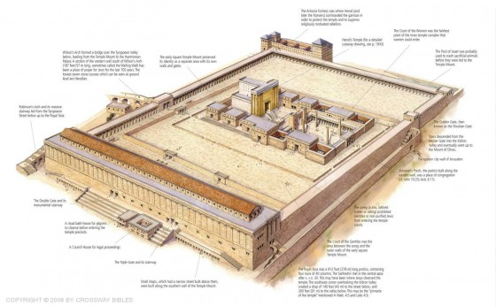
The First Century Temple

Slide 11
Mark 11:17
And he was teaching them and saying to them, “Is it not written…

Slide 12
Mark 11:17
And he was teaching them and saying to them, “Is it not written,
‘My house shall be called a house of prayer for all the nations?’ But you have made it a ‘den of robbers.’”

Slide 13
Isaiah 56:1-8

Slide 14
Isaiah 56:1-8
Thus says the Lord:
“Keep justice, and do righteousness,
for soon my salvation will come,
and my righteousness be revealed.

Slide 15
Isaiah 56:1-8
Let not the foreigner who has joined himself to the Lord say, “The Lord will surely separate me from his people”; and let not the eunuch say, “Behold, I am a dry tree.” For thus says the Lord: “To the eunuchs who keep my Sabbaths, who choose the things that please me and hold fast my covenant, I will give in my house and within my walls a monument and a name better than sons and daughters; I will give them an everlasting name that shall not be cut off.

Slide 16
Isaiah 56:1-8
“And the foreigners who join themselves to the Lord, to minister to him, to love the name of the Lord, and to be his servants, everyone who keeps the Sabbath and does not profane it, and holds fast my covenant—these I will bring to my holy mountain, and make them joyful in my house of prayer;

Slide 17
Isaiah 56:1-8
Their burnt offerings and their sacrifices will be accepted on my altar; for my house shall be called a house of prayer for all peoples.”
The Lord God, who gathers the outcasts of Israel, declares, “I will gather yet others to him besides those already gathered.”

Slide 18
Jeremiah 7:1-11

Slide 19
Jeremiah 7:1-11
The word that came to Jeremiah from the Lord: “Stand in the gate of the Lord's house, and proclaim there this word, and say, Hear the word of the Lord, all you men of Judah who enter these gates to worship the Lord. Thus says the Lord of hosts, the God of Israel: Amend your ways and your deeds, and I will let you dwell in this place. Do not trust in these deceptive words: ‘This is the temple of the Lord, the temple of the Lord, the temple of the Lord.’

Slide 20
Jeremiah 7:1-11
For if you truly amend your ways and your deeds, if you truly execute justice one with another, if you do not oppress the sojourner, the fatherless, or the widow, or shed innocent blood in this place, and if you do not go after other gods to your own harm, then I will let you dwell in this place, in the land that I gave of old to your fathers forever.

Slide 21
Jeremiah 7:1-11
“Behold, you trust in deceptive words to no avail. Will you steal, murder, commit adultery, swear falsely, make offerings to Baal, and go after other gods that you have not known, and then come and stand before me in this house, which is called by my name, and say, ‘We are delivered!’—only to go on doing all these abominations? Has this house, which is called by my name, become a den of robbers in your eyes?

Slide 22
John 2:19-22

Slide 23
John 2:19-22
Jesus answered them, “Destroy this temple, and in three days I will raise it up.” The Jews then said, “It has taken forty-six years to build this temple, and will you raise it up in three days?” But he was speaking about the temple of his body. When therefore he was raised from the dead, his disciples remembered that he had said this, and they believed the Scripture…

Slide 25
Three Truths to Take Away

Slide 26
Three Truths to Take Away
God’s people are the temple of the Holy Spirit. We need to be cleansed for God’s purpose.

Slide 27
Three Truths to Take Away
God’s people are the temple of the Holy Spirit. We need to be cleansed for God’s purpose.
God’s salvation WILL reach the nations, and the nations WILL worship Him.

Slide 28
Three Truths to Take Away
God’s people are the temple of the Holy Spirit. We need to be cleansed for God’s purpose.
God’s salvation WILL reach the nations, and the nations WILL worship Him.
Read what God has promised, and invest your life into those things, for He is faithful.

