Slide 1
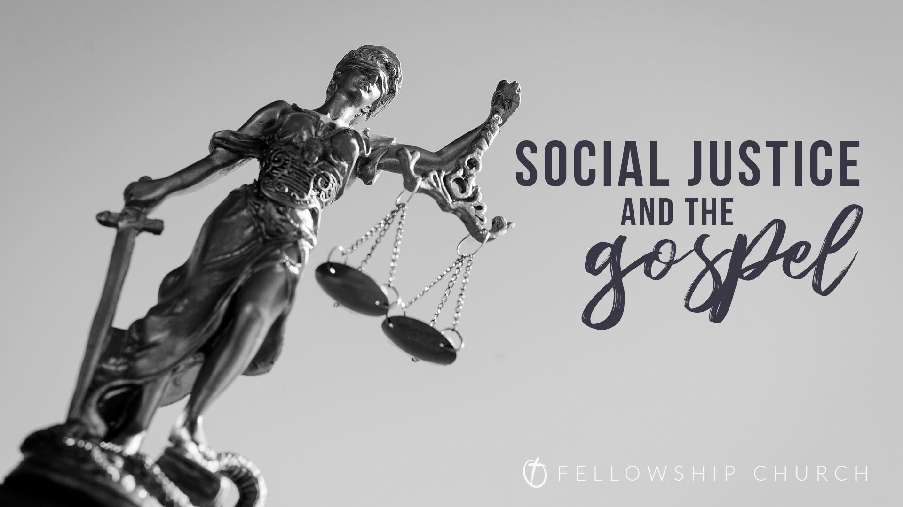
Let Biblical Justice Roll!

Slide 2
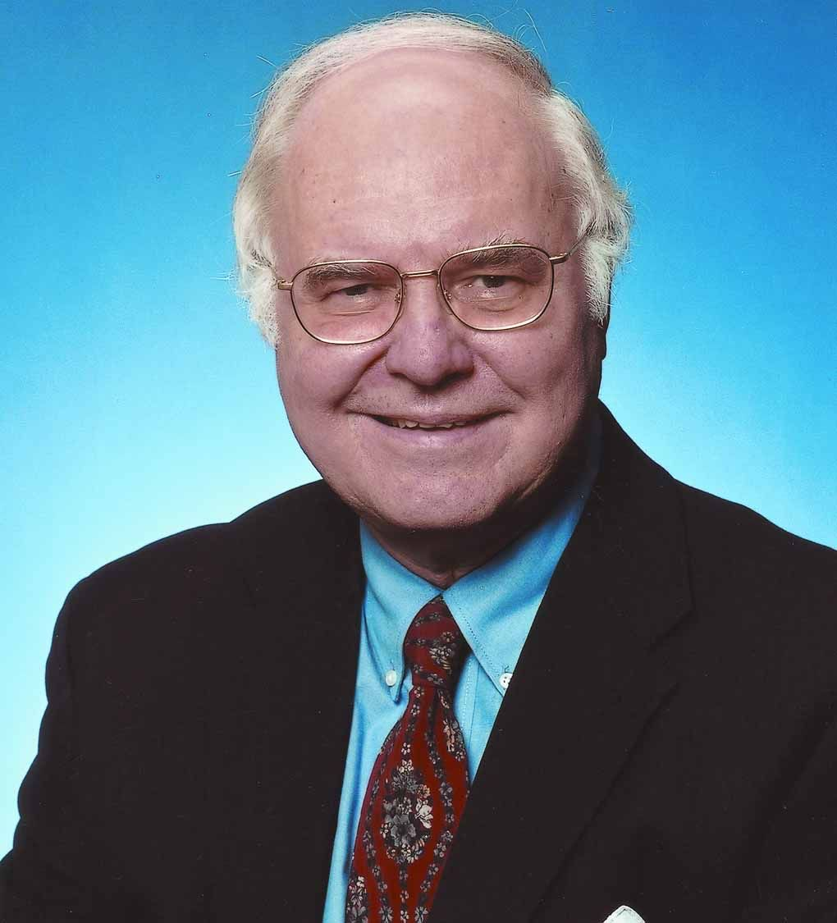
Michael Novak
The trouble with social justice begins with the very meaning of the term. Whole books have been written about social justice without ever offering a definition. It is allowed to float in the air as if everyone will recognize an instance of it when it appears. This vagueness seems indispensable. The minute one begins to define social justice, one runs into embarrassing intellectual difficulties. It becomes, most often, a term of art whose operational meaning is, “We need a law against that.”

Slide 3
The focus of social justice is not virtue, it is power.

Slide 4
William H Young
“the core concept of social justice is the redistribution of resources and advantages to the disadvantaged, to achieve social and economic equality.”

Slide 5
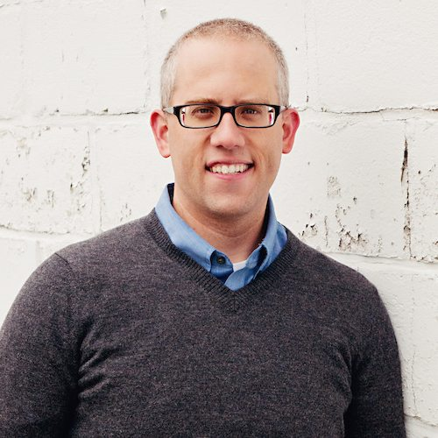
Kevin DeYoung
“We have not offered a definition of the term because there really isn’t one. It is something ambiguously connected with poverty and oppression.”

Slide 6
Social Justice in the Culture
Entertainment, politics, sports
NBA, NFL, MLB
Large Corporations

Slide 7
Faithful America
“We are Christians putting our faith into action for social justice. When corporations and religious institutions invoke religious freedom as a justification for bigotry and discrimination, we speak up.”

Slide 8
If these are examples of social justice, is this the justice that the Scripture calls us to?

Slide 9
Main Areas of Social Justice Concern
Racial Equality
LGBTQ+ Rights
Feminism/Women’s Rights

Slide 10
Is God Concerned About Justice?
Yes, absolutely!
God is just and demands righteous justice.

Slide 11
Amos 5

Slide 12
Amos 5
Theme of Amos is the justice of God
Israel wanted God to judge their oppressors – the Assyrians.
Amos prophesied that God would judge Israel.

Slide 13
Amos 5:21-24
I hate, I despise your feasts, and I take no delight in your solemn assemblies. 22 Even though you offer me your burnt offerings and grain offerings, I will not accept them; and the peace offerings of your fattened animals, I will not look upon them. 23 Take away from me the noise of your songs; to the melody of your harps I will not listen. 24 But let justice roll down like waters, and righteousness like an ever-flowing stream.

Slide 14
The Injustices of Amos 5
The people hated those who upheld true justice in the courts.
They hate him who reproves in the gate, and they abhor him who speaks the truth. (ESV)
There are those who hate the one who upholds justice in court and detest the one who tells the truth. (NIV)
Amos 5:10

Slide 15
The Injustices of Amos 5
They were overtaxing the poor for the benefit of the wealthy.
You levy a straw tax on the poor and impose a tax on their grain. Therefore, though you have built stone mansions, you will not live in them…
Amos 5:11

Slide 16
What the Injustice was ‘not’:
It was not the disparity,

Slide 17
What the Injustice was ‘not’:
It was not the disparity.
It was not the fact that the poor were poor.

Slide 18
The Injustices of Amos 5
The poor were being deprived of justice in the courts due to bribes.
For I know how many are your transgressions and how great are your sins - you who afflict the righteous, who take a bribe, and turn aside the needy in the gate.
Amos 5:12

Slide 19
Truths to Apply
The justice of ‘social justice’ is not the same as the biblical justice of God.
That distinction is not a reason to ignore the plight of those in need.
The church is called to serve and minister to the needy in Jesus’ name.

