Slide 1
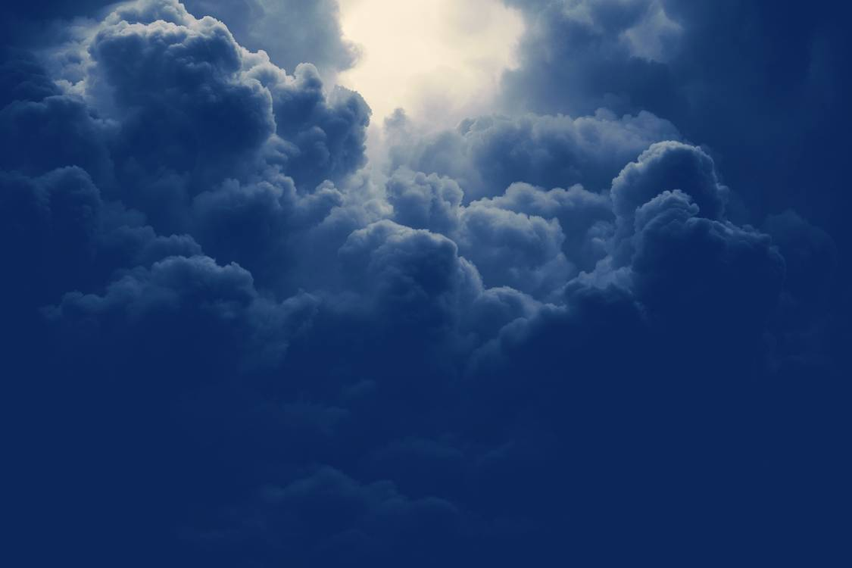

Do Not Be Ashamed
II Timothy 1:8-14

Slide 2
II Timothy 1:8
“Therefore, do not be ashamed of the testimony about our Lord, nor of me his prisoner…”

Slide 3
II Timothy 1:8
“Therefore, do not be ashamed of the testimony about our Lord, nor of me his prisoner…”

Slide 4
II Timothy 1:8
“Therefore, do not be ashamed of the testimony about our Lord, nor of me his prisoner…”

Slide 5
II Timothy 1:8
“Therefore, do not be ashamed of the testimony about our Lord, nor of me his prisoner, but share in suffering for the gospel…”

Slide 6
II Timothy 1:8
“Therefore, do not be ashamed of the testimony about our Lord, nor of me his prisoner, but share in suffering for the gospel…”

Slide 7
II Timothy 1:8
“Therefore, do not be ashamed of the testimony about our Lord, nor of me his prisoner, but share in suffering for the gospel…”

Slide 8
II Timothy 1:8
“Therefore, do not be ashamed of the testimony about our Lord, nor of me his prisoner, but share in suffering for the gospel…”

Slide 9
II Timothy 1:8
“Therefore, do not be ashamed of the testimony about our Lord, nor of me his prisoner, but share in suffering for the gospel by the power of God…”

Slide 10
II Timothy 1:8,9
“Therefore, do not be ashamed of the testimony about our Lord, nor of me his prisoner, but share in suffering for the gospel by the power of God who saved us and called us to a holy calling, not because of our works…”

Slide 11
II Timothy 1:8,9
“Therefore, do not be ashamed of the testimony about our Lord, nor of me his prisoner, but share in suffering for the gospel by the power of God who saved us and called us to a holy calling, not because of our works but because of his own purpose and grace, which he gave us in Christ Jesus before the ages began…”

Slide 12
II Timothy 1:8-10
“Therefore, do not be ashamed of the testimony about our Lord, nor of me his prisoner, but share in suffering for the gospel by the power of God who saved us and called us to a holy calling, not because of our works but because of his own purpose and grace, which he gave us in Christ Jesus before the ages began, and which now has been manifested through the appearing of our Savior Christ Jesus, who abolished death and brought life and immortality to light through the gospel…”

Slide 13
II Timothy 8:11,12
“…through the gospel, for which I was appointed a preacher and apostle and teacher, which is why I suffer as I do. But I am not ashamed…”

Slide 14
II Timothy 8:11,12
“…through the gospel, for which I was appointed a preacher and apostle and teacher, which is why I suffer as I do. But I am not ashamed, for I know whom I have believed…”

Slide 15
II Timothy 8:11,12
“…through the gospel, for which I was appointed a preacher and apostle and teacher, which is why I suffer as I do. But I am not ashamed, for I know whom I have believed, and I am convinced that he is able to guard until that day what has been entrusted to me.”

Slide 16
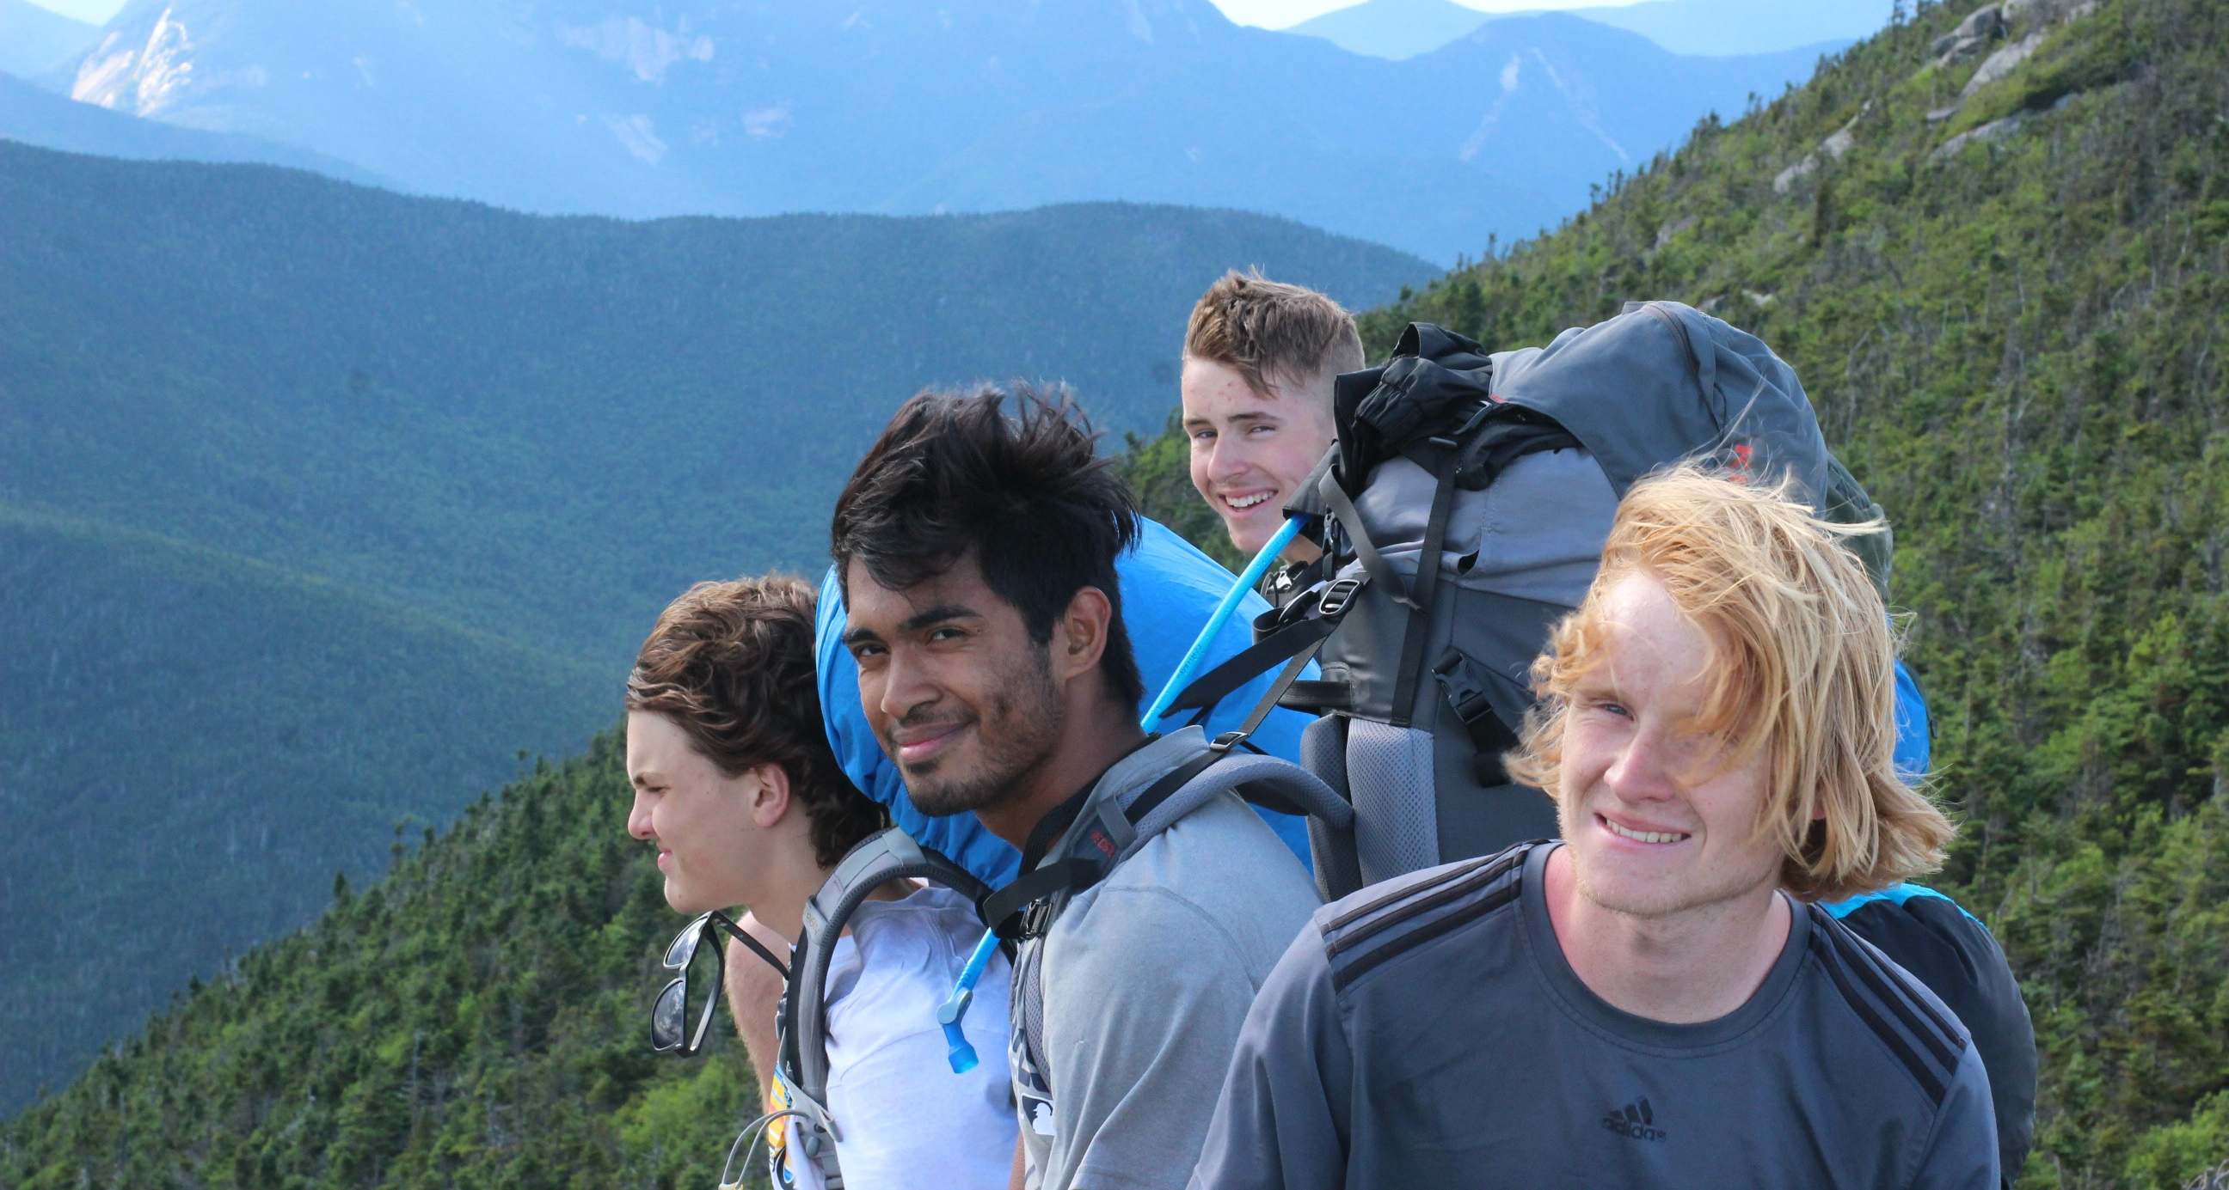
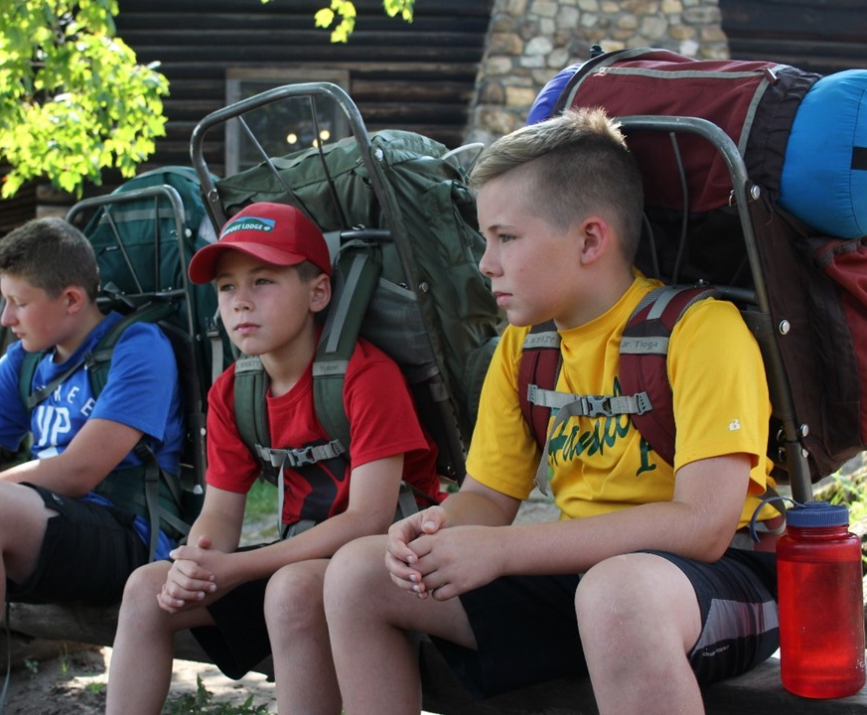
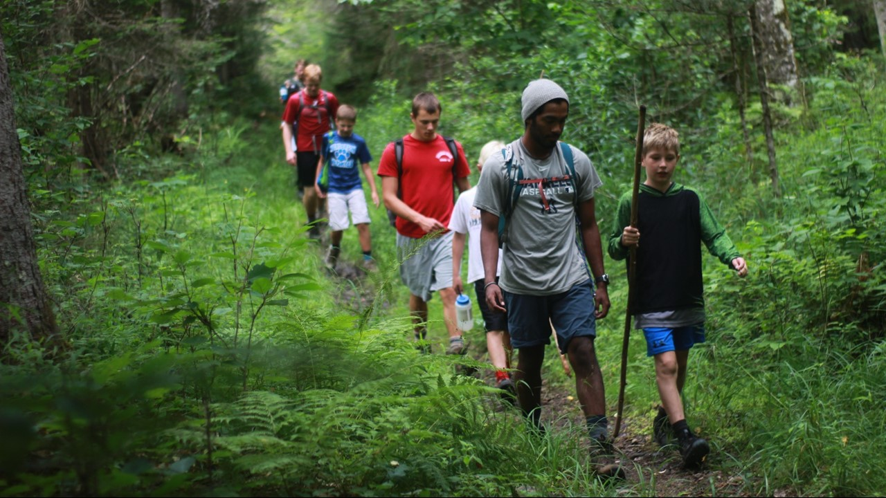


Slide 17
II Timothy 8:11,12
“…through the gospel, for which I was appointed a preacher and apostle and teacher, which is why I suffer as I do. But I am not ashamed, for I know whom I have believed, and I am convinced that he is able to guard until that day what has been entrusted to me.”

Slide 18
What does this mean for us?
For us to be unashamed, WE must be willing to suffer for believing, without attacking as the world does, welcoming the consequences with joy.

Slide 19
Matthew 5:11,12
Blessed are you when others revile you and
persecute you and utter all kinds of evil
against you falsely on my account. Rejoice
and be glad, for your reward is great in
heaven, for so they persecuted the prophets
who were before you.

Slide 20
What does this mean for us?
For us to be unashamed, WE must be willing to suffer for believing, without attacking as the world does, welcoming the consequences with joy.
We must consider the cost of being a disciple of Jesus, bear our cross, and follow Him.

Slide 21
What does this mean for us?
For us to be unashamed, WE must be willing to suffer for believing, without attacking as the world does, welcoming the consequences with joy.
We must consider the cost of being a disciple of Jesus, bear our cross, and follow Him.
“God is not ashamed to be called their God, for He has prepared for them a city.” ~Hebrews 11:16

Slide 22
The Apostles Creed

Slide 23
The Apostles Creed
We believe in God, the Father almighty,
creator of heaven and earth.
We believe in Jesus Christ, his only Son, our Lord,
who was conceived by the Holy Spirit
and born of the virgin Mary.
He suffered under Pontius Pilate,
was crucified, died, and was buried;
he descended to the dead.
The third day he rose again from the dead.
He ascended to heaven
and is seated at the right hand of God the Father almighty.
From there he will come to judge the living and the dead.

Slide 24
The Apostles Creed
We believe in the Holy Spirit,
One holy church,
the communion of saints,
the forgiveness of sins,
the resurrection of the body,
and the life everlasting.
Amen.

Slide 25
EFCA Statement of Faith; Art. 4,5,9

Slide 26
EFCA Statement of Faith; Art. 4,5,9
We believe that Jesus Christ is God incarnate, fully
God and fully man, one Person in two natures.
Jesus—Israel's promised Messiah—was conceived
through the Holy Spirit and born of the virgin Mary.
He lived a sinless life, was crucified under Pontius
Pilate, arose bodily from the dead, ascended into
heaven and sits at the right hand of God the Father
as our High Priest and Advocate.

Slide 27
EFCA Statement of Faith; Art. 4,5,9
We believe that Jesus Christ, as our representative
and substitute, shed His blood on the cross as the
perfect, all-sufficient sacrifice for our sins. His
atoning death and victorious resurrection constitute
the only ground for salvation.

Slide 28
EFCA Statement of Faith; Art. 4,5,9
We believe in the personal, bodily, and glorious return
of our Lord Jesus Christ. The coming of Christ, at a
time known only to God, demands constant
expectancy and, as our blessed hope, motivates
the believer to godly living, sacrificial service and
energetic mission.

