Slide 1


Slide 2
BACKGROUND TO 2 PETER
Written to believers facing various trials
Scattered abroad
Persecution
False teachers

Slide 3
BACKGROUND TO 2 PETER
Written to believers facing various trials
Scattered abroad
Persecution
False teachers
Themes
Pursue righteous living by God’s grace
Desire to know God, commitment to Scripture
Defense of Christ’s return

Slide 4
2 PETER 3:14
Therefore, beloved, since you are waiting for these, be diligent to be found by him without spot or blemish and at peace.

Slide 5
2 PETER 3
Believers are awaiting Christ’s return & final judgment

Slide 6
2 PETER 3
Believers are awaiting Christ’s return & final judgment
False teachers denying Christ’s return & final judgment

Slide 7
2 PETER 3
Believers are awaiting Christ’s return & final judgment
False teachers denying Christ’s return & final judgment
Scripture proves Christ’s return & a final judgment

Slide 8
2 PETER 3:1-8 SCRIPTURAL SUPPORT FOR THE DAY OF THE LORD

Slide 9
2 PETER 3:1-8 SCRIPTURAL SUPPORT FOR THE DAY OF THE LORD
Prophets: Daniel 7:13-14
The coming of the Messiah to establish his eternal kingdom

Slide 10
2 PETER 3:1-8 SCRIPTURAL SUPPORT FOR THE DAY OF THE LORD
Prophets: Daniel 7:13-14
The coming of the Messiah to establish his eternal kingdom
Gospels: Matthew 25:13
“Watch therefore, you neither know the day nor the hour.”

Slide 11
2 PETER 3:1-8 SCRIPTURAL SUPPORT FOR THE DAY OF THE LORD
Prophets: Daniel 7:13-14
The coming of the Messiah to establish his eternal kingdom
Gospels: Matthew 25:13
“Watch therefore, you neither know the day nor the hour.”
Epistles: 1 Thessalonians 5:2-3
“The day of the Lord will come like a thief in the night… destruction will come.”

Slide 12
2 PETER 3:1-8 SCRIPTURAL SUPPORT FOR THE DAY OF THE LORD
Prophets: Daniel 7:13-14
The coming of the Messiah to establish his eternal kingdom
Gospels: Matthew 25:13
“Watch therefore, you neither know the day nor the hour.”
Epistles: 1 Thessalonians 5:2-3
“The day of the Lord will come like a thief in the night… destruction will come.”
History: Genesis 6-7
God brought judgment to the world once before with water

Slide 13
2 PETER 3:1-8 SCRIPTURAL SUPPORT FOR THE DAY OF THE LORD
Prophets: Daniel 7:13-14
The coming of the Messiah to establish his eternal kingdom
Gospels: Matthew 25:13
“Watch therefore, you neither know the day nor the hour.”
Epistles: 1 Thessalonians 5:2-3
“The day of the Lord will come like a thief in the night… destruction will come.”
History: Genesis 6-7
God brought judgment to the world once before with water
Psalms: Psalm 90:4
We do not see time as God sees it. He will fulfill his promise in his timing.

Slide 14
2 PETER 3:14
Spotless
Contrasts false teachers (2:13)
Christ desires to find believers living as those who have been cleansed of their sins

Slide 15
2 PETER 3:14
Spotless
Contrasts false teachers (2:13)
Christ desires to find believers living as those who have been cleansed of their sins
Blameless
Only Christ can forgive and make believers blameless
Evidenced by reputation and integrity
Proof of redemption

Slide 16
2 PETER 3:14
Spotless
Contrasts false teachers (2:13)
Christ desires to find believers living as those who have been cleansed of their sins
Blameless
Only Christ can forgive and make believers blameless
Evidenced by reputation and integrity
Proof of redemption
At peace
At peace with God
At peace with other believers

Slide 17
2 PETER 3:15
And count the patience of our Lord as salvation.

Slide 18
A TIME OF SALVATION
God is not willing that any should perish
The time before Christ’s return is an opportunity to share the gospel with others

Slide 19
2 PETER 3:15-16
just as our beloved brother Paul also wrote to you according to the wisdom given him, as he does in all his letters when he speaks in them of these matters. There are some things in them that are hard to understand, which the ignorant and unstable twist to their own destruction, as they do the other Scriptures.

Slide 20
PETER & PAUL IN AGREEMENT
Blameless living in preparation for Christ’s return
2 Peter 3:14 “Therefore, beloved, since you are waiting for these, be diligent to be found by him without spot or blemish and at peace.”
1 Thessalonians 5:23 “Now may the God of peace himself sanctify you completely, and may your whole spirit, and soul, and body be kept blameless at the coming of our Lord Jesus Christ”

Slide 21
PETER & PAUL IN AGREEMENT
God’s delayed wrath is for the sake of salvation
2 Peter 3:15 “And count the patience of our Lord as salvation.”
Romans 9:22-23 “What if God, desiring to show his wrath and to make known his power, has endured with much patience vessels of wrath prepared for destruction, in order to make known the riches of his glory for vessels of mercy, which he has prepared beforehand for glory.

Slide 22
UNDERSTANDING SCRIPTURE
Just because some passages might be difficult to understand doesn’t mean they are impossible to understand.
Those who don’t take the time to understand Scripture can be easily led astray.

Slide 23
2 PETER 3:17
You therefore, beloved, knowing this beforehand, take care that you are not carried away with the error of lawless people and lose your own stability.

Slide 24
2 PETER 3:18
But grow in the grace and knowledge of our Lord and Savior Jesus Christ.

Slide 25
GROWING
Growing in Grace
Grace is the unmerited favor of God.
Grace is central and essential to spiritual growth.

Slide 26
GROWING
Grow in Grace
Grace is the unmerited favor of God.
Grace is central and essential to spiritual growth.
Grow in Knowledge
Not just factual knowledge.
Believers should seek to know Christ intimately in order to be conformed to his image.

Slide 27
GROWING
Grow in Grace
Grace is the unmerited favor of God.
Grace is central and essential to spiritual growth.
Grow in Knowledge
Not factual knowledge.
Believers should seek to know Christ intimately in order to be conformed to his image.
Growth cannot happen apart from the
grace and knowledge of Christ

Slide 28
SANCTIFICATION

Slide 29
SANCTIFICATION
Set apart
To be set apart for holy purposes.
People and things dedicated to God

Slide 30
SANCTIFICATION
Set apart
To be set apart for holy purposes.
People and things dedicated to God
Cleansing
To make something holy which was once considered to be defiled

Slide 31
THREE COMPONENTS OF SALVATION

Slide 32
THREE COMPONENTS OF SALVATION
Justification
The one time, instantaneous act of God that occurs when we enter into a relationship with him.
God frees us from the penalty of sin and declares us righteous because of the sinless, perfect life of his Son, Jesus (Rom 3:24)

Slide 33
THREE COMPONENTS OF SALVATION
Justification
The one time, instantaneous act of God that occurs when we enter into a relationship with him.
God frees us from the penalty of sin and declares us righteous because of the sinless, perfect life of his Son, Jesus.
Sanctification
The ongoing act of God in which we are being freed from the power of sin and conformed to the image of Christ (2 Thess 2:13)
Begins from the moment we are justified and ends when we meet him.

Slide 34
THREE COMPONENTS OF SALVATION
Justification
The one time, instantaneous act of God that occurs when we enter into a relationship with him.
God frees us from the penalty of sin and declares us righteous because of the sinless, perfect life of his Son, Jesus.
Sanctification
The ongoing act of God in which we are being freed from the power of sin and conformed to the image of Christ (2 Thess 2:13)
Begins from the moment we are justified and ends when we meet him.
Glorification
The fulfillment of our salvation when we will be in a glorified body.
Believers are made perfect and completely freed from the presence of sin (Rom 8:17)

Slide 35
THREE COMPONENTS OF SALVATION
ROMANS 8:29-30 “For those whom he foreknew he also predestined to be conformed to the image of his Son, in order that he might be the firstborn among many brothers. And those whom he predestined he also called, and those whom he called he also justified, and those whom he justified he also glorified.”

Slide 36
THREE COMPONENTS OF SALVATION
ROMANS 8:29-30 “For those whom he foreknew he also predestined to be conformed to the image of his Son, in order that he might be the firstborn among many brothers. And those whom he predestined he also called, and those whom he called he also justified, and those whom he justified he also glorified.”

Slide 37
THREE COMPONENTS OF SALVATION
ROMANS 8:29-30 “For those whom he foreknew he also predestined to be conformed to the image of his Son, in order that he might be the firstborn among many brothers. And those whom he predestined he also called, and those whom he called he also justified, and those whom he justified he also glorified.”

Slide 38
THREE COMPONENTS OF SALVATION
ROMANS 8:29-30 “For those whom he foreknew he also predestined to be conformed to the image of his Son, in order that he might be the firstborn among many brothers. And those whom he predestined he also called, and those whom he called he also justified, and those whom he justified he also glorified.”

Slide 39
SECOND COMING STATE OF MIND Principles of Sanctification
1 PETER 1:13 “Therefore, preparing your minds for action, and being sober-minded, set your hope fully on the grace that will be brought to you at the revelation of Jesus Christ.”

Slide 40
SECOND COMING STATE OF MIND Principles of Sanctification
Sanctification Principle 1: Holiness Must Be A Daily Pursuit
Be diligent to be found without spot or blemish and at peace (14)

Slide 41
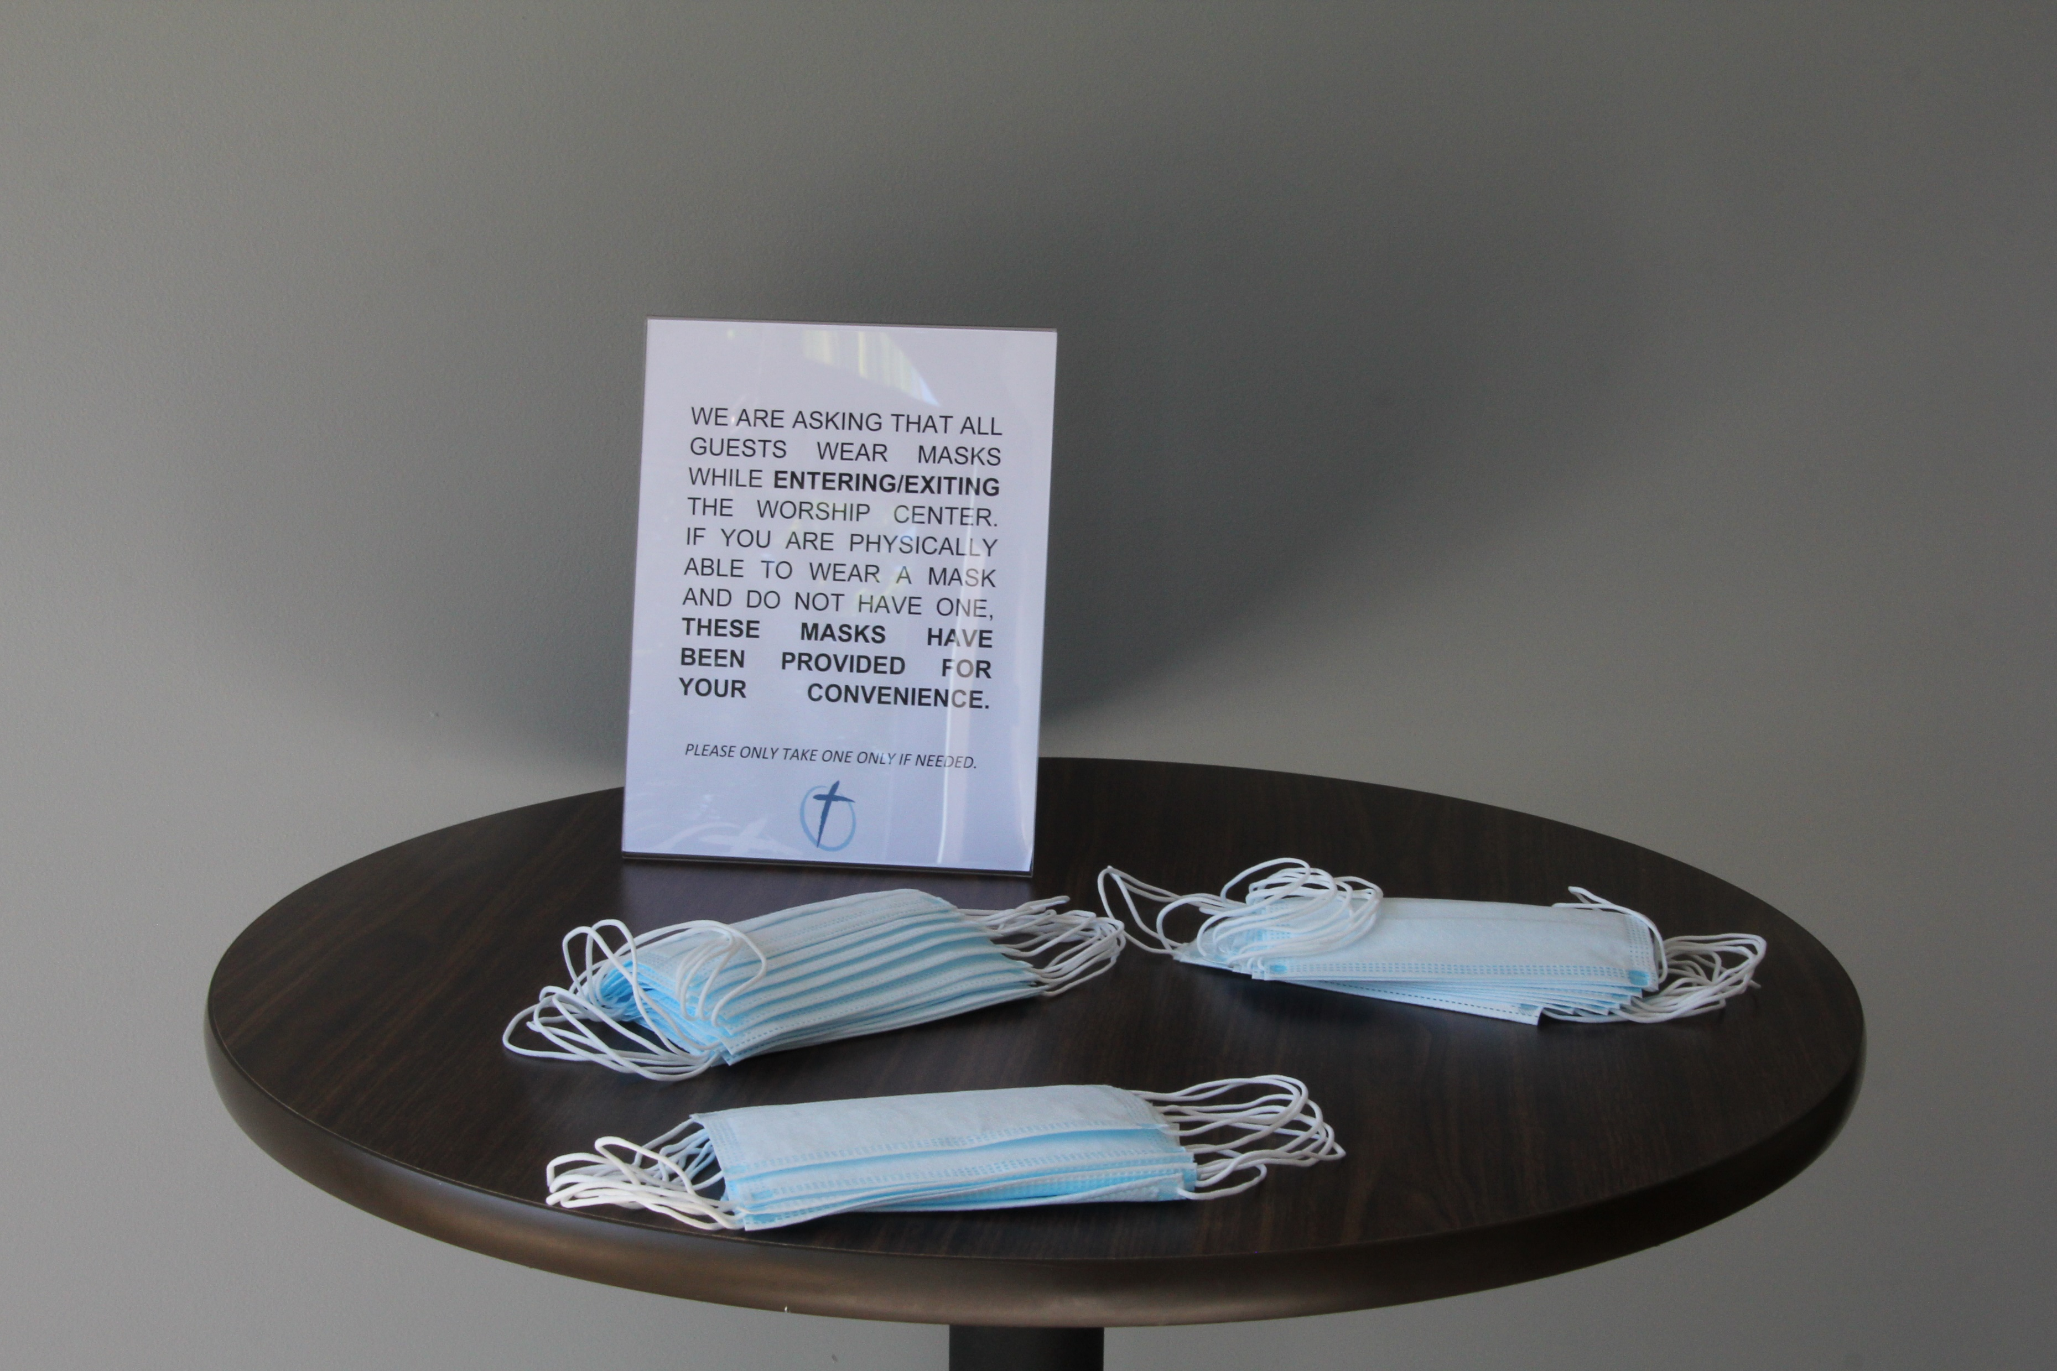

Slide 42
HOLINESS MUST BE A DAILY PURSUIT
Since the Lord is coming at a time that we do not know, our desire should be to meet him in purity and peace. Spotless and blameless.

Slide 43
HOLINESS MUST BE A DAILY PURSUIT
Since the Lord is coming at a time that we do not know, our desire should be to meet him in purity and peace. Spotless and blameless.
As a born again follower of Christ, you must live as though the Son of God shed his blood to make you clean – because he has!

Slide 44
HOLINESS MUST BE A DAILY PURSUIT
Since the Lord is coming at a time that we do not know, our desire should be to meet him in purity and peace. Spotless and blameless.
As a born again follower of Christ, you must live as though the Son of God shed his blood to make you clean – because he has!
We must deal truthfully with our sin by confessing, repenting, and pursuing purity.

Slide 45
COLOSSIANS 3:1-9
Set your minds on things above, not on earthly things. For you died, and your life is now hidden with Christ in God. When Christ, who is your life, appears, then you also will appear with Him in glory.
Put to death, therefore, the components of your earthly nature: sexual immorality, impurity, lust, evil desires, and greed, which is idolatry. Because of these, the wrath of God is coming on the sons of disobedience…
Do not lie to one another, since you have taken off the old self with its practices, and have put on the new self, which is being renewed in knowledge in the image of its Creator.

Slide 46
2 TIMOTHY 2:2
So flee youthful passions and pursue righteousness, faith, love, and peace, along with those who call on the Lord from a pure heart.

Slide 47
THE TIME OF WAITING IS SALVATION

Slide 48
THE TIME OF WAITING IS SALVATION
Sanctification
Believers should view this present age as the time that God is using to sanctify us; to prepare us for eternity as we prepare for Christ’s return.

Slide 49
THE TIME OF WAITING IS SALVATION
Sanctification
Believers should view this present age as the time that God is using to sanctify us; to prepare us for eternity as we prepare for Christ’s return.
Evangelism
Believers should use this time of waiting and pursuing purity as an opportunity for evangelism.

Slide 50
SECOND COMING STATE OF MIND Principles of Sanctification
Sanctification Principle 1: Persistent Pursuit of Purity
Be diligent to be found without spot or blemish and at peace (14)
Sanctification Principle 2: Believers Must Be on Guard Against Error
Do not be carried away with the error of lawless people and lose your own stability (17)

Slide 51
BELIEVERS MUST BE ON GUARD AGAINST ERROR
Being on guard prevents us from being carried away with error

Slide 52


Slide 53
BELIEVERS MUST BE ON GUARD AGAINST ERROR
Being on guard prevents us from being carried away with error
Being on guard ensures our spiritual stability

Slide 54
BELIEVERS MUST BE ON GUARD AGAINST ERROR
Being on guard prevents us from being carried away with error
Being on guard ensures our spiritual stability
When we lose focus of him and start to pursue things that have nothing to do with our spiritual growth, we will become unstable and unable to walk steadily on the path of righteousness.

Slide 55
SECOND COMING STATE OF MIND Principles of Sanctification
Sanctification Principle 1: Persistent Pursuit of Purity
Be diligent to be found without spot or blemish and at peace (14)
Sanctification Principle 2: Faithfully Fighting against Falsehood
Do not be carried away with the error of lawless people and lose your own stability (17)
Sanctification Principle 3: Growth Happens in Grace & Knowledge
But grow in the grace and knowledge of our Lord and Savior Jesus Christ (18)

Slide 56
GROWTH HAPPENS IN GRACE & KNOWLEDGE
Growing in Grace
True spiritual growth always happens in grace and cannot happen apart from the grace of God.
Since sanctification is a component of salvation, and salvation is by grace alone, then the process of sanctification is something that happens by grace alone.
We are not sanctified by our own efforts.

Slide 57

“The truest measure of our growth is not our behavior – it’s our grasp of grace – a grasp which involves coming to deeper and deeper terms with the unconditionality of God’s love.”

Slide 58
GROWTH HAPPENS IN GRACE & KNOWLEDGE
Growing in Knowledge

Slide 59
GROWTH HAPPENS IN GRACE & KNOWLEDGE
Growing in Knowledge
Know what the Scriptures teach.

Slide 60
GROWTH HAPPENS IN GRACE & KNOWLEDGE
Growing in Knowledge
Know what the Scriptures teach.
Growing in knowledge strengthens our ability to discern (Rom 12:2).

Slide 61
GROWTH HAPPENS IN GRACE & KNOWLEDGE
Growing in Knowledge
Know what the Scriptures teach.
Growing in knowledge strengthens our ability to discern (Rom 12:2).
Grow in a knowledge of the Lord and Savior Jesus Christ.
Not just factual knowledge
Intimate knowledge; a personal relationship

Slide 62
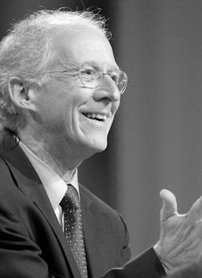
“If we but knew a fraction of the future God is making for us. if we could believe what no eye has seen, nor ear heard, nor the heart of man conceived, what God him, as prepared for those who love our hearts would be freed from the greed and fears that cause us to sin. We would escape from the corruption that is in the world, and become partakers of the divine nature.”
JOHN PIPER

Slide 63
GROWTH HAPPENS IN GRACE & KNOWLEDGE
Growing in Knowledge
Know what the Scriptures teach.
Growing in knowledge strengthens our ability to discern (Romans 12:2).
Grow in a knowledge of the Lord and Savior Jesus Christ.
Not just factual knowledge
Intimate knowledge; a personal relationship
The more we know him, the more we will learn to
trust him, long for his grace, and grow!

Slide 64
SECOND COMING STATE OF MIND Principles of Sanctification
Sanctification Principle 1: Persistent Pursuit of Purity
Be diligent to be found without spot or blemish and at peace (14)
Sanctification Principle 2: Faithfully Fighting against Falsehood
Do not be carried away with the error of lawless people and lose your own stability (17)
Sanctification Principle 3: Growth Happens in Grace & Knowledge
But grow in the grace and knowledge of our Lord and Savior Jesus Christ (18)
Sanctification Principle 4: Christ Must Be Glorified
To Him be the glory both now and to the day of eternity (18)

Slide 65
CHRIST MUST BE GLORIFIED
1 CORINTHIANS 1:30 “And because of [God] you are in Christ Jesus, who became to us wisdom from God, righteousness and sanctification and redemption.”

Slide 66
CHRIST MUST BE GLORIFIED
He is the source of our salvation

Slide 67
CHRIST MUST BE GLORIFIED
He is the source of our salvation
All that counts is what is done to bring him glory

Slide 68
CHRIST MUST BE GLORIFIED
He is the source of our salvation
All that counts is what is done to bring him glory
He must be glorified both now and forever!

