Slide 1
GOSPEL WORTHY LIVING

Slide 3
PHILIPPIANS 1
27 Only let your manner of life be worthy of the gospel of Christ, so that whether I come and see you or am absent, I may hear of you that you are standing firm in one spirit, with one mind striving side by side for the faith of the gospel, 28 and not frightened in anything by your opponents.

Slide 4
PHILIPPIANS 1
12 I want you to know, brothers, that what has happened to me has really served to advance the gospel, 13 so that it has become known throughout the whole imperial guard and to all the rest that my imprisonment is for Christ.

Slide 5
PHILIPPIANS 1
14 And most of the brothers, having become confident in the Lord by my imprisonment, are much more bold to speak the word without fear.
15 Some indeed preach Christ from envy and rivalry, but others from good will. 16 The latter do it out of love, knowing that I am put here for the defense of the gospel. 17 The former proclaim Christ out of selfish ambition, not sincerely but thinking to afflict me in my imprisonment. 18 What then? Only that in every way, whether in pretense or in truth, Christ is proclaimed, and in that I rejoice.

Slide 6
PHILIPPIANS 1
Yes, and I will rejoice, 19 for I know that through your prayers and the help of the Spirit of Jesus Christ this will turn out for my deliverance, 20 as it is my eager expectation and hope that I will not be at all ashamed, but that with full courage now as always Christ will be honored in my body, whether by life or by death.
21 For to me to live is Christ, and to die is gain.

Slide 7
GOSPEL WORTHY CONDUCT
Only let your manner of life be worthy of the gospel of Christ.

Slide 8
GOSPEL WORTHY CONDUCT
Are you worthy of salvation?

Slide 9
GOSPEL WORTHY CONDUCT
Are you worthy of salvation?
NO.

Slide 10
ROMANS 3:10
None is righteous, no, not one.

Slide 11
GOSPEL WORTHY CONDUCT
Politeuomai
Behave as a citizen; conduct one’s self as pledged to some law of life

Slide 13
GOSPEL WORTHY CONDUCT
Ephesians 4:1
walk in a manner worthy of the calling to which you’ve been called, with all humility and gentleness, with patience bearing with one another in love.
Colossians 1:10
walk in a manner worthy of the Lord, fully pleasing to him: bearing fruit in every good work and increasing in the knowledge of God.
1 Thessalonians 2:12
walk in a manner worthy of God, who calls you into his own kingdom and glory.

Slide 14
GOSPEL WORTHY CONDUCT
A gospel worthy life is one that is characterized by the new nature that is found in Christ.

Slide 15
GOSPEL WORTHY CONDUCT
27 Only let your manner of life be worthy of the gospel of Christ, so that whether I come and see you or am absent, I may hear of you that you are standing firm in one spirit, with one mind striving side by side for the faith of the gospel,

Slide 17
DUTIES OF A GOSPEL WORTHY LIFE: UNITY
UNITY IN THOUGHT
Standing firm in one spirit, with one mind.

Slide 18
PHILIPPIANS 2
1 So if there is any encouragement in Christ, any comfort from love, any participation in the Spirit, any affection and sympathy, 2 complete my joy by being of the same mind, having the same love, being in full accord and of one mind. 3 Do nothing from selfish ambition or conceit, but in humility count others more significant than yourselves. 4 Let each of you look not only to his own interests, but also to the interests of others.

Slide 19
PHILIPPIANS 2
5 Have this mind among yourselves, which is yours in Christ Jesus, 6 who, though he was in the form of God, did not count equality with God a thing to be grasped, 7 but emptied himself, by taking the form of a servant, being born in the likeness of men. 8 And being found in human form, he humbled himself by becoming obedient to the point of death, even death on a cross. 9 Therefore God has highly exalted him and bestowed on him the name that is above every name, 10 so that at the name of Jesus every knee should bow, in heaven and on earth and under the earth, 11 and every tongue confess that Jesus Christ is Lord, to the glory of God the Father.

Slide 20
DUTIES OF A GOSPEL WORTHY LIFE: UNITY
UNITY IN THOUGHT
Standing firm in one spirit, with one mind.
UNITY IN ACTIONS
Striving side by side for the faith of the gospel.

Slide 21
OUR VISION
We will be a Worshipping fellowship of believers…
Declaring the worth of God and his Son Jesus Christ.
We will be a Growing fellowship of believers…
Making disciples in community united through a common mission.
We will be a Serving fellowship of believers…
Serving Christ’s church, serving the community in which we exist and serving the world for the glory of God.

Slide 22
OUR MISSION
Fellowship Church exists to pervade the Back Mountain, the Wyoming Valley, and the World with the gospel by making disciples who make disciples and who display the glory of the Lord Jesus Christ in every phase of their lives.

Slide 24
DUTIES OF A GOSPEL WORTHY LIFE: FEARLESSNESS
27 Only let your manner of life be worthy of the gospel of Christ, so that whether I come and see you or am absent, I may hear of you that you are standing firm in one spirit, with one mind striving side by side for the faith of the gospel, 28 and not frightened in anything by your opponents.

Slide 25
DUTIES OF A GOSPEL WORTHY LIFE: FEARLESSNESS
Psalm 56:10
In God I trust, I shall not be afraid. What can man do to me?
For you have delivered my soul from death.

Slide 26
DUTIES OF A GOSPEL WORTHY LIFE: FEARLESSNESS
27 Only let your manner of life be worthy[h] of the gospel of Christ, so that whether I come and see you or am absent, I may hear of you that you are standing firm in one spirit, with one mind striving side by side for the faith of the gospel, 28 and not frightened in anything by your opponents. This is a clear sign to them of their destruction, but of your salvation, and that from God. 29 For it has been granted to you that for the sake of Christ you should not only believe in him but also suffer for his sake

Slide 27
DUTIES OF A GOSPEL WORTHY LIFE: FEARLESSNESS
Deut 31:6
Be strong and courageous. Do not fear or be in dread of them, for it is the LORD your God who goes with you. He will not leave you or forsake you.
John 14:27
Peace I leave with you; my peace I give you. Not as the world gives do I give you. Let your hearts not be troubled, neither let them be afraid.

Slide 28
DUTIES OF A GOSPEL WORTHY LIFE: FEARLESSNESS
Philippians 1:20
I will not be at all ashamed, but that with full courage now as always Christ will be honored in my body.

Slide 31
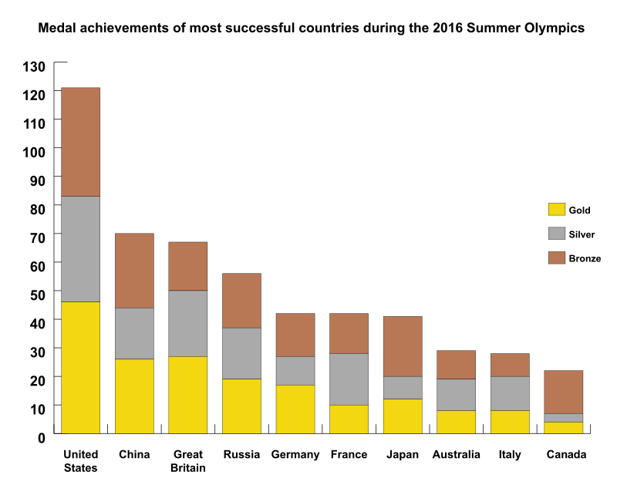

Slide 32
GOSPEL WORTHY LIVING

