Slide 1
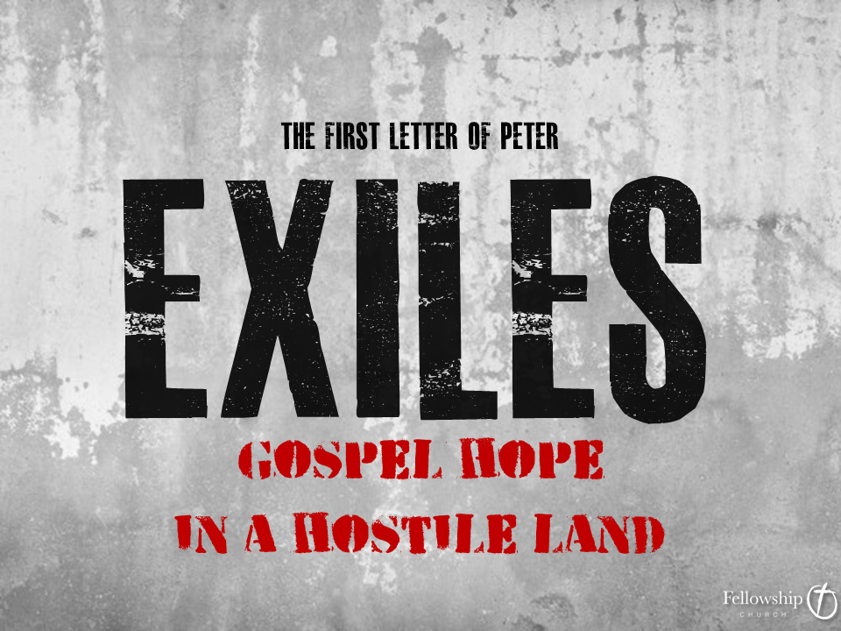

Slide 2
Introduction to 1st Peter
Author – The Apostle Peter

Slide 3
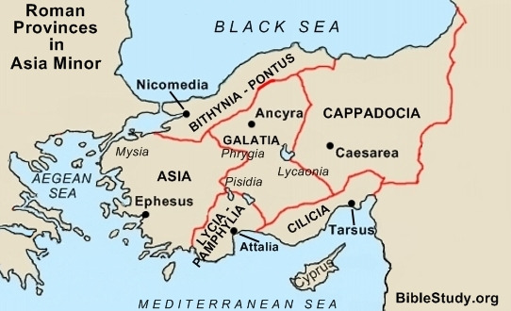

Slide 4
Introduction to 1st Peter
Author – The Apostle Peter
Audience – Primarily Greek Gentile believers.

Slide 5
Introduction to 1st Peter
Author – The Apostle Peter
Audience – Primarily Greek Gentile believers.
Setting & Date – From Rome, early 60’s prior to AD64.

Slide 6
Peter, an apostle of Jesus Christ, To those who are elect exiles of the Dispersion in Pontus, Galatia, Cappadocia, Asia, and Bithynia, 2 according to the foreknowledge of God the Father, in the sanctification of the Spirit, for obedience to Jesus Christ and for sprinkling with his blood: May grace and peace be multiplied to you.
1st Peter 1:1-2

Slide 7
Exiles: People who are living temporarily in a place that is not their true home.

Slide 8
Exiles: People who are living temporarily in a place that is not their true home.
Elect Exiles:

Slide 9
Exiles: People who are living temporarily in a place that is not their true home.
Elect Exiles: Chosen exiles.

Slide 10
Three Trinitarian Descriptions of the Chosen Exiles
To those who are elect exiles…
According to the foreknowledge of God the Father.

Slide 11
Divine Sovereignty and Free Will
Divine Sovereignty – The biblical doctrine that God is in complete control over time, space, history, and the future.

Slide 12
Divine Sovereignty and Free Will
Divine Sovereignty – The biblical doctrine that God is in complete control over time, space, history, and the future.
Free Will – (limited) – The concept that humans are designed by God with the capacity for freely making choices for which they are responsible.

Slide 13
Three Trinitarian Descriptions of the Chosen Exiles
To those who are elect exiles…
In the sanctification of the Spirit.

Slide 14
Three Trinitarian Descriptions of the Chosen Exiles
To those who are elect exiles…
For obedience to Jesus Christ and for sprinkling with his blood.

Slide 15
Peter’s Trinitarian Theology
God the Father as having sovereignly planned salvation.
God the Son, Jesus Christ as the one who accomplished God’s plan through his life, death, and resurrection.
God the Spirit as the one who applies the work of Christ to all believers.

Slide 16
Three Trinitarian Descriptions of the Chosen Exiles
To those who are elect exiles…
For obedience to Jesus Christ and for sprinkling with his blood.

Slide 17
Peter Pronounces Multiplied Blessings
May grace and peace be multiplied to the chosen exiles!

